Slide 1

Shapes and Colors
By Luz Aguilar

Slide 2
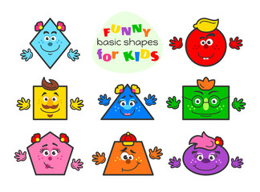

Slide 3


Slide 4





Slide 5





Slide 6
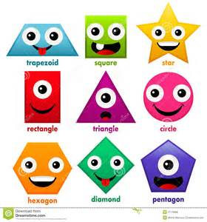

Slide 7
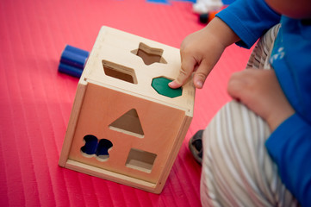
Let’s Play

Slide 8
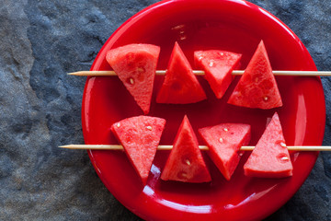
How many shapes can you see?
What color is the fruit and plate?

Slide 9
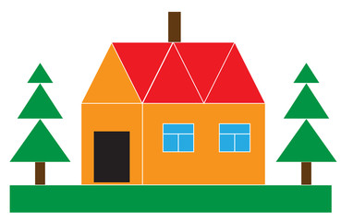
How many shapes can you see?
How many colors can you see?

Slide 10

Colors are Fun

Slide 11

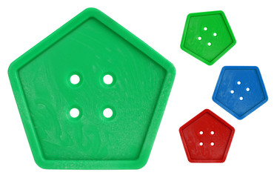
What shape can you see?
How many colors can you see?

Slide 12

What shape can you see?
What colors can you see?

Slide 13

How many shapes can you see?
How many colors can you see?

Slide 14


Lets review one more time

Slide 15

See you next time.

