Slide 1
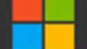
Microsoft Corporation
Microsoft

Slide 2
Agenda
Microsoft History
Products
Competitors
SWOT
Revenue
Potential Growth
Summary

Slide 3
History
1975
Albuquerque, New Mexico
Altari 8800
Microsoft Incorporates

Slide 4
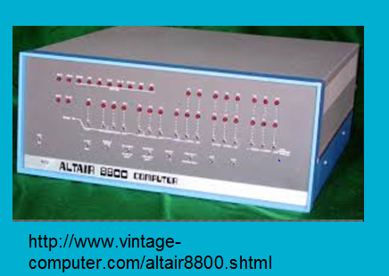

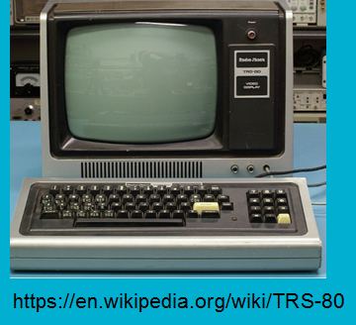
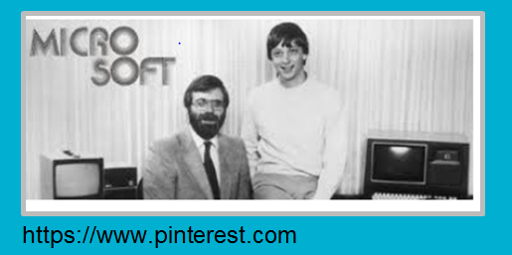
History
April 4, 1975
August 3, 1977
March 13, 1986
January 1, 1979
Microsoft Founded
TRS-80
Microsoft Goes Public
1975 |  |  |  | 2015
June 25, 1998
Microsoft moves to Albuquerque, NM
Microsoft Launches Windows 98

Slide 5

Founder
William (Bill) H. Gates
Born: October 28, 1955
Attended Lakeside School where he discovered his interest in software and started programing computers at the age 13.
In 1973, he attended Harvard and developed a version of programing language BASIC for the first PC.
June 27, 2008, he transitioned out of a day-to-day role in the company to spend more time on his global health and education work at the Bill & Melinda Gates Foundation.

Slide 6

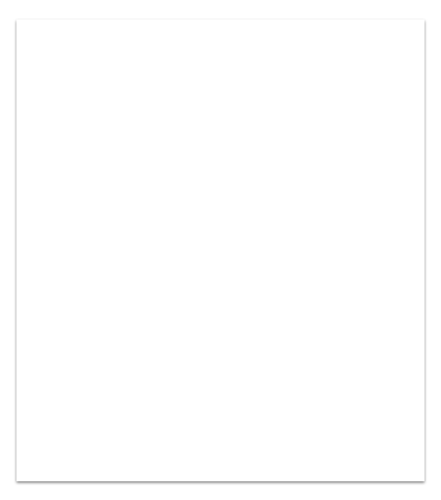
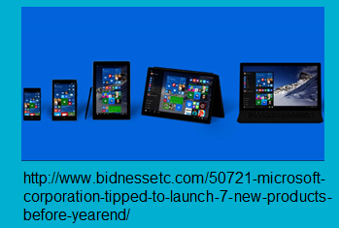
New Products
Lumia 950
Lumia 950 XL
Surface Pro 5
Microsoft Band
Tip
In this example, we’re leading off ide.

Slide 7
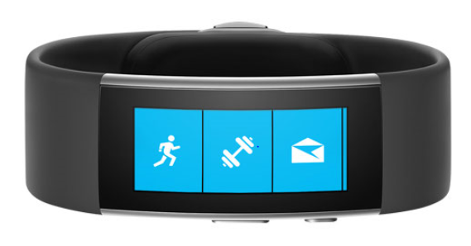
Microsoft Band
Activity Tracker
Heart Rate, Calorie Counter, Sleep
Compatable with Android and Iphones
Bluetooth, text, calendar, call alerts
https://www.microsoft.com/microsoft-band/en-us/features

Slide 8
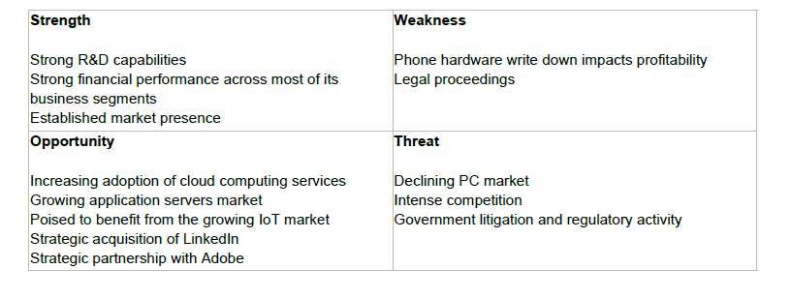
Competitors (what they are doing?)
Apple Inc.
Google Inc.
Samsung Electronics Co., Ltd.
Gaming Systems
Nintendo and Sony
Tip
Sofware Products, operatiing systems recives pressure from compeititon (Forturne 100)
Software Consumer Needs and Habiits for Devices
Xbox gaming and entertainment business competes with console platforms
Notes:
Intense competition
Microsoft faces intense competition across all markets for its products and services. The company's
competitors range in size from Fortune 100 companies to small, specialized single-product businesses
and open source community-based projects. Further, the internet as a distribution channel and noncommercial
software model has further reduced barriers to entry.
The company's business that develops and markets operating systems for computing devices, related
software and online services faces competition from various commercial software products and from
alternative platforms and devices, mainly from Apple and Google. The company's Office product
competes with software application vendors such as Apple and Google and numerous web-based and
mobile application competitors as well as local application developers in Asia and Europe. Windows
Phone operating system faces competition from iOS, Android, and Blackberry operating systems. The
company's Xbox gaming and entertainment business competes with console platforms from Nintendo and
Sony. Microsoft phones face intense competition from Samsung and Apple. In addition, the company's
resale products face competition from various online marketplaces, including those operated by Amazon,
Apple, and Google. Microsoft's information and content solutions competes with Google and a wide array
of websites, social platforms such as Facebook, and portals such as Yahoo! that provide content and
online offerings to end users. Further, the company also faces competition from game studios, including
Electronic Arts and Activision Blizzard.
The company's business that develops and markets server software, software developer tools, cloudbased
services, and solutions competes with vertically integrated computer manufacturers such as HP,
IBM and Oracle. It also competes with commercial and non-commercial software developers such as Red
Hat. Commercial competitors for its server applications for PC-based distributed client/server
environments include CA Technologies, IBM and Oracle. Its system management solutions compete with

Slide 9
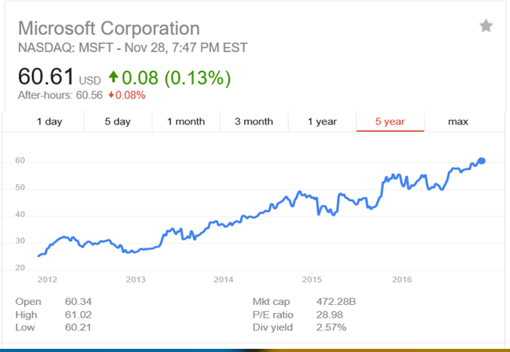
Historical Revenue

Slide 10
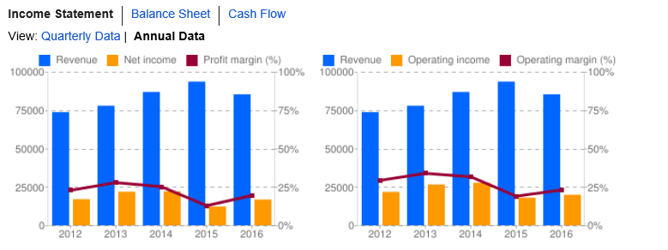
Four Year Revenue Table
12 months ending June
2016 | 2015 | 2014 | 2013
$85,320 | $95,580 | $86,833 | $77.849
In Millions of USD

Slide 11
Four Year Net Income Table
12 months ending June
2016 | 2015 | 2014 | 2013
$16,798 | $12,193 | $22,074 | $21,863
In Millions of USD

Slide 12
Five Year Price Earning Ratio
Year | Stock Trading Price | EPS at Year End | P/E Ratio
6-30-2016 | $50.72 | $2.25 | 22.5
6-30-2015 | $44.71 | $2.29 | 19.5
6-30-2014 | $42.17 | $2.65 | 16.1
6-28-2013 | $34.38 | $2.60 | 13.2

Slide 13
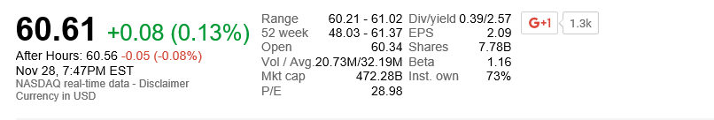
Stock Beta
Beta: 1.16

Slide 14
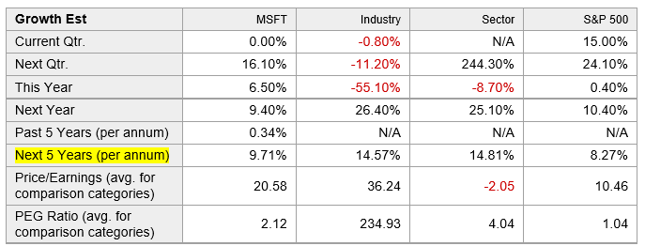
Potential Growth in EPS

Slide 15
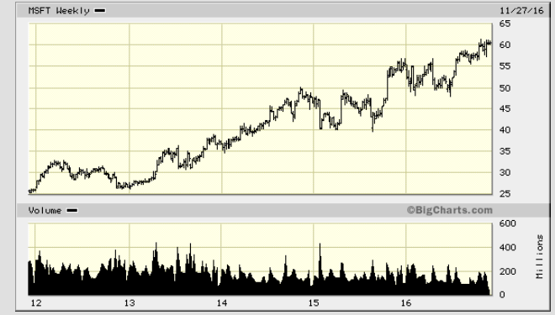
Five Year Stock Chart

Slide 16
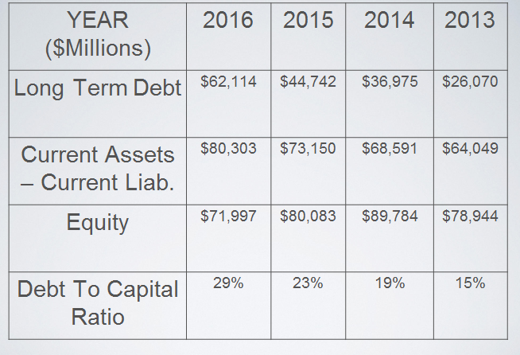
Solvency or Debt Ratio

Slide 17
Dividend Yield
Microsoft pays 2.57% Dividend Return Yearly

Slide 18
Summary
Final comments - would you buy this stock today based on what your analysis shows you.
  Yes
  No
  Why

Slide 19
Questions

Slide 20
References
Microsoft Corporation SWOT Analysis. (2016). Microsoft Corporation SWOT Analysis, 1-11.
https://finance.yahoo.com/q/ae?s=MSFT+Analyst+Estimates
https://www.google.com/finance?q=NASDAQ:MSFT
http://news.microsoft.com
http://bigcharts.marketwatch.com/quickchart/quickchart.asp?symb=MSFT&insttype=&freq=2&show=&time=12

