Slide 1
Healthful Living
HEED 103
Dr. M. L. Holt
Application 3
Morgan State University

Slide 2
Trans-Theoretical Model and Stages of Change

Slide 3
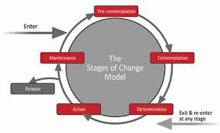

Slide 4
TTM Constructs
Construct | Description
Precontemplation | No intention to take action within the next 6 months
Contemplation | Intends to take action within the next 1 to 6 months
Preparation | Intends to take action within the next 30 days and has taken some behavioral steps in this decision
Action | Changed overt behavior for less than 6 months
Maintenance | Changed overt behavior for more than 6 months
Termination | No temptation to replace and 100% confidence

Slide 5
Application Instructions
Identify the stage of change the person is in
Name some processes that can be put into place to advance them to the next stage

Slide 6
Scenario #1
You have been smoking for 16 years and now you are ready to stop due to health concerns. You purchase nicotine patches and join a 12 step program.

Slide 7
Scenario #2
You want to be a doctor that specializes in foot odor. Looking at the course catalog you need to register for a class in "Different Smells" before graduation. First you have to take the required courses.

Slide 8
Scenario #3
Your high school reunion is coming up and you want to drop those 10 pounds you seemed to have gained. You join a gym 3 months ago and you have lost 7 pounds! 3 more to go.

Slide 9
Scenario #4
During a routine visit to the doctor you would told your blood pressure is a bit elevated, borderline hypertension. It would be in your best interest to try to reduce stress and get plenty of sleep over the next 6 months and check back.

Slide 10
QUESTIONS???????

