Slide 1
Agenda
Miscellaneous Business
Week Learning Outline
DQ & Lab Recap
Physical Layer
Data Link Layer
Next Week
Team Time

Slide 2
Miscellaneous Business…
Questions from last weeks lecture??
Questions from this weeks reading??
Did we all get the Application layer info integrated okay??
Lab’s going okay?

Slide 3
7-Layer Model of OSI
Application Layer
  set of utilities used by application programs
Presentation Layer
  formats data for presentation to the user
  provides data interfaces, data compression and translation between different data formats
Session Layer
  initiates, maintains and terminates each logical session between sender and receiver
Transport Layer
  deals with end-to-end issues such as segmenting the message for network transport, and maintaining the logical connections between sender and receiver
Network Layer
  responsible for making routing decisions
Data Link Layer
  deals with message delineation, error control and network medium access control
Physical Layer
  defines how individual bits are formatted to be transmitted through the network

Slide 4
Types of Data Transmitted
Analog data
  Produced by telephones
  Sound waves, which vary continuously over time, analogous to one’s voice
  Can take on any value in a wide range of possibilities
Digital data
  Produced by computers, in binary form
  information is represented as code in a series of ones and zeros
  All digital data is either on or off, 0 or 1

Slide 5
Types of Transmission
Analog transmissions
  Analog data transmitted in analog form
  Examples of analog data being sent using analog transmissions are broadcast TV and radio
Digital transmissions
  Made of discrete square waves with a clear beginning and ending
  Computer networks send digital data using digital transmissions
Data converted between analog and digital formats
  Modem (modulator/demodulator): used when digital data is sent as an analog transmission
  Codec (coder/decoder): used when analog data is sent via digital transmission

Slide 6
Data Type vs. Transmission Type
 | Analog Transmission | Digital Transmission
Analog Data | AM and FM Radio, Broadcast TV | Pulse code modulation, MP3, CDs, iPOD, cellphones, VoIP
Digital Data | Dial up modem sending email from your house | Codes such as ASCII or EBCDIC run over Ethernet LANs

Slide 7
Digital Transmission: Advantages
Produces fewer errors
  Easier to detect and correct errors, since transmitted data is binary (1s and 0s, only two distinct values)
  A weak square wave can easily be propagated again in perfect form, allowing more crisp transmission than analog
Permits higher maximum transmission rates
  e.g., Optical fiber designed for digital transmission
More efficient
  Possible to send more digital data through a given circuit, circuit can be “packed”
More secure
  Easier to encrypt digital bit stream
Simpler to integrate voice, video and data
  Easier mix and match V, V, D on the same circuit, since all signals made up of 0’s and 1’s

Slide 8
Circuit Configuration
Circuit Configuration
  Point-to-Point circuits include most wired connections today
  Multipoint circuits are most commonly used in wireless today
Shared circuits (multipoint) are less expensive

Slide 9
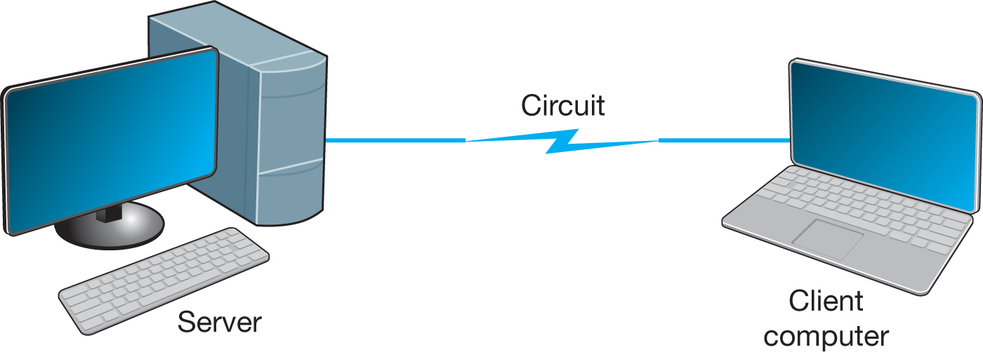
Point-to-Point Configuration
Used when computers generate enough data to fill the capacity of the circuit
Each computer has its own circuit to reach the other computer in the network (expensive)

Slide 10
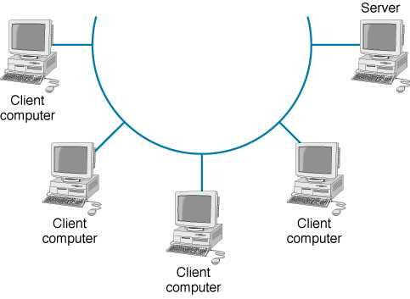
Multipoint Configuration
Used when each computer does not need to continuously use the entire capacity of the circuit
+ Cheaper (not as many wires) and simpler to wire
- Only one computer can use the circuit at a time

Slide 12
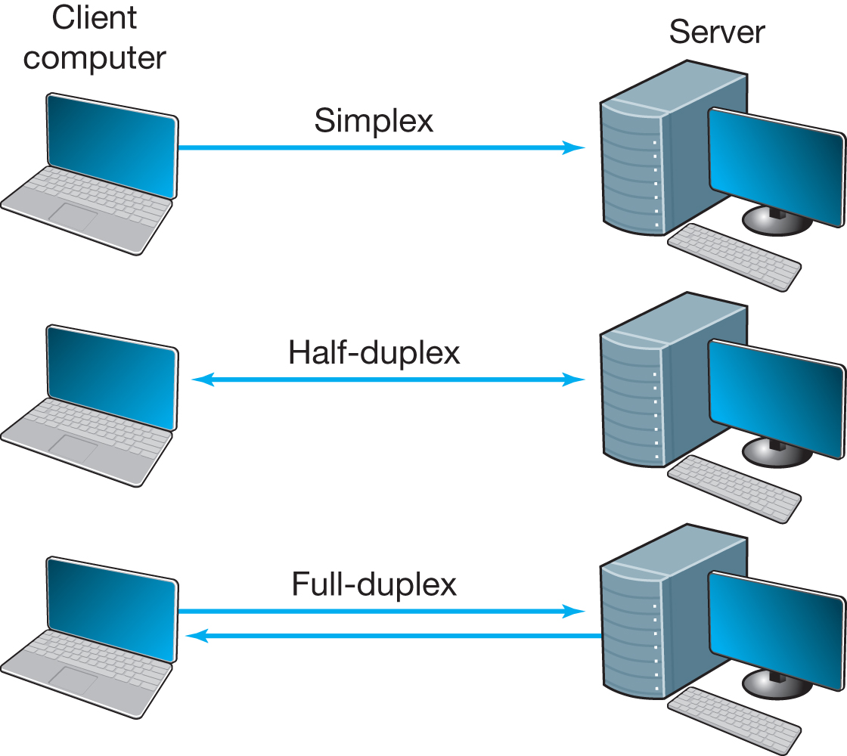
Data Flow (Transmission)
data flows in one direction only, (radio or cable television broadcasts)
data flows both ways, but only one direction at a time (e.g., CB radio, it requires control info)
data flows in both directions at the same time

Slide 13
Selection of Data Flow Method
Main factor: Application
  If data required to flow in one direction only
    Simplex Method
      e.g., From a remote sensor to a host computer
  If data required to flow in both directions
    Terminal-to-host communication (send and wait type communications)
      Half-Duplex Method
    Client-server; host-to-host communication (peer-to-peer communications)
      Full Duplex Method
    Half-duplex or Full Duplex
Capacity may be a factor too
  Full-duplex uses half of the capacity for each direction

Slide 14
Multiplexing
Breaking up a higher speed circuit into several slower (logical) circuits
  Several devices can use it at the same time
  Requires two multiplexer: one to combine; one to separate
Main advantage: cost
  Fewer network circuits needed
Categories of multiplexing:
  Frequency division multiplexing (FDM)
  Time division multiplexing (TDM)
  Statistical time division multiplexing (STDM)
  Wavelength division multiplexing (WDM)

Slide 15
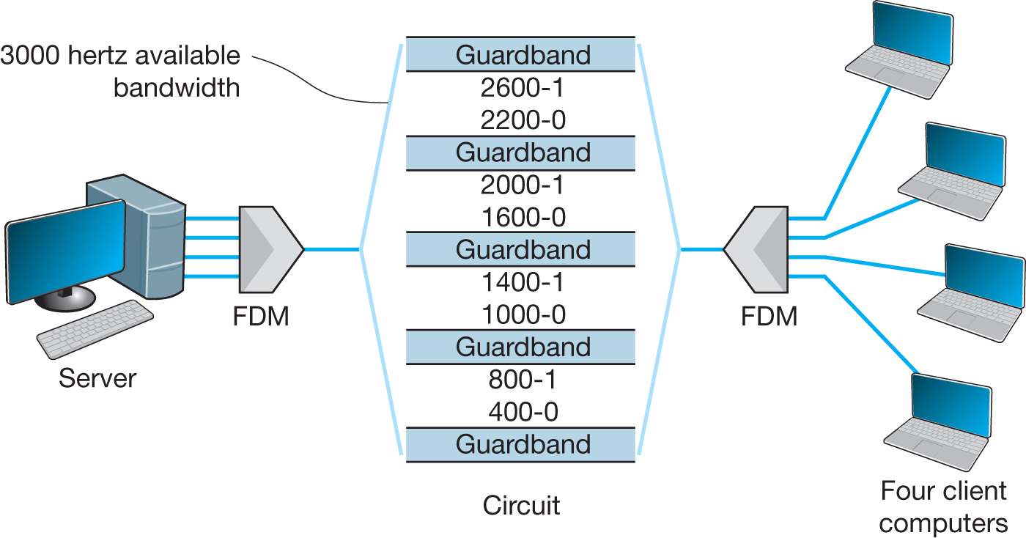
Frequency Division Multiplexing
Makes a number of smaller channels from a larger frequency band by dividing the circuit “horizontally”
Guardbands needed to separate channels
  To prevent interference between channels
  Unused frequency bands are wasted capacity

Slide 16
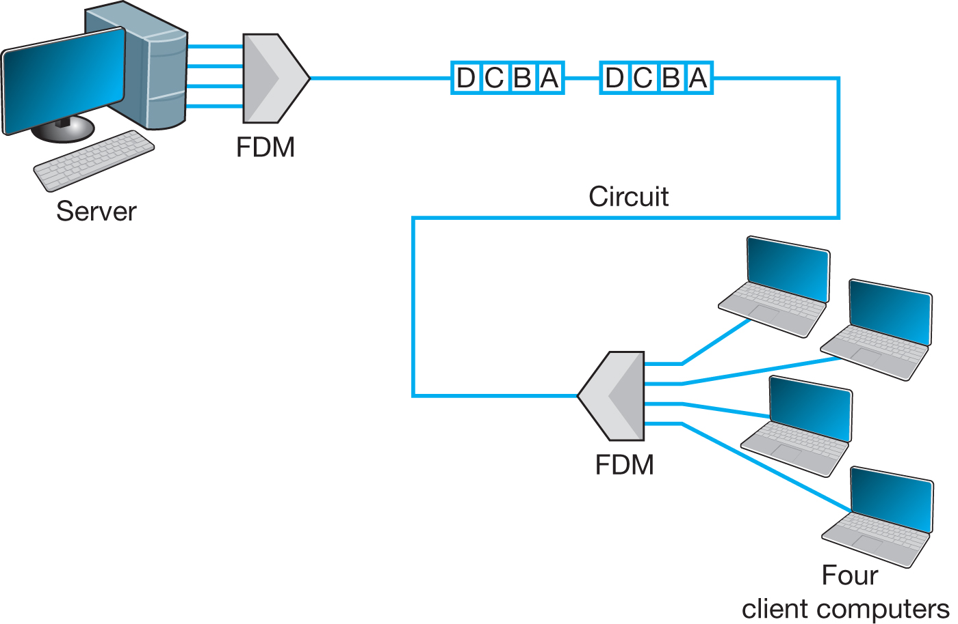
Time Division Multiplexing
Dividing the circuit “vertically”
TDM allows multiple channels to be used by allowing the channels to send data by taking turns
This example shows 4 terminals sharing a circuit, with each terminal sending one character at a time

Slide 17
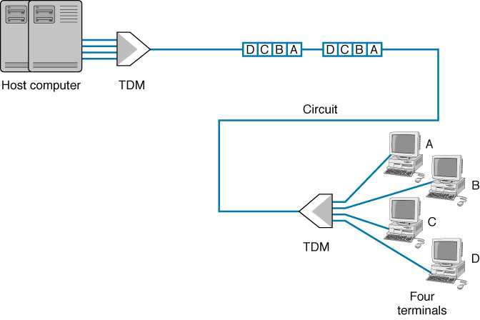
Comparison of TDM / FDM
Time on the circuit shared equally
Each channel getting a specified timeslot whether needed or not
More efficient than FDM
Since TDM doesn’t use guardbands, entire capacity can be divided up between channels

Slide 18
Communications Media
Physical material that carries transmission
Guided media:
    Transmission flows along a physical guide (Media guides the signal across the network)
    Examples include twisted pair wiring, coaxial cable and fiber optic cable
Wireless media (radiated media)
    No wave guide, the transmission flows through the air or space
    Examples include radio such as microwave and satellite, as well as infrared communications

Slide 19
Twisted Pair (TP) Wires
Twisted-pair (TP) cable
  Insulated pairs of wires bundled together
  Wires twisted to reduce electromagnetic interference
  Some times use additional shielding (STP)
  Commonly used for telephones, LANs
  Characteristics
    Price – inexpensive
    Distance – typically up to 100m
    Use - Telephones, LANs

Slide 20
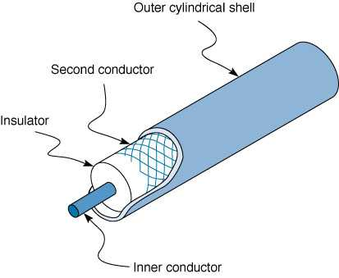
Coaxial Cable
(protective jacket )
Wire mesh ground
Less prone to interference than TP due to shield
More expensive than TP, thus quickly disappearing
used mostly for cable TV

Slide 21
Fiber Optic Cable
Light created by an LED (light-emitting diode) or laser is sent down a thin glass or plastic fiber
Has extremely high capacity, ideal for broadband
Works well under harsh environments
  Not fragile, nor brittle; Not heavy nor bulky
  More resistant to corrosion, fire, water
  Highly secure, know when is tapped
Fiber optic cable structure (from center):
  Core (v. small, 5-50 microns, ~ the size of a single hair)
  Cladding, which reflects the signal
  Protective outer jacket

Slide 22
Types of Optical Fiber
Multimode (about 50 micron core)
  Earliest fiber-optic systems
  Signal spreads out over short distances (up to ~500m)
  Inexpensive
Graded index multimode
  Reduces the spreading problem by changing the refractive properties of the fiber to refocus the signal
  Can be used over distances of up to about 1000 meters
Single mode (about 5 micron core)
  Transmits a single direct beam through the cable
  Signal can be sent over many miles without spreading
  Expensive (requires lasers; difficult to manufacture)

Slide 23
Wireless Media
Radio
  Wireless transmission of electrical waves through air
  Each device has a radio transceiver with a specific frequency
    Low power transmitters (few miles range)
    Often attached to portables (Laptops, PDAs, cell phones)
  Includes
    AM and FM radios, Cellular phones
    Wireless LANs (IEEE 802.11) and Bluetooth
    Microwaves and Satellites, Low Earth Orbiting Satellites
Infrared
  “invisible” light waves with frequency below red light spectrum
  Requires line of sight; generally subject to interference from heavy rain, smog, and fog
  Used in remote control units such as for controlling the TV

Slide 24
Microwave Radio
High frequency form of radio communications
  Extremely short (micro) wavelength (1 cm to 1 m)
  Requires line-of-sight
Performs same functions as cables
  Often used for long distance, terrestrial transmissions (over 50 miles without repeaters)
  No wiring and digging required
  Requires large antennas (about 10 ft) and high towers
Possesses similar properties as light
  Reflection, Refraction, and focusing
  Can be focused into narrow powerful beams for long distance
  Some effect from water, rain and snow

Slide 25
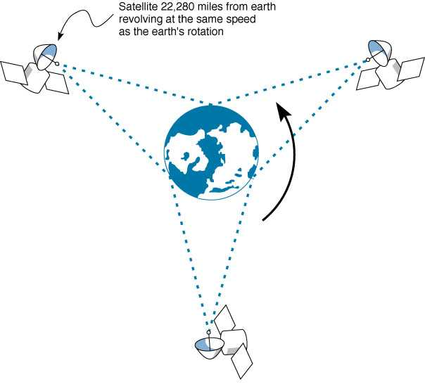
Satellite Communications
Special form of microwave communications
Signals travel at speed of light, yet long propagation delay
due to great distance between ground station and satellite

Slide 26
Factors Used in Media Selection
Type of network
  LAN, WAN, or Backbone
Cost
  Always changing; depends on the distance
Transmission distance
  Short: up to 300 m; medium: up to 500 m
Security
  Wireless media is less secure
Error rates
  Wireless media has the highest error rate (interference)
Transmission speeds
  Constantly improving; Fiber has the highest

Slide 27
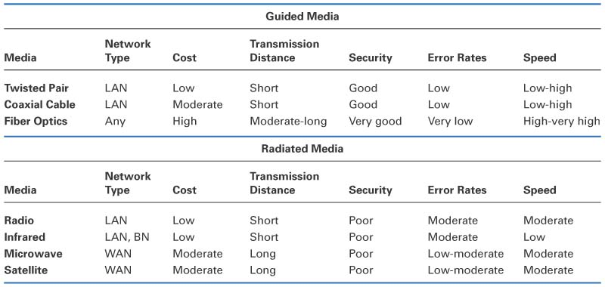
Media Summary

Slide 28
7-Layer Model of OSI
Application Layer
  set of utilities used by application programs
Presentation Layer
  formats data for presentation to the user
  provides data interfaces, data compression and translation between different data formats
Session Layer
  initiates, maintains and terminates each logical session between sender and receiver
Transport Layer
  deals with end-to-end issues such as segmenting the message for network transport, and maintaining the logical connections between sender and receiver
Network Layer
  responsible for making routing decisions
Data Link Layer
  deals with message delineation, error control and network medium access control
Physical Layer
  defines how individual bits are formatted to be transmitted through the network

Slide 29
Data Link Layer - Introduction
Network Layer
Data Link Layer
Responsible for moving messages from
one device to another
Controls the way messages are sent
on media
Organizes physical layer bit streams into
coherent messages for the network layer
Major functions of a data link layer protocol
  Media Access Control
    Controlling when computers transmit
  Error Control
    Detecting and correcting transmission errors
  Message Delineation
    Identifying the beginning and end of a message
Physical Layer

Slide 30
Media Access Control (MAC)
Controlling when and what computer transmit
  Important when more than one computer wants to send data at the same time over the same, shared circuit
    Point-to-point half duplex links
      computers take turns
    Multipoint configurations
      Ensure that no two computers attempt to transmit data at the same time
Two possible approaches
  Controlled access
  Contention based access

Slide 31
Controlled Access
Controlling access to shared resources
  Acts like a stop light
Commonly used by mainframes (or its front end processor)
  Determines which circuits have access to mainframe at a given time
Also used by some LAN protocols
  Token ring, FDDI
Major controlled access methods
  X-ON/X-OFF and Polling

Slide 32
Contention
Transmit whenever the circuit is free
Collisions
  Occurs when more than one computer transmitting at the same time
  Need to determine which computer is allowed to transmit first after the collision
Used commonly in Ethernet LANs
Problematic in heavy usage networks

Slide 33
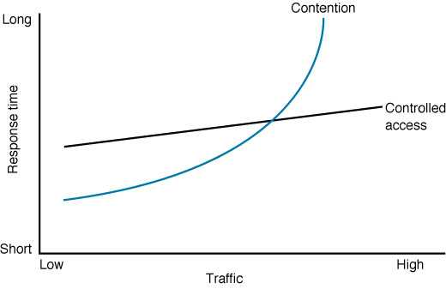
Relative Performance
Depends on network conditions
When volume is high, performance deteriorates (too many collisions)
Work better for networks with high traffic volumes
Cross-over point: About 20 computers
Network more efficiently used
Work better for smaller networks with low usage

Slide 34
Error Control
Handling of network errors caused by problems in transmission
  Network errors
    Can be a changing a bit value during transmission
    Controlled by network hardware and software
  Human errors:
    Can be a mistake in typing a number
    Controlled by application programs
Categories of Network Errors
  Corrupted (data is changed from what it is)
  Lost data (cannot find the data at all)

Slide 35
Sources of Errors and Prevention
Source of Error
What causes it
How to prevent it
Line Outages
Faulty equipment, Storms, Accidents (circuit fails)
White Noise
Movement of electrons (thermal energy)
Increase signal strength (increase SNR)
Impulse Noise
Sudden increases in electricity
(e.g., lightning, power surges)
Shield or move the wires
More important
Cross-talk
Multiplexer guard bands are too small or wires too close together
Increase the guard bands, or
move or shield the wires
Echo
Poor connections (causing signal to be reflected back to the source)
Fix the connections, or
tune equipment
Attenuation
Gradual decrease in signal over distance (weakening of a signal)
Use repeaters or amplifiers
Intermodulation Noise
Signals from several circuits combine
Move or shield the wires
Jitter
Analog signals change (small changes in amp., freq., and phase)
Tune equipment
mostly on analog
Harmonic Distortion
Amplifier changes phase (does not correctly amplify its input signal)
Tune equipment

Slide 36
Error Detection Techniques
Parity checks
Checksum
Cyclic Redundancy Check (CRC)

Slide 37
Parity Checking
One of the oldest and simplest
A single bit added to each character
  Even parity: number of 1’s remains even
  Odd parity: number of 1’s remains odd
Receiving end recalculates parity bit
  If one bit has been transmitted in error the received parity bit will differ from the recalculated one
Simple, but doesn’t catch all errors
  If two (or an even number of) bits have been transmitted in error at the same time, the parity check appears to be correct
  Detects about 50% of errors

Slide 38
Examples of Using Parity
To be sent: Letter V in 7-bit ASCII: 0110101
EVEN parity
sender
receiver
01101010
number of all transmitted 1’s remains EVEN
parity
sender
receiver
ODD parity
01101011
number of all transmitted 1’s remains ODD
parity

Slide 39
Cyclic Redundancy Check (CRC)
Example:
P = 58
G = 8
Q = 7
R = 2
P / G = Q + R / G
Message (treated as one long binary number)
Quotient (whole number)
Remainder:
  added to the message as EDV
  could be 8 bits, 16 bits, 24 bits, or 32 bits long
  CRC16 has R of 16 bits
A fixed number (determines the length of the R)
Most powerful and most common
Detects 100% of errors (if number of errors <= size of R)
  Otherwise: CRC-16 (99.998%) and CRC-32 (99.9999%)

Slide 40
Error Correction
Once detected, the error must be corrected
Error correction techniques
  Retransmission (or, backward error correction)
    Simplest, most effective, least expensive, most commonly used
    Corrected by retransmission of the data
      Receiver, when detecting an error, asks the sender to retransmit the message
    Often called Automatic Repeat Request (ARQ)
  Forward Error Correction
    Receiving device can correct incoming messages itself

Slide 41
Automatic Repeat Request (ARQ)
Process of requesting that a data transmission be resent
Main ARQ protocols
  Stop and Wait ARQ (A half duplex technique)
    Sender sends a message and waits for acknowledgment, then sends the next message
    Receiver receives the message and sends an acknowledgement, then waits for the next message
  Continuous ARQ (A full duplex technique)
    Sender continues sending packets without waiting for the receiver to acknowledge
    Receiver continues receiving messages without acknowledging them right away

Slide 42
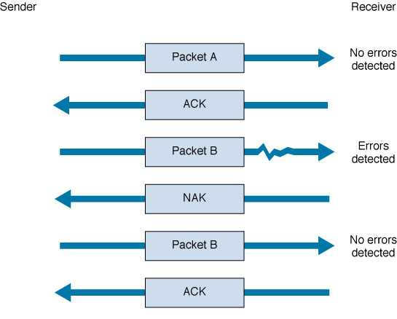
Stop and Wait ARQ
Sender
Receiver
Sends the packet, then waits to hear from receiver.
Sends
acknowledgement
Sends the next packet
Sends negative acknowledgement
Resends the packet
again
Sends
acknowledgement

Slide 43
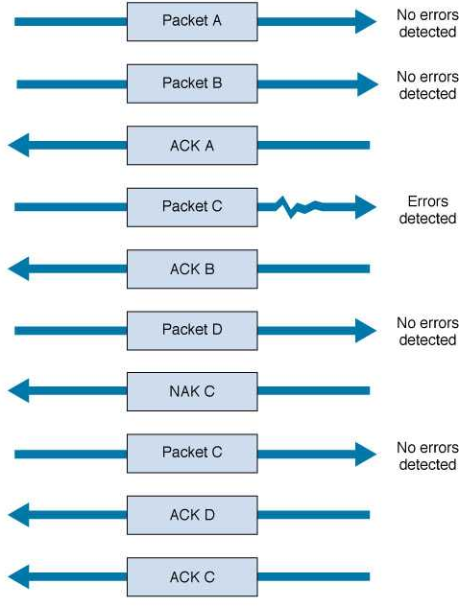
Continuous ARQ
Sender sends packets continuously without waiting for receiver to acknowledge
Notice that acknowledgments now identify the packet being acknowledged.
Receiver sends back a NAK for a specific packet to be resent.

Slide 44
Flow Control with ARQ
Ensuring that sender is not transmitting too quickly for the receiver
  Stop-and-wait ARQ
    Receiver sends an ACK or NAK when it is ready to receive more packets
  Continuous ARQ:
    Both sides agree on the size of the “sliding window”
      Number of messages that can be handled by the receiver without causing significant delays

Slide 45
Flow Control Example
window size =4
sender
receiver
0 1 2 3 4 5 6 7 8 9
...3 2 1 0
ACK 0...
(slide window)
...4
0 1 2 3 4 5 6 7 8 9
ACK 4...
(slide window)
…8 7 6 5
0 1 2 3 4 5 6 7 8 9
ACK 7..
set window size to 2
(slide window)
..9
0 1 2 3 4 5 6 7 8 9
(timeout)
...9 8
0 1 2 3 4 5 6 7 8 9

Slide 46
Data Link Protocols
Classification
  Asynchronous transmission
  Synchronous transmission
Differ by
  Message delineation
  Frame length
  Frame field structure
frame k-1
frame k
frame k+1

Slide 47
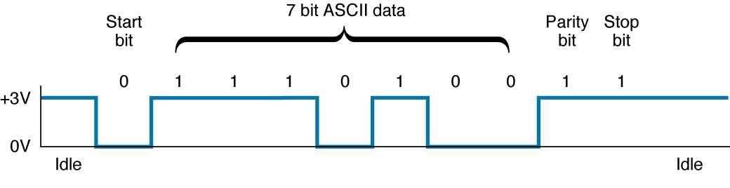
Asynchronous Transmission
Start bit used by the receiver for separating characters and for synch.
Each character is sent independently
Stop bits sent between transmissions (a series of stop bits)

