Slide 1
Adopting Electronic Health Records (EHRs)
Institution Affiliation
Date

Slide 2
Introduction
Electronic Health Record (HER) refers to storing health record of a patient in an electronic device.
All medical and personal information of a patient should be stored.
The information should be maintained by the health provider over time.
The information can be accessed by all authorized practitioners.
It can also be accessed by the patients in case of referrals to another facility.
The system is efficient, effective, and cost saving.
Notes:
The current system of health information documentation in our organization needs to be changed with a lot of urgencies. This is because of the inconveniences caused by the current system which has resulted in huge losses for the part of the company. The impact has also hit on our patients which mean affecting their health situation negatively. The current system which involves manually recording patients information on papers and submitting the same to the next health care attendant has had many challenges. This has necessitated the importance of adopting Electronic Health records whereby, patients information will be transmitted electronically from one unit of the hospital to another. The system will basically be used for storing health record of a patient in an electronic device. The information should be maintained by the health provider over time. The information can be accessed by all authorized practitioners when attending to the patient. It can also be accessed by the patients in case of referrals to another facility. This system is bound to bring the great contribution to the company’s vision been the first in coming up with health care innovations that will enable our patients to enjoy a great healthier life.

Slide 3
Why Adopt EHR
Adopting EHR will be a great step ahead for our hospital.
It will help in strengthening the bond between our customers (patients) and the organization at large.
Doctors and nurses will also be able to make better decisions when attending to the patients.
The system is cost effective.
It is also save much time thus reducing the number of complaints.
Most importantly, patients health records won’t be lost.
Notes:
There are various reasons which give us the privilege of adopting Electronic Health Records. In line with our vision of developing innovations in our organization that will bring positive changes in how we carry out services, the system will be a great change in keeping health records of our patients. This means it’s a great step for our organization. First, the current system has encountered such challenges as loss of patients information arising from misplacements of documents, defaced documents, among others. There has also been unnecessary delays in the transition of health information from one department to the other and also high costs associated with the filling of the information. This means that in order to avoid such losses and cut on costs, the current system needs to change immediately. Adopting EHR will strengthen the bond between our customers (patients) and the organization at large. Doctors and nurses will also be able to make better decisions when attending to the patients as well counter all the above challenges.

Slide 4

Overall Impact of Embracing the Change
It will lead to overall organization’s performance.
Increase our competitiveness.
The change will bring more customer satisfaction.
Employees will be more satisfied when delivering services.
The change will also raise employees’ morale
High customers and employees retention.
Notes:
Changing our system from the current manual transition of information to electronic one will help boost the overall organizational performance in a great way. First is that the change will put the organization in a more competitive edge as many other organizations are switching to the same system. This means that if we don’t adopt the electronic system, we may lose many part of our market share to our competitors who have adopted the system. The change will also make our customers more satisfied as they will enjoy such benefits as lower charges, less time spent in the facility, good queue management, and most importantly proper diagnosis. The change will also enable the employees do their work in a professional way since they can easily and timely access all the information they need while delivering their services (Chronister, 2015). This will make them more satisfied in the works. It will also raise their overall morale in delivering their duties. The overall impact of the change is that the organizations will save on costs of recording information, build customer loyalty as well as reduce employee’s turnover.

Slide 5
Key Takeaways According To Wilson
Coming up with change strategy
Communicate the change plan
Implement the change
Make a follow up
Identify various changes that needs to be done on the plan
Implement the changes to various future changes
Notes:
According to Wilson (2014), there are various lessons learnt when coming up with a change and adopting a plan for the implementation. First, in order to successfully adopt a change in an organization, the management needs to come up with a plan of implementation. According to Wilson (2014), the first step the management needs to come up with a change strategy. Change strategy refers to a plan on how to adopt a change in the organization. The plan should address such concerns as changes in work schedules and scopes, importance of the change, when the change will start to be implemented, among other factors. The plan should then be communicated by the management to all the parties involved. This should be done in a timely manner and all necessary information should be communicated. The next step is to implement the change as laid down in the plan. This involves actualizing the change and is mostly done by the people on the ground mostly the employees. It also involves the help of experts who will install the system and give tutorials on how to use the system Then, the management and supervisors should make a follow up to see if the change is implemented as per the plan. This is a control measure and hence should derive other changes that need to be done on the plan especially if the results are not as planned. Finally is to implement those changes in the future changes.

Slide 6
Kotter’s Recommended Change
Create urgency
Create a coalition
Develop a vision for change
Communicate the change’s vision
Remove obstacles
Develop short term wins
Build on change
Strengthen the changes in corporate culture
Notes:
Kotter’s module involves eight steps of implementing a change. First is to create urgency of the change through by analyzing the various threats of an organization and showcasing that to employees and other stakeholders through a scenario (Kotter, 2007). Then form a powerful a strong coalition by looking for other leaders and 3employees who will help in planning and implementation of the change. Develop a vision for change by coming up with values for change and developing a strategy for the same. This should be followed by proper communication of the vision and addressing various concerns regarding the change. Remove snags by distinguishing or contracting a change group so obstructions to the change can be expelled all the more rapidly, make short-term wins by making little transient objectives and developing them and making more until a definitive objective is me. Build on the change by developing it and then strengthen it by making it an organizational culture.

Slide 7
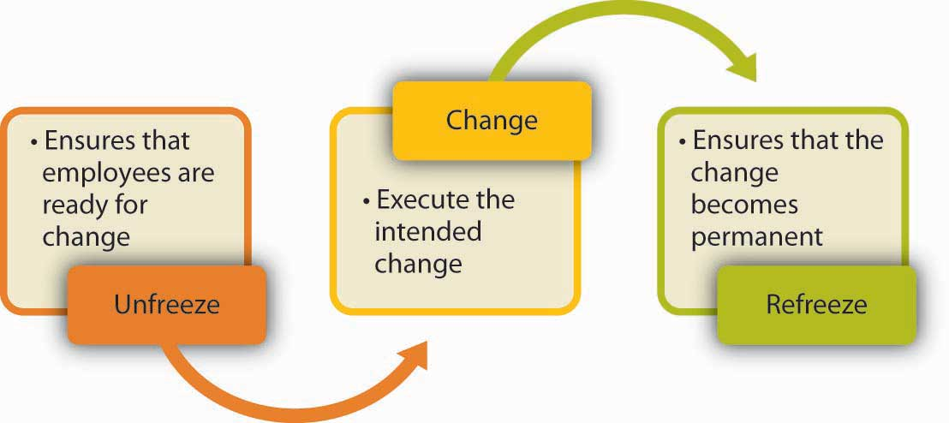
Lewin’s Recommended Change
Notes:
When analyzing Lewin’s change model, it has three distinct steps of implementing change. The first step is to unfreeze (Schein, 1996). This involves the process of understanding why the organization needs to change through a careful analysis of the organization's challenges currently met and how the change will help to fight this challenges. The step also involves all stakeholder involved to openly discuss the challenges they meet as an individual and as an organization thus providing an opportunity to discuss if the change is really important. The next stage is change. This refers to implementation of the change by a stakeholders involved. It may be an overnight thin or the change may be implemented in a process which takes time. The last stage is to refreeze which entails that the change is beginning to take shape and hence the need to make sure that the change is continually been used on all activities of an organization.

Slide 8
Mckinsey 7S Model and ADKAR Model
Mckinsey 7Smodel | ADKAR Change Model
Strategy Structure Systems Shared Style Staff Skills | Awareness Desire Knowledge Ability Reinforcement
Notes:
There other two models to be analyzed are McKinsey 7S Model and ADkar. The McKinsey model helps one understand the concept of change as well as why its necessary for implementation. The model derives a physical and emotional components attached to change. The model also holds that all components of change are important and should be addressed. However, the model has some shortcoming in that since all factors are interrelated, the failure of one factor may affect all others. The model is also complex in nature. The second model is ADKAR Model which refers to acronym for five components of change. The first step involves awareness of the change, its impacts and reasons behind, the goals of the change as well as the implementation plan. The other step involves the desire to change, then the knowledge needed in order to acquire the change followed by the analysis of the organizational ability to change. Finally, is to reinforce the change.

Slide 9
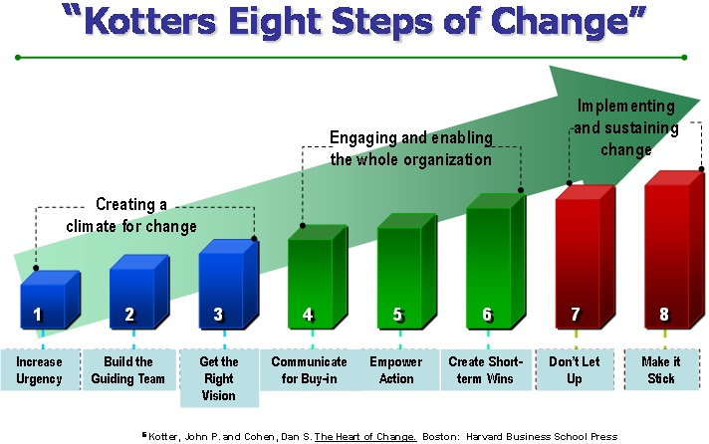
Chosen Module: Kotter’s Change Module
Notes:
I have chosen that our company will utilize Kotter's Change Module and I have as of now began with this model by conversing with our representatives and different clients and different partners about the current issues to make a direness for change. A considerable measure of our pioneers are as of now ready with the means we have to take to roll out these improvements. There has been a ton of extraordinary contribution from everybody on the things that would help our partnership and the progressions we have to make. We are really here today to convey the dreams we have thought of for our organizational good. I have concluded that we will try to expel any hindrances that may be in our way by enlisting as well as selecting representatives to what is known as a change group so they can take a shot at the things that are expected to change. I trust that we will likewise be remunerated all in all one changes are executed. Some short and long haul objectives will be set by our change group and I trust that with this being done everybody will see that these changes will be beneficial for us. With every single new contract and audits of current client we will discuss the new changes and request their contribution on these progressions, we will speak regularly about the change.

Slide 10
References
Chronister, M. (May , 6 2015). Understanding Employee Turnover Rate. Retrieved from Teambonding: https://www.teambonding.com/understanding-employee- turnover-rate/
Kotter, J. R. (2007). Leading change-Why transformation efforts fail. Harvard business review, 85(1), 96-+.
Schein, E. H. (1996). Kurt Lewin's change theory in the field and in the classroom: Notes toward a model of managed learning. Systems practice, 9(1), 27-47.
Wilson, J. (2014). Managing Change Successfully. Journal of Accountancy, 217(4), 38.

