Slide 1
THE FOG OF WAR Joshua May Columbia Southern University 07/15/2017

Slide 2
Presentation Title
I am choosing military themed art because I am a veteran myself and have a deep appreciation for the men and women who protect the many freedoms I have. There are many views and opinions of what the military represents and I hope to gain a better understanding of all aspects through the artists illustration.

Slide 3
Presentation Title
The theme of this art gallery will illustrate varying perspectives of the modern day military while paying respect and tribute to those who stood for the same values and principles as our forefathers did.

Slide 4
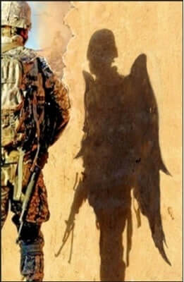
1. Angel Waiting Todd Krasovetz 2015 Oil Canvas Painting
Notes:
Military Art Original Oil on Canvas Limited Edition Print Title Angel Waiting by Todd Krasovetz
2015.

Slide 5
1. Angel Waiting
Visual Elements:
Line: The lines in this painting are varying and not straight at all but do form a silhouette and attract the viewers attention.
Shape: The shapes used in this painting are not ordinary but familiar to the military member. The shadow is represented by arches and vague points.
Light: The light is coming from the sun and the focal point is the shadow caused from a military soldier standing in its way.
Color: The colors used mesh well with each other yet contrast extreme differences with two separate backgrounds for which the artist is attracting your attention.
Texture: The texture is matte with other areas being raised by an unknown media.
Mass: The artwork is heavy where the attention from the viewer is being guided. Darker areas seem heavier.
Time: Daytime or at the end of the day.

Slide 6
1. Angel Waiting
Design Principles:
Unity: This painting unites both sides of the canvas to one thought or understanding
Variety: The diversity comes from the understanding of what the military person represents as well as what he represents to others.
Balance: The painting is asymmetrical.
Emphasis: The focal point is placed on what some people view the military as. Being an angel for those who find hope and protection in the form of military help.
Directional forces: The path first leads your eyes to the center of the painting, then left to right in order to comprehend the meaning.
Contrast: Contrasting elements are seen throughout the painting in the form of various shades and color differences.
Repetition & rhythm: no
Scale & proportion: yes

Slide 7
1. Artwork Title
The background of this painting is the perception or view that many people have for our military. Many people see war as unnecessary but others see it as a necessary evil that brings hope and justice for their way of life.

Slide 8
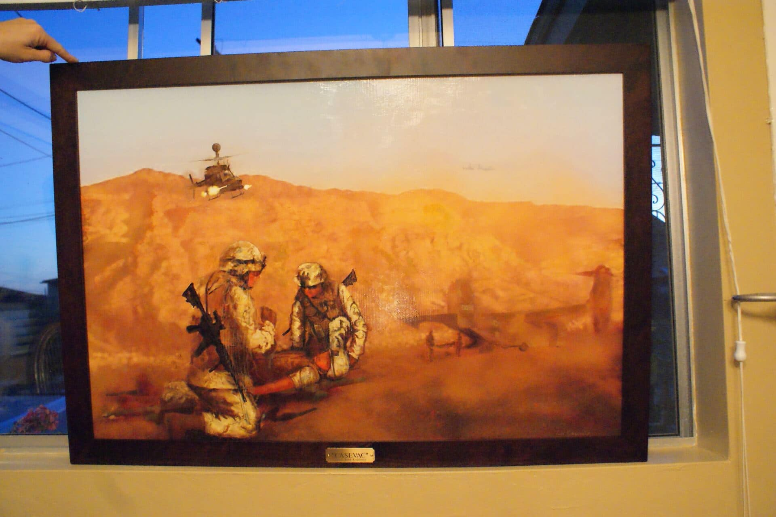
2. CASEVAC Artist’s Todd Krasovetz 2016 Oil Canvas Painting
Artwork image
CASEVAC Todd Krasovetz 2016
Notes:
Include citation

Slide 9
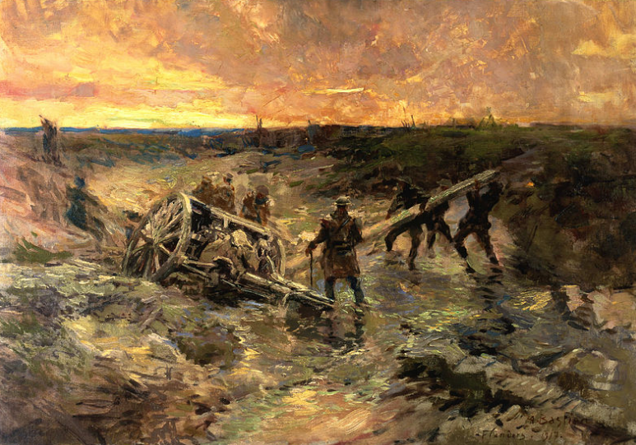
Canadian Gunners In The Mud
Shape
Rugged landscape
Round gun firing a blast
Flat horizon that indicates the setting sun
Diagonal cloud surface
Light
Light is coming from the sky
The setting sun sends rays from the horizon
The light from the sky also highlights the terrain, the gun and the soldiers
Notes:
According to Frank, (2014), shape is rugged landscape, round gun firing a blast. Flat horizon that indicates the setting sun
Diagonal cloud surface
Light is coming from the sky, and the setting sun sends rays from the horizon
The light from the sky also highlights the terrain, the gun and the soldiers

Slide 10
Canadian Gunners In The Mud
Mass
The artwork is relatively heavy in most parts
The bush thicket is heavy
The sky is light
Time
The scene indicates that its an evening
Darkness is slowly enveloping the surface
The clouds reflect a setting sun
Motion
The soldiers are standing firmly
A soldier stands while watching
Three other solders are helping the other fire the gun
Notes:
Mass indicates that the artwork is relatively heavy in most parts, the bush thicket is heavy, the sky is light
Time, the scene indicates that its an evening, darkness is slowly enveloping the surface
The clouds reflect a setting sun
Motion the soldiers are standing firmly, a soldier stands while watching, three other solders are helping the other fire the gun

Slide 11
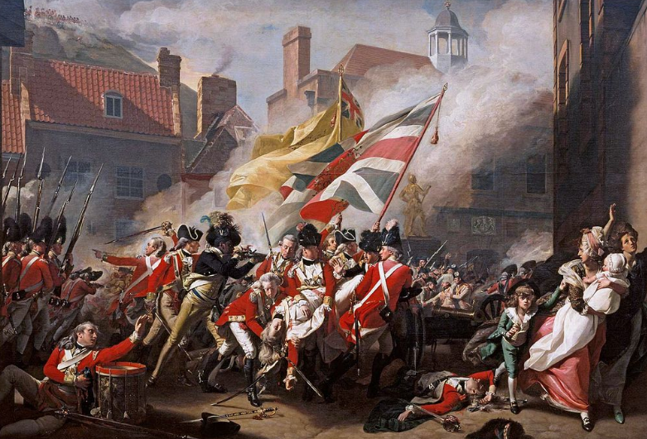
The Death of Major Peirson
Shape
Shape of building and scours of injured people
Clouds surround the area
Light
The light comes from the sky
The light focuses on the people fighting
Light focuses on the smoke from firing of bullets
Notes:
Shape include the shape of building and scours of injured people, clouds surround the area
Light sources entail the light comes from the sky, the light focuses on the people fighting, light focuses on the smoke from firing of bullets

Slide 12
The Death of Major Peirson
Mass
The art is light all through
A bit of variation in the clouds that’s relatively heavy
Time
The clouds indicate that the scene is daytime
The scene is daytime because of the clarity
The environment is crystal clear associated with daylight
Motion
People are moving away from the fighting scene
Soldiers are fighting the opponents
Scours of injured people lie on the ground
Notes:
Mass
The art is light all through
A bit of variation in the clouds that’s relatively heavy
Time
The clouds indicate that the scene is daytime
The scene is daytime because of the clarity
The environment is crystal clear associated with daylight
Motion
People are moving away from the fighting scene
Soldiers are fighting the opponents
Scours of injured people lie on the ground

Slide 13
The Death of Major Peirson
Color
Intense color variation for instance, shadows have dim colors
Clothes have very bright colors
The smoke have dim colors
Texture
The paint has a visual pattern
The paint uses a clear pattern that espoused the images in an almost real-life experience
Notes:
Color
Intense color variation for instance, shadows have dim colors
Clothes have very bright colors
The smoke have dim colors
Texture
The paint has a visual pattern
The paint uses a clear pattern that espoused the images in an almost real-life experience

Slide 14
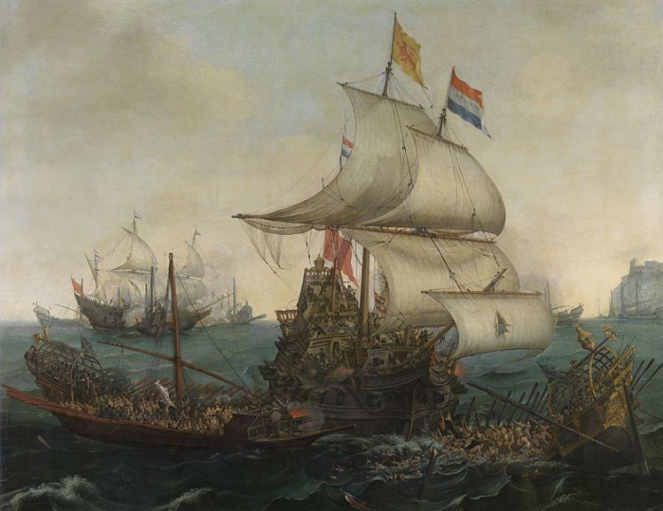
Dutch Ships Ramming Spanish Galleys
Shape
Ship is the main object in the art
Small ships are seen in the vicinity
Small water waves captured
Distant objects meaning ships are near shore
Light
The clouds are source of light
It’s a bit dark which means night is approaching
The sky is thus the main source of light in the image
Notes:
According to Sullivan, (2010), shape ship is the main object in the art, small ships are seen in the vicinity, small water waves captured, distant objects meaning ships are near shore. Light the clouds are source of light, it’s a bit dark which means night is approaching, the sky is thus the main

Slide 15
Dutch Ships Ramming Spanish Galleys
Color
Dull colors represent the waves of the waters
Bright colors associated with the sky
The ship have dull colors that’s a source
Texture
Impasto texture in the image
Actual texture is used in the image
Notes:
Color
Dull colors represent the waves of the waters
Bright colors associated with the sky
The ship have dull colors that’s a source
Texture
Impasto texture in the image
Actual texture is used in the image

Slide 16
Dutch Ships Ramming Spanish Galleys
Mass
The artwork is heavy especially the sea
The artwork is light on the sky
Time
Its evening presumably because its windy
The environment is dull and sight of the sun
Motion
The ship is leaving the shore because the mast is high
Other ships have their mast high
The wind is blowing the mast presuming motion
Notes:
According to Sullivan, (2010), mass of the artwork is heavy especially the sea, the artwork is light on the sky
Time its evening presumably because its windy, the environment is dull and sight of the sun. Motion include the ship is leaving the shore because the mast is high
Other ships have their mast high
The wind is blowing the mast presuming motion

Slide 17
References:
Frank, P. (2014). Prebles’ artforms: An introduction to the visual arts (11th ed.). Boston, MA: Pearson.
Sullivan, G. (2010). Art practice as research: Inquiry in visual arts. Thousand Oaks [Calif.: Sage Publications.

Slide 18
2. Artwork Title
Design Principles:
Unity: what elements work together to make a harmonious whole?
Variety: What creates diversity?
Balance: Is it symmetrical or asymmetrical?
Emphasis: What is the focal point?
Directional forces: What are the paths for the eye to follow?
Contrast: Where do you see contrasting elements in the artwork?
Repetition & rhythm: Is an element repeated?
Scale & proportion: Are the objects in proportion to each other?

Slide 19
2. Artwork Title
Explanation of background using facts

Slide 20
3. Title of artwork Artist’s name Year created Media
Artwork image
Citation
Notes:
Include citation

Slide 21
3. Artwork Title
Visual Elements:
Line: Describe what kind of lines are in the artwork (vertical, horizontal, diagonal, thick, thin, etc.). What do the lines do? Do they lead your eye to something?
Shape: Describe what kind of shapes are in the artwork and where they appear. Are there circular shapes in clouds, rectangular shapes in buildings?
Light: Where is the light coming from? What is it highlighting?
Color: What colors are used? Are the colors bright, tints, muted? Are they different shades of one hue?
Texture: Is there a pattern on some area in the artwork? Is there a paint texture such as impasto?
Mass: Is the artwork heavier in one area?
Time: Is there anything in the artwork that gives the sense of time? Is it a daytime or nighttime scene?
Motion: Is motion depicted? Are people walking, running, floating, or climbing toward something?

Slide 22
3. Artwork Title
Design Principles:
Unity: what elements work together to make a harmonious whole?
Variety: What creates diversity?
Balance: Is it symmetrical or asymmetrical?
Emphasis: What is the focal point?
Directional forces: What are the paths for the eye to follow?
Contrast: Where do you see contrasting elements in the artwork?
Repetition & rhythm: Is an element repeated?
Scale & proportion: Are the objects in proportion to each other?

Slide 23
3. Artwork Title
Explanation of background using facts

Slide 24
4. Title of artwork Artist’s name Year created Media
Artwork image
Citation
Notes:
Include citation

Slide 25
4. Artwork Title
Visual Elements:
Line: Describe what kind of lines are in the artwork (vertical, horizontal, diagonal, thick, thin, etc.). What do the lines do? Do they lead your eye to something?
Shape: Describe what kind of shapes are in the artwork and where they appear. Are there circular shapes in clouds, rectangular shapes in buildings?
Light: Where is the light coming from? What is it highlighting?
Color: What colors are used? Are the colors bright, tints, muted? Are they different shades of one hue?
Texture: Is there a pattern on some area in the artwork? Is there a paint texture such as impasto?
Mass: Is the artwork heavier in one area?
Time: Is there anything in the artwork that gives the sense of time? Is it a daytime or nighttime scene?
Motion: Is motion depicted? Are people walking, running, floating, or climbing toward something?

Slide 26
4. Artwork Title
Design Principles:
Unity: what elements work together to make a harmonious whole?
Variety: What creates diversity?
Balance: Is it symmetrical or asymmetrical?
Emphasis: What is the focal point?
Directional forces: What are the paths for the eye to follow?
Contrast: Where do you see contrasting elements in the artwork?
Repetition & rhythm: Is an element repeated?
Scale & proportion: Are the objects in proportion to each other?

Slide 27
4. Artwork Title
Explanation of background using facts

Slide 28
5. Title of artwork Artist’s name Year created Media
Artwork image
Citation
Notes:
Include citation

Slide 29
5. Artwork Title
Visual Elements:
Line: Describe what kind of lines are in the artwork (vertical, horizontal, diagonal, thick, thin, etc.). What do the lines do? Do they lead your eye to something?
Shape: Describe what kind of shapes are in the artwork and where they appear. Are there circular shapes in clouds, rectangular shapes in buildings?
Light: Where is the light coming from? What is it highlighting?
Color: What colors are used? Are the colors bright, tints, muted? Are they different shades of one hue?
Texture: Is there a pattern on some area in the artwork? Is there a paint texture such as impasto?
Mass: Is the artwork heavier in one area?
Time: Is there anything in the artwork that gives the sense of time? Is it a daytime or nighttime scene?
Motion: Is motion depicted? Are people walking, running, floating, or climbing toward something?

Slide 30
5. Artwork Title
Design Principles:
Unity: what elements work together to make a harmonious whole?
Variety: What creates diversity?
Balance: Is it symmetrical or asymmetrical?
Emphasis: What is the focal point?
Directional forces: What are the paths for the eye to follow?
Contrast: Where do you see contrasting elements in the artwork?
Repetition & rhythm: Is an element repeated?
Scale & proportion: Are the objects in proportion to each other?

Slide 31
5. Artwork Title
Explanation of background using facts

Slide 32
Formal Art Criticism Theories
Describe the theory
Tell why you feel this artwork is best categorized and understood using this theory
Tell how the theory explains one of your gallery artworks

Slide 33
Contextual Art Criticism Theory
Describe the theory
Tell why you feel this artwork is best categorized and understood using this theory
Tell how the theory explains one of your gallery artworks

Slide 34
Expressive Art Criticism Theories
Describe the theory
Tell why you feel this artwork is best categorized and understood using this theory
Tell how the theory explains one of your gallery artworks

Slide 35
Comprehensive Statement
Describe what you learned about the role of art in society
Tell what you learned about Art Criticism theories

Slide 36
Comprehensive Statement
Summarize your theme and describe what you have learned during your research.

Slide 37
Comprehensive Statement
Tell what you learned about art in general
Summarize and conclude your presentation

Slide 38
References

