Slide 1
LUSH Ad Campaign
Kelly Smith
MKTG325

Slide 2
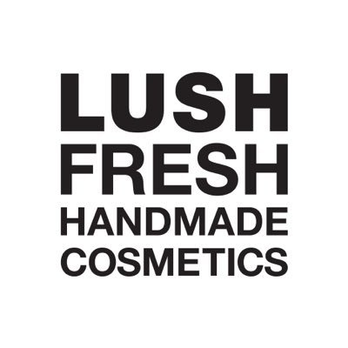
Summary: This digital ad will be placed over all social media outlets. This will be the initial onset of the campaign and this ad will be placed on Google, Facebook, Twitter, Instagram, SnapChat, and in print for store signage. We will also be able to have some YouTube influencers to produce content for videos on this campaign to spread the message and way to participate. Once the ad has been placed we can implement the campaign starting on the specified date, running for a total of two weeks over the first two weeks of spring. This will coincide with our new spring bath bomb launch. The goal is to sell as many bath bombs as possible while helping a good cause and garner some exposure on our customer’s social media platforms to further brand recognition.
A mass email communication will be sent out to all on the mailing list

Slide 3
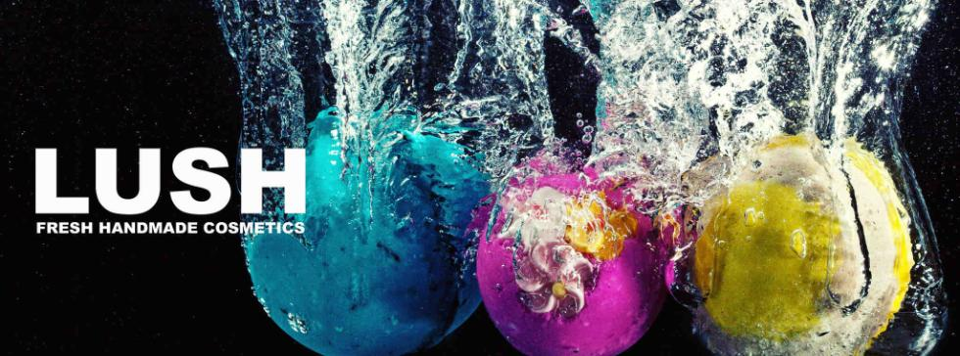
LUSH is asking you to drop some bombs in the war on Animal Testing. Drop any of our LUSH Bath Bombs into a tub of water, post a video to social media using the hashtag #WarOnAnimalTesting and LUSH will donate $.25 (up to $250,000) to end Animal Testing. You get a great bath, we get to show you how much we care, and together we get to help end cosmetic testing on our furry friends. What could be better? Come in to any LUSH to pick up your bomb to drop on Animal Testing today!

Slide 4
Target / Email Communication
Target: Our target market is socially conscious millennials with disposable income and a desire to help ethically responsible causes. These are in the median age group and have professional or well-paying jobs. Most of these will not have children and live and work in an urban area. It is important to this target market to help socially responsible causes and by linking our brand with a good cause we can increase our brand value with them. Using social media to allow them to participate will help create brand ambassadors and word-of-mouth advertising will spread due to this
The following is an email communication that will be sent our in mass to all customers signed up on the mailing list.
The communication will announce the launch of the spring line
The communication will also link the Easter egg bath bombs to the anti animal testing campaign and direct people to our social media sites

Slide 5



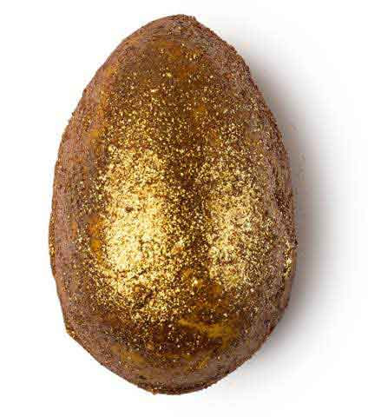
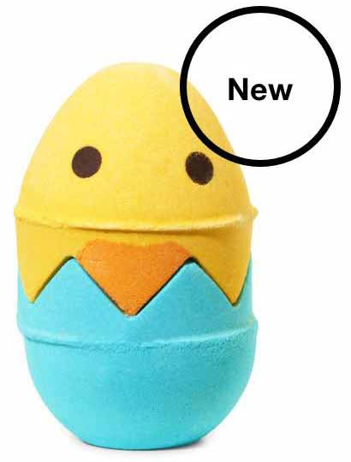
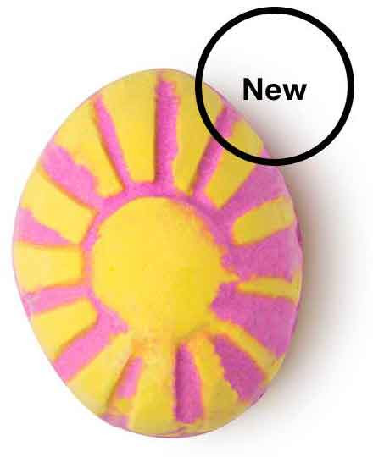
It’s spring at LUSH and that can only mean one thing… EASTER EGGS! 100% of our spring line products are self preserving, which means they contain no artificial preservatives. It also means that products wont spoil despite being made with AMAZING ingredients like cocoa butter, vegetarian glycerin and honey.
“Check out our entire self-preserving Easter range online, give our customer care team a call at 1-888-733-5874, or visit your local shop to see it in person before it hops away for good.” Make sure to check our social media to find out how to participate in our #WarOnAnimalTesting @lushcosmetics
Bath Bomb Melt
Gorgeous glittery egg blooms into a golden honey scented magic
Bath Bomb
Adorable bergamot scented chick hides a cute secret inside
Bath Bomb
Fuchsia waters are left after this fast fizzing vanilla grapefruit treat

Slide 6

The Pitch
The following blur will be placed on the website and on social media outlets
“New spring bath bombs are arriving at LUSH Fresh Handmade Cosmetics and we want you to try them all! Come in to any LUSH location between March15 - 30, purchase one bath bomb and get a second bath bomb of equal or lesser value free. Mix and match any of our bath bombs including our year-round classics and location exclusives. Come stock up on bath bombs and help us fight against animal testing online! #WarOnAnimalTesting “

Slide 7
Campaign Summary
These blurbs, posts, and communications would be paired with the digital ad campaign across social media and popular blog sites for maximum effectiveness of both sale and campaign. This buy one get one free promotion along with the social responsibility campaign during the spring product launch would not only reach but engage customers, spread brand recognition, and move product. The company politics, best ingredients and hand crafted products would draw new customers and then retain them.
All of these elements would come together beautifully to reach and keep our target customer. In today’s market place it’s not enough to have a good product. Millennials want good products made from good ingredients that are ethically sourced, that are not only good for them but also good to the environment. These are things that LUSH offers and this combination attack would adequately show off the product and our ethical nature as a company thus giving our millennial consumer what they want all around.

Slide 8
Campaign
Summary
If we properly engage the consumers with this experimental approach the campaign (and in turn, the company and products) could end up trending world-wide on social media. Utilizing social media to connect the company with its target market is the key element in this campaign and is also the key in measuring its success. The real measurement metric of how successful this campaign is will be how high we can get the hashtag to trend world-wide.
This campaign could not only prove to be very successful in selling product and spreading brand recognition but it could also prove to be very helpful to the fight against animal testing and bringing attention to the issue. Since what is important to our customers is important to us we will make sure that the funds donated from the use of the hashtag be split up equally amongst non-profit organizations that fight animal testing.
By giving the consumers something to feel good about we are connecting the company image with that good feeling and that, along with the quality of the products, is what will end up driving repeat business. This combination approach would best saturate the market, hit our target demographic, and create the most good for the company, consumer, and the cause being supported.

Slide 9
Reference
Johnston, E. (2016, May 18). 5 steps to understanding your customer's buying process. Retrieved from https://www.b2bmarketing.net/en/resources/blog/5-steps-understanding-your-customers-buying-process
Youssef, M. M., & Abdallah, H. A. (n.d.). Rise of Experiential Marketing in Emerging Markets. Ethical and Social Perspectives on Global Business Interaction in Emerging Markets Advances in Business Strategy and Competitive Advantage, 284-312. doi:10.4018/978-1-4666-9864-2.ch015
Easter treats are here! (n.d.). Retrieved March 19, 2017, from https://www.lushusa.com/

