Slide 1
Too Faced Cosmetics vs Smashbox Cosmetics
Kelly Smith
DMKT325

Slide 2
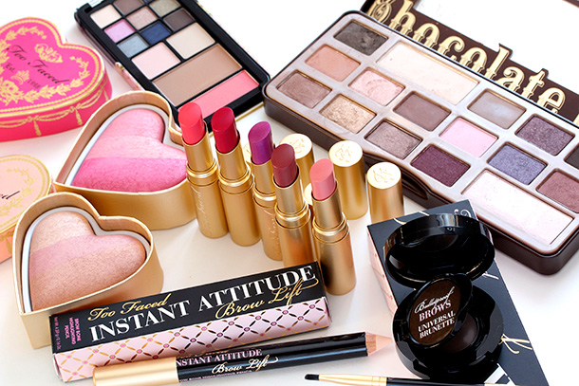
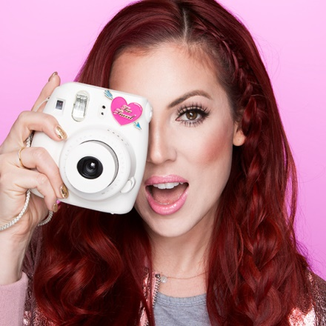
Too Faced Cosmetics
Too Faced was born out of the darkness of grunge in the 90’s and grew based on its pretty-in-pink reputation for innovation and cruelty-free products. (TooFaced.com, "About Founders Jerrod Blandino & Jeremy Johnson")
Through sly advertising via YouTube influencers Too Faced has not only managed to become a commonly used brand amongst makeup artists but a commonly used brand amongst the general public and younger generations now consider it a staple.
Too Faced Cosmetics was recently purchased by Estee Lauder who has stated that it intends to use the brand to reach a more youthful target market.

Slide 3
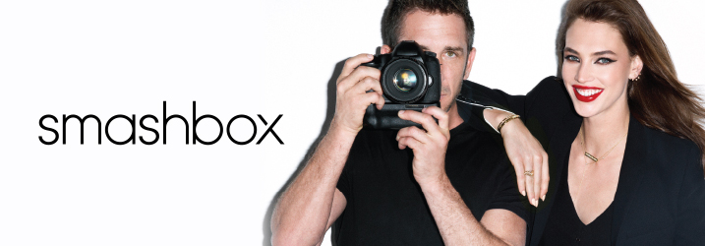
Smashbox Beauty Cosmetics is currently owned by Estee Lauder Companies.
The founders of the corporation were Dean and Davis Factor.
Smashbox cosmetics as the name suggests deals with beauty products.
The products produced range from eyeliners to foundation to
lipsticks among others.

Slide 4
Two Campaigns
Both Too Faced and Smashbox have tapped the same influencers time and again
Most recently they both called on YouTuber Laura Lee for her massive online presence and cult like following
Both campaigns were similar with the Too Faced ad being more traditional and the Smashbox ad being more like an ad disguised as a video
Laura used foundation for Too Faced and did a video on 3D printed lipstick for Smashbox

Slide 5
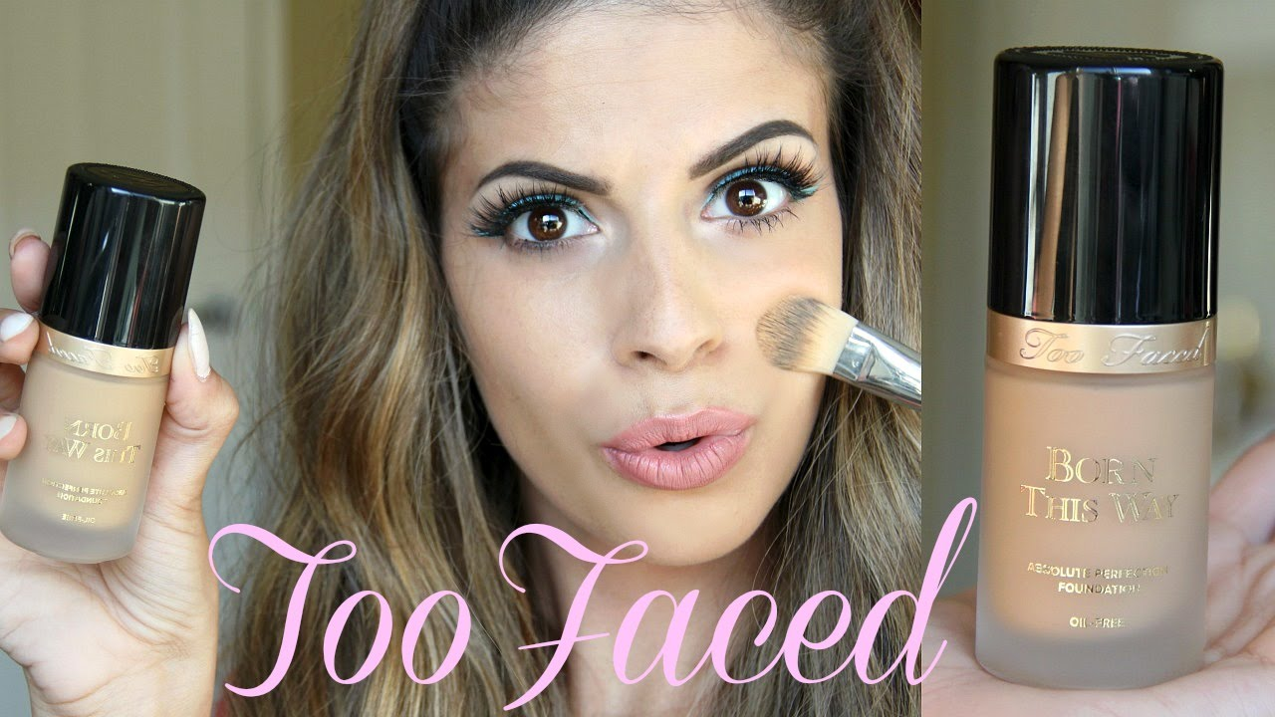
Too Faced Relevance
Too Faced has managed to stay relevant with their target customer group since 1998 by reaching out to unconventional beauty influencers such as YouTube and Instagram beauty gurus
The Too Faced Instagram account currently has 8.3 MILLION followers
The Too Faced YouTube account currently has 251,447 subscribers
The Too Faced Twitter account currently has 444,000 followers
("Laura Lee")
Notes:
Lara Lee is a YouTube influencer that has partnered with Too Faced on multiple occasions in sponsored posts, ads, and she regularly uses their products in her non-sponsored videos.
According to an article in The New Hampshire Business Review written by Andrew Valeriani, Flooring America President of Digital Marketing, “The best ways in which to ensure you are prominently appearing on the first page in a Google search, business owners should consider paid advertisements (Google, Bing, Yahoo) and organic search listings.” What Too Faced has done has flown in the face of traditional marketing techniques such as what this article suggests. (Valeriani, 2016) Every single YouTube influencer has a Google Ad Sense account to advertise their channel. By partnering with YouTube influencers Too Faced is tagged and advertised on the influencer’s YouTube channel and Ad Sense accounts. So, they are really getting double or triple the bang for their advertising bucks!

Slide 6
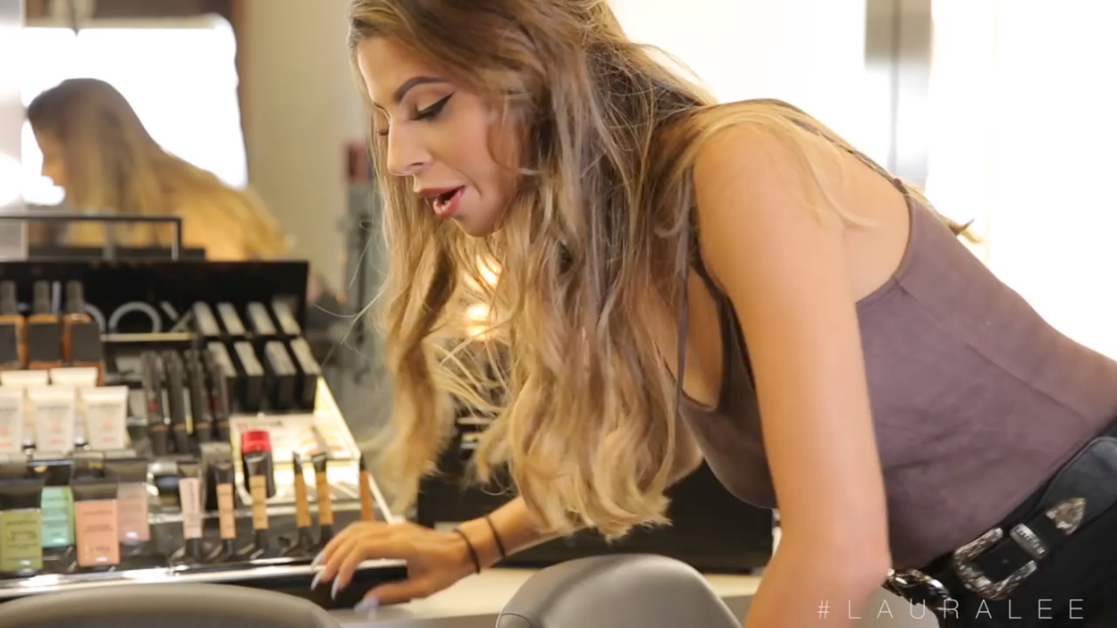
Laura Lee for Smashbox
Notes:
Laura Lee is YouTuber with 2,333,243 subscribers. She has partnered with Smashbox on more than one occasion. On this particular campaign she is talking about their new 3D printed lipsticks, a promotional effort.

Slide 7
An Effective Campaign For Example:
Lush Freshmade Costmetics use fresh all natural ingredients that make the customers skin feel and smell great while being socially responsible at the same time. So you feel good inside and out. I’d say that is a pretty big benefit for those that shop there. The particular fragrances they use make you feel unique which raises your self esteem and the esteem gives you a higher standing amongst peers. The physical, mental, and moral benefits of shopping with this company are worth the extra you pay for the finer ingredients and social consciousness
For their Valentines Day campaign they used gay and lesbian couples using the products with the message that #lovewins
The campaign images were posted to their Twitter account
Many found this controversial which drove sales of the limited edition line

Slide 8
Too Faced Differentiation
Too Faced has managed to set itself aside from other cosmetics company by offering fun, hip, cosmetics that really appeal to a younger crowd.
Product offerings such as “Better Than Sex Mascara” and “Lip Injection Extreme Lip Gloss” aren’t names that your Grandmother would consider purchasing.
Odd ingredients such as honey , jelly, chocolate, and peanut butter scent in eyeshadows and cheek blushes make using the products fun
Too Faced is cruelty-free and that is more important to younger generations than it was in the past
("Makeup and Beauty Blog", 2017)

Slide 9
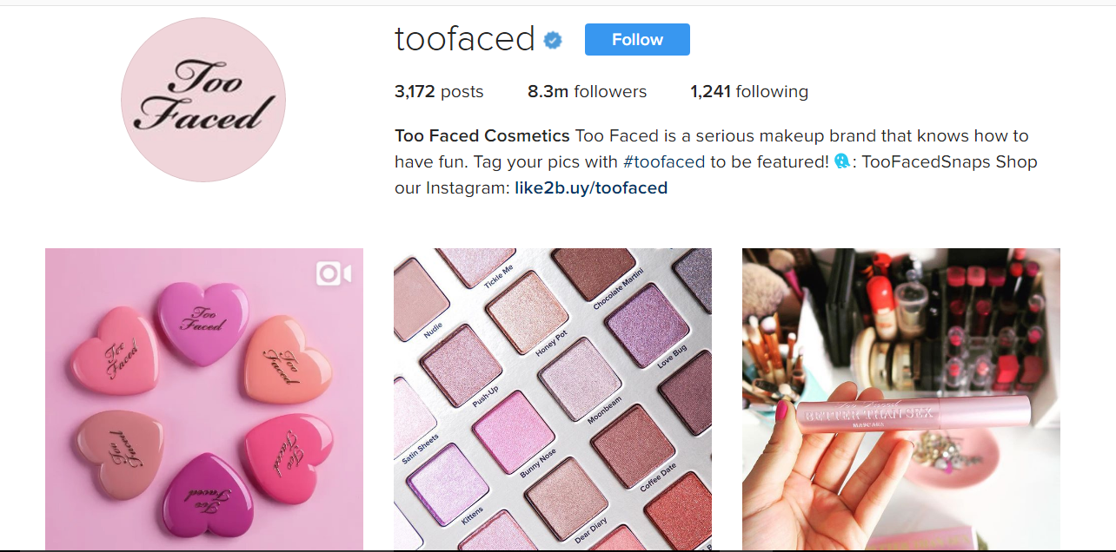
8.3 Million fans on instagram alone
("Too Faced Cosmetics (@toofaced) • Instagram photos and videos")
Notes:
Too Faced not only has a huge online presence they regularly host events for social media influencers which, of course, makes for great photos and videos!

Slide 10
conclusion
It is important for brands such as Too Faced that wish to target a younger youth-based customer segment to set themselves apart from the competition and stay relevant with consumers on social media platforms. It has been said that the younger demographic isn’t susceptible to traditional advertising methods and it is therefore extremely important to engage the customer in new and unique ways . One way Too Faced is doing this is with the use of great marketing images via their Instagram account. Another is paying for YouTube beauty influencers such as Laura Lee to push their brand image in videos. Too Faced has managed to use social media to grab and hold it’s target customer in a way that no other brand has.

Slide 11
Brand Asset Valuator. (n.d.). Retrieved from http://www.valuebasedmanagement.net/methods_brand_asset_valuator.html
K. (2017, February 14). I'm Jerrod Blandino of Too Faced Cosmetics, and This Is My Makeup Life - Makeup and Beauty Blog. Retrieved from http://www.makeupandbeautyblog.com/skin-care/interview-jerrod-blandino-faced-cosmetics/
L. (n.d.). Laura Lee. Retrieved from https://www.youtube.com/user/laura88lee
Li, S. (2016, November 15). Estee Lauder eyes younger customers with $1.45-billion purchase of Too Faced. Retrieved from http://www.latimes.com/business/la-fi-estee-lauder-too-faced-20161115-story.html
Too Faced Cosmetics (@toofaced) • Instagram photos and videos. (n.d.). Retrieved from https://www.instagram.com/toofaced/?hl=en
Account, L. N. (2017, March 17). Lush North America (@lushcosmetics). Retrieved March 18, 2017, from https://twitter.com/lushcosmetics
http://www.smashbox.com/
https://youtu.be/rh9s4uODnvE

