Slide 1
Topic: Exploring Entrepreneurism Candiss Brown Unit 3 IP Instructor: Lisa Smart July 26, 2017

Slide 2

Company Logo
Notes:
Mimi Store incorporates an attractive color in its logo that shows the company’s sacrifice to the customers and bravery. Its slogan “Forever Living” creates a sense of reliability that encourages the users to use it and finally live free of germs.
Because of the stiff competition in the market, the company has included marketing strategies both in the long term and short term. In this, the company will enhance the creation of the firm's brand name and the image in the market, which will attract the potential customers. The strategy will also help foster teamwork among the personnel as they all focus on delivering quality services. It will also enable the corporation to maintain the perfect competition in the market. Mimi has confident in achieving all these since the company’s Logo has the potential to attract a large number of customers just by the look of it.
Mimi slogan “Forever Living " has been of much significance in the marketing strategies. It has contributed to an increase in the prospective of customer's retention and the desire to be attended to by the Mimi Store. Many people have opted to make an attempt and use the new product which ensures maximum protection.

Slide 3
Company Information
Mimi Store is a small business that deals with commodities such as toys, clothes and costumes among others.
It is located on the opposite side of strip mall at Traville Gateway in Rockville.
Originally opened in the year 2010, one of its strategies is to invite the whole world to come and get their services in the long run.
Customer satisfaction is the main objective of the Mimi Store.
The founders of this company are Johnson and his brother Andrew.
Notes:
Mimi Store is a small business that deals with clothes, costumes, and toys among others. It is located on the opposite side of strip mall at Traville Gateway in Rockville. Originally opened in the year 2010, one of its strategies is to invite the whole world to come and get their services in the long run. Bing a small business Customer satisfaction is the main objective of the Mimi Store. The founders of this company are Johnson and his brother Andrew.

Slide 4
Mission Statement
Mimi Store Mission Statement is to move beyond possibilities and be recognized as a local/global leader beyond and within its target market by going global and meeting customer’s needs.
Working towards the mission achievement, Mimi is dedicated to open other branches in several countries.
As a result, this small business has discovered a new product “Aloe Vera disinfectant”
There is an immediate market identified in the United Arabs Emirates.
Therefore, Mimi Store have to market the new discovered product in UAE.
Notes:
Working towards the mission achievement, the Mimi is dedicated to providing high quality products. Therefore, this small business has been moving with the technology in the market that include; offering Aloe Vera antiseptic which ensures maximum protection. The accommodation of the advanced technology by the company has contributed to its growth both locally and globally. In addition, the founders together with the other stakeholders have been striving to work as a cohesive, and harmonious objectives focused on simplifying the company's mission.

Slide 5
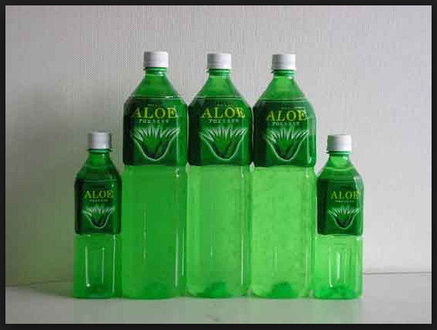
Product or Service
Aloe Vera disinfectant;
This is an antiseptic and disinfectant that suppresses and kills bacteria and germs.
Aloe Vera disinfectant is used externally in the cleaning of cuts, any wound and in the washing of hands.
It is also useful in the cleaning of the environmental surfaces in places such as the the kitchen and the toilets. In these places it helps to kill the germs and other bacteria.
It is also very useful in the slaughter houses as it is used to clean in order to kill the germs.
Aloe Vera disinfectant is also useful in washing of garments, such as blankets and baby clothes.
Notes:
). Aloe Vera disinfectant is an antiseptic and disinfectant that kills bacteria. Aloe Vera disinfectant l is used externally in the cleaning of cuts, any wound and in the washing of hands. It is also used to kill germs in environmental surfaces such as toilets, household floors and in any wall such as in slaughter houses. Aloe Vera disinfectant is also used in cleaning of clothes, such as baby clothes.

Slide 6
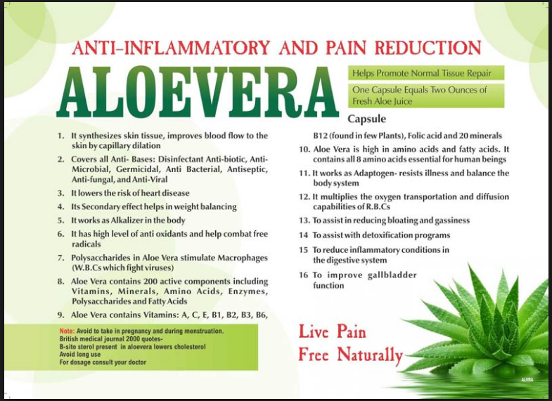
Aloe Vera disinfectant
Notes:
Aloe Vera disinfectant product ensures 100% protection from external germs. This product is in a liquid form that is white in colour when it is in concentrated form, but it dissolves in water and produces a milky emulsion with some few kind of oil droplets. Chloroxylenol is the most type of ingredient found in this Aloe Vera disinfectant that gives the antiseptic effect. This chloroxylenol is the one who controls all kind of bacteria, viruses, algae and fungi. The product is recommended for external use only and-and every person should consider using this disinfectant.

Slide 7
Market
Mimi Store products are doing well in the market today both locally and globally. This means that establishing a new branch in United Arabs Emirates (UAE) will not be a hard task.
The United Arabs Emirates (UAE) is a nation that is located in the Middle East.
The significant change in the demography has led to increase of patients in hospitals with bacteria and fungi infections.
Notes:
The United Arabs Emirates (UAE) is a nation that is located in the Middle East. The nation is mostly focused and interested in the citizen's social welfare by ensuring the provision of quality services to the citizens with the primary objective of maintaining an advanced social and enhancement of stable economic growth. It has led to the increase in the population. Due to demographic change there has been the challenge of people flocking in the hospitals most of them suffering from external bacteria, fungi and algae infections. Most of the doctors in this region have been using a disinfectant that has not been that accurate in the killing of these infections. Therefore, this has created a business opportunity Mimi Store brand. In recent past, most of the Emirates here have no confident with the current antiseptic product. Selling Mimi Store product in this country means that marketing strategies both in the long term and the short term must be put in place

Slide 8
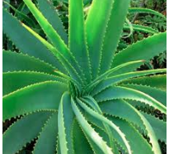

Cont’d
The main focus of the company is to cater for the welfare of the customers by ensuring that the customers’ needs are fully met.
In this regard, the company focus on provision of quality products and quality services to the customers and enhancement of its growth economically.
Notes:
In analysing the market, customers will involve two aspects that are the customer's demographic profile and the customer's behavioural analysis. In demographic profile, the analysis focus is towards the customer's age, their current income, and their geographical locations. In UAE, the population is increasing day by day. It means that there are number children who are being born each day. Most of these infants need to be handled with care when being delivered. The doctors have been looking for the best antiseptic to use in their hospitals to fight with infections caused by external bacterial. Aloe Vera disinfectant ensures 100% protection from bacteria, and this will solve their problem. Aloe Vera disinfectant will be mixed with water that will be used in the cleansing of these infants.

Slide 9
Cont’d
A significant number of the physicians have been using some disinfectant which have not been very effective in killing of the bacteria and fungi
This lack of an effective disinfectant for these bacteria and fungi infections has created a market gap for the company.
Most recently, it was very clear that the Emirates did not had confidence with the existing disinfectants in the market.
The company will have long-term and short-term marketing strategies
Notes:
Most of the Emirates earn income ranging from 25-30 dollars. Their income changes their preferences towards the products that offer relative prices. Aloe Vera disinfectant pricing is absolute relative. In their geographical locations most the prospective customers are located in areas with high technology. Most of them can access the media, and this will be helpful in marketing processes.
In behavioural context, the customers' preferences for a product are based on the pricing, the quality of the product, suitability and prestige. Aloe Vera disinfectant is of high quality with relative pricing. Its assurance of preventing bacterial infections will shift their preferences towards the new product in the market

Slide 10
Cont’d
There has been a positive report from other countries where the Mimi new product has already been introduced.
Most the clients there say that since the introduction of this disinfectant in their country, bacterial infections have reduced.
According to the recent research done in China where the product is already in the market, the study shows that the rate at which the product is selling is increasing day by day.
Notes:
There also has an impact on the China country hospitals since most of the doctors have embraced the disinfectant. As time goes by most of the China citizen are changing their preferences towards the Aloe Vera disinfectant as most of them have witnessed its maximum protection. The diagram below shows the report gathered from other countries about the new product performance for the last five months.

Slide 11
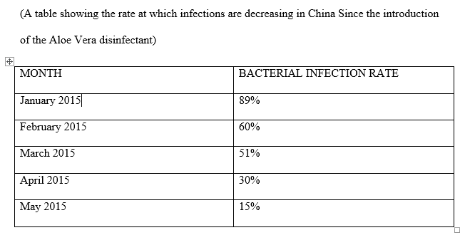
Cont’d

Slide 12
Customer Analysis
On the population distribution, the company's analysis focuses on the geographical distribution, age and the economic status of the customers.
In UAE, the rate at which the population is increasing is very high. The birth rate is one of the factors accounting for the rapid population increase.
The new product will do well in this market because most of the babies being born needs to be handled carefully
In hospitals, the physicians are also looking for an effective antiseptic which will enable get lid of the external bacterial.
Aloe Vera disinfectant will provide a solution because it ensures 100% protection from bacteria

Slide 13
Competitors
The competition is very stiff in United Arabs Emirates. This is because in the market, there are approximately more than 50 antiseptic products from different companies.
Basically, the competitors have the same product but they are differentiating themselves through branding and pricing
The competitors are also carrying out product promotion through the social media, print media and channels such as radios and televisions
Aloe Vera seeks to differentiate itself through offering of quality products and better customer care services.
Further, most of the companies in the business offers defective products and this has made customers to loose confidence in them
Notes:
In analysing the market, customers will involve two aspects that are the customer's demographic profile and the customer's behavioural analysis. In demographic profile, the analysis focus is towards the customer's age, their current income, and their geographical locations. In UAE, the population is increasing day by day. It means that there are number children who are being born each day. Most of these infants need to be handled with care when being delivered. The doctors have been looking for the best antiseptic to use in their hospitals to fight with infections caused by external bacterial. Aloe Vera disinfectant ensures 100% protection from bacteria, and this will solve their problem. Aloe Vera disinfectant will be mixed with water that will be used in the cleansing of these infants.
Most of the Emirates earn income ranging from 25-30 dollars. Their income changes their preferences towards the products that offer relative prices. Aloe Vera disinfectant pricing is absolute relative. In their geographical locations most the prospective customers are located in areas with high technology. Most of them can access the media, and this will be helpful in marketing processes.
In behavioural context, the customers' preferences for a product are based on the pricing, the quality of the product, suitability and prestige. Aloe Vera disinfectant is of high quality with relative pricing. Its assurance of preventing bacterial infections will shift their preferences towards the new product in the market

Slide 14
Advertising
The company will adopt a unique marketing approach which is completely different from that of its competitors. Further it will adopt an approach appropriate to conquers new market.
The method that will be used include technologically advanced methods of marketing in order to reach a wide scope of customers at a lower cost. The methods of marketing to de adopt will match with the dynamics in the market.
Among the key approach to be used include direct engagement with the customers at the geographical location areas.
Notes:
The company is focused on both long term and short term goals. The communication objective is to reach as many Emirates as possible. The primary target being those potential customers who feel empowered by the exclusiveness of the Mimi store product and at the same time maintain a long-term relationship with the current market share as the product seems to have a brand extension (Hollensen, 2015). The brand appears to expand shortly through various product promotions such as public awareness, trade fair and exhibitions and discount promotions. In the long run, as future marketing opportunities are identified the brand will pursue them and will capitalize on them. This will involve the drawing of a larger market share by promoting the product through trade and fair exhibitions in the whole world.

Slide 15
Cont’d
Mimi Store has done a thorough market research in order to understand the market . It has also carried out a survey in order to understand the customers interest, and adopt the international best practices in marketing.
Mimi is ready to start marketing and this will begin by launching of the product in the target market.
During the launch of the product, the company will use a communication medium which will reach many customers
The company in this regard will seek to adopt the latest technology in marketing to be able to reach as many customers as possible.
The availability and accessibility of the internet connection in UAE will make it appropriate and easy for the company to use social media platforms to market its products.
Notes:
To achieve both short term and long term objectives trade shows and exhibitions will be the tool used in the Adverting of the product. This advertising and promotion method will enable the Mimi store company network with other members in the industry which will be useful in the growth of the customer's base. This will include the demonstration of the product even into other businesses in the UAE market. This type of promotion will enable the face to face conversation with the potential customers. Exhibitions will allow the Mimi store company to keep up with the development required in the market. This will enable the company to know what is new in the market allowing them to maintain the perfect competition.

Slide 16
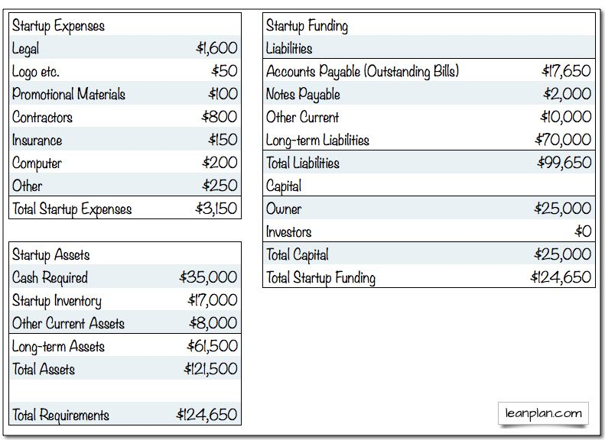
Financials
Notes:
The balance sheet above shows the startup expenses, Startup Assets and Startup funding

Slide 17
Growth Potential
Mimi Store potential growth will be mainly achieved through globalization.
Globalization has made it easy for the technology to be transferred from the developed nations to the developing nations.
Globalisation has led to the formation of the global market village.
with the globalisation and the developed of the advanced technology, people do not require to be in the same geographical location in order to be able to do business together. E-commerce is now a reality.
For example, with the internet connectivity, people can use social media platforms to carry out business with each other.
Notes:
Globalization refers to the free movement of goods, capital, services, technology and information from one nation to another. In the globalization, the different nations will be integrated. Due to the high level of advanced technology the countries will be incorporated to an extent that people from all the corners of the world will not need to be physically together to carry out their business. For instance, due to the development of internet connectivity, people from different parts of the world can continue with their businesses as though they are physically together (Karakaya, & Stahl, 2015). Globalization has enabled Countries import technology from the developed nations to exploit their sources. This will enhance the reach of my product to their markets through the technology imported. In this case, therefore, Mimi store will concentrate on the advanced technology in the marketing of the product in UAE. Since most of the countries are recently trading with this multinational nation, the presence of technology will enhance the reach of in their market.

Slide 18
References
Businesses.In Proceedings of the 1993 World Marketing Congress (pp. 208-212). Springer International Publishing.
Hollensen, S. (2015).Marketing management: A relationship approach. Pearson Education.
Karakaya, F., & Stahl, M. J. (2015). Global Barriers to Market Entry for Developing Country .
Lee, S., & Ross, S. D. (2012). Sport sponsorship decision making in a global market: An
approach of Analytic Hierarchy Process (AHP). Sport, Business and Management: An
International Journal, 2(2), 156-168.

