Slide 1
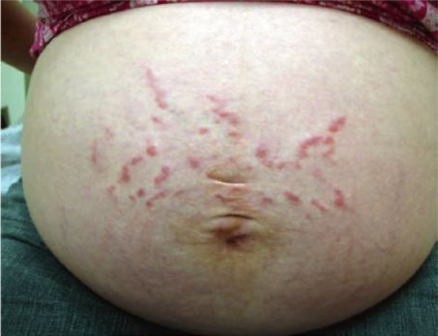
PUPPP Rash (Pruritic urticarial papules and plaques of pregnancy)
General, overall description of the disease
PUPPP Rash (Pruritic urticarial papules and plaques of pregnancy) are itchy rashes that develop in the stomach’s stretch marks during late pregnancy, specifically during the third trimester (Greenberg, Hendrickson & Silverberg, 2015). They are polymorphic 1-2mm in shape, pink-red papules (Allen, 2010).
(Allen, 2010)
Clinical manifestations
The mean onset of the condition stands at approximately 35 weeks with eruptions being polymorphous (Greenberg, Hendrickson & Silverberg, 2015). The intensity of the condition spontaneously comes to an end a short period after delivering.
Etiology
The cause for PUPPP Rash is not clearly known. However, it is associated with excess maternal gains in weight and several pregnancies. The rash begins at the abdomen and may at times be surmounted by vesicles. Even so, subsequent pregnancies do not have increased incidence (Elder, 2013).
Complications/sequelae
There are no effects that can be considered adverse from the condition apart from the fact that it can cause maternal discomfort when it become intense. This is true for both the mother and child.
Pathogenesis/pathophysiology
The cause might be due to abnormal dermatological reaction to abdominal distension. With increased incidences in women with several gestations, there is an indication that stretching of the skin has a role in leading to an immune mediated reaction.
Treatment options
Oral antihistamines
Topical steroids
Oral steroids for severe cases
Itch relieving baths
Moisturizers
Prevalence of the disease in the population
This is among the most common gestational dermatosis with the incidence varying from around one in 200 pregnancies (Gambling, Douglas & McKay, 2011). The incidence rate is higher in twin and triplet pregnancies by 2.9% and 14% respectively (Gambling, Douglas & McKay, 2011).
Prognosis
The condition of the woman and the newborn remains in good shape. It normally resolves after 4-6 weeks of delivery (Rudolph et al., 2006).
References
Allen, H. (2010). Dermatology terminology. New York: Springer.
Elder, D. E. (2013). Atlas and synopsis of Lever's histopathology of the skin. Philadelphia: Wolters Kluwer/Lippincott Williams & Wilkins
Gambling, D., Douglas, M., & McKay, R. (2011). Obstetric anesthesia and uncommon disorders. Cambridge: Cambridge University Press.
Greenberg, M., Hendrickson, R., & Silverberg, M. (2015). Greenberg's Text-Atlas of Emergency Medicine. Philadelphia: Wolters Kluwer.
Rudolph, C., Al-Fares, S., Vaughan-Jones, S., Mullegger, R., Kerl, H., & Black, M. (2006). Polymorphic eruption of pregnancy: clinic pathology and potential trigger factors in 181 patients. British Journal Of Dermatology, 154(1), 54-60.

