Slide 1

Mid-Quarter Breather: The Course Argument
We are fish swimming in water
Can we live out of the water?

Slide 2
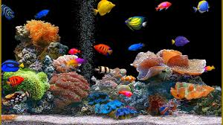
Course Argument
We are fish swimming in water
We are our
Social
Interactions
Do you know your social interactions?

Slide 3
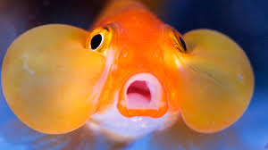
Course Argument
Who are we? How did we get this way?
Our social interactions were created by culture,
politics, ethnicity, religion and our climate—including the Jackson School, the UW
What waters are you swimming in?

Slide 4
Course Argument
What is “our” water like?
Water, depending on our history and culture, is quite different.
For us, in the West, we are creatures of the Enlightenment, we developed nation states, human rights, democracy, capitalist economies, we pushed away traditional culture (religion) into the background.
THIS IS MODERNITY
Did everybody do the same, in the same way?
Are there multiple modernity's?

Slide 5
Course Argument
What kind of fish are in this “modern” water?
A mix, in the West:
A privileged class, educated, able to make choices, empowered, secular, right’s based, consumerist, open to new experiences—
wanting the whole world to become like us—to create markets in every part of the ocean-to create human rights, like ours, everywhere
Does the whole world want to become like us?

Slide 6

Course Argument
What kind of fish are in these “modern” waters?
Is our modernity so great?
What disappeared in our liquid modernity?
Anthony Giddens

Slide 7
Course Argument
How would we map the morality of our piece of water?
Are we instrumentalists--utilitarian's?
Are we Kantians?
Are we Christian, Hindu or Islamic?
Are we hedonists, egoists, libertarians?
Are human right’s activists?
By what moral compass do you swim in the sea?

Slide 8
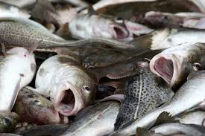
Course Argument
Do all fish want to be like us?
Some but not all.
Many, in other world cultures, Islamic, in particular, find our culture full of poison:
Hedonistic, libertine, anti-family, unjust, and not submitted to God
to their God
How do we negotiate their judgments?

Slide 9
Course Argument
What are the rules for fish who have quite different ethical, moral and cultural preferences and principles?
What principles do you use to adjudicate differences?
Is there a handy set that can be used so that we all can come to an agreement on how to move forward without conflict?
This is public policy, foreign policy—how do we insure human security for all?

Slide 10
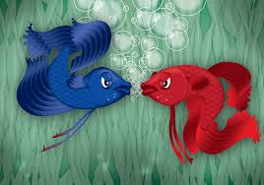
Course Argument
Do the other fish hate us and why?
?

Slide 11
Course Argument
Can communicate non-violently?
Observe (without judgment)?
Say what we feel?
Express our needs?
Make a request, ask for a concrete action?

Slide 12
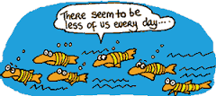
Course Argument Does Climate Change Everything?
Is the Ocean in which we swim becoming too hot?
Why?
Did modernity (the development of modern economies —(an instrumental logic towards nature) actually become our enemy?

Slide 13
Course Argument
What difference can we make?
What kind of cultural, moral, ethical leaders will we choose to be?
Will we be thoughtful about this, or just take up our families ideas/or your peers? How will we decide?

Slide 14
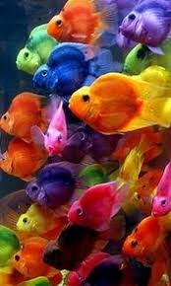
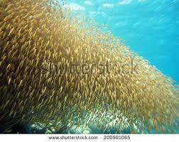
Course Argument
Can we fix the water?
Do we have that power? Is there a group of fish that we admire who are actually making a difference in the environment, in overcoming major cultural, religious and political differences?
Who?
How?

Slide 15

Course Argument
Can “we” live peacefully with the “other”?
Can you?
Or, should we force everyone to be like “us”, and which is “us” anyway?

Slide 16
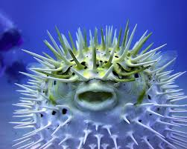
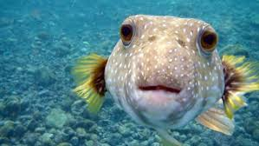
Course Argument
We are fish swimming in water
We are our
Social
Interactions
Our social interactions will determine the fate of the world

Slide 17
Modernity, Modernity's
Modernity begins in full force with the 18th century American and French Revolutions. It is a social-cultural movement that resists tradition and emphasizes individualism, freedom and equality; it asserts that progress for humanity is possible through science and technology; it develops forms of market economy, moving away from religiously legitimated feudalism and agrarian life and toward industry and urbanization—fostering forms of representative democracy, public education and professionalized bureaucracies.

Slide 18
Secularism(s), Secularization
All of the ideas and institutions of modernity emerge from within religion, but coalesce into a new worldview called secularism, which rejects religion's claim to govern them and attempts to limit the authority of religion to the private sphere. Secularization is thus a by-product of modernity and is the privatization of faith, demanding the separation of religion from state governance; this is often followed by the decline of the power of religion in politics, economy and society more generally.

Slide 19
Fundamentalism(s)
Fundmentalism(s) is a response to this secularization in order to re-assert that a single religion has authority over the market, state, and specifically, over the individual. However, fundamentalists often accept other aspects of modernity aside from secularization. That is, fundamentalists’ pick and choose parts of modernity (media, industry and technology), which are a boon to Islamists (see Iran sacralizing atomic energy, or ISIS exploiting social media, both funded by the sale of oil), and Christian fundamentalists (except the Radical Reformers—Anabaptists), who use the products of media and modernity to secure their claims.

Slide 20
Post-modernism(s)
Post-modernism is a latecomer to this stream of thought, and is a critique of Enlightenment concepts of freedom, liberation and self-determination in human nature. Post-modernists question the hegemony of modernist epistemology and interrogate how it fosters a cultural hegemony that disciplines the body rather than freeing it.
Postmodernists make arguments against foundationalism and essentialism, arguing that truth claims are always a function of interested groups with ideological commitments. There are no non-interested, non-political epistemologies; truth is always on behalf of interested parties.

