Slide 1
How to Write in Chemistry
Chemistry Research Paper

Slide 2
Sentence Structure and Writing Style
Beginning a sentence
Avoid beginning a sentence with a symbol, numeric value or equation
Incorrect: 315.6 mg of ammonium chloride was added to the solution, which was then heated to 50 degrees Celsius.
Correct: After the addition of 315.6 mg of Ammonium Chloride, the solution was heated to 50 degrees Celsius.

Slide 3
Sentence Structure and Writing Style Cont.
Dangling Modifiers and Illogical Construction
Check the modifier phrase or the pronoun “it” actually refers to the intended subject
Incorrect: Being coated with grease, I cleaned the flask before adding reagents…
Was I coated with grease or was the flask?
Correct: Because the flask was coated with grease, it was cleaned before…

Slide 4
Sentence Structure and Writing Style Cont.
Equations
Equations appear as a separate line from the text and are numbered sequentially throughout the manuscript. Equations can then be referred to by number.
Example: “ The quenching rate constant can be calculated using the Stern-Volmer equation:”
k_q = {8RT}/{3\eta}
R- is the constant
T- is the temperature
N- is the viscosity of the solution

Slide 5
Sentence Structure and Writing Style Cont.
Hyphens
Hyphenate compound adjectives
Example: 1) 5-ml aliquots were added
2) Crystal deposited from the slowly- cooled solution
Spaces
There should be a space between a quantity and its units and between a quantity or word and subsequent parenthetical phrase.
Example:
6.626 J s
25.15 K = 298.15 C
45 mL

Slide 6



Paragraph Structure
Introduction
Abstract
Experimental
Results
Discussion
Conclusion
Appendix

Slide 7
Introduction
Heading
Name of the experiment followed by your name, date, or list of partners
Layout
Explains to the reader what basic scientific question is being addressed
Organization
Funnels the reader from a larger area of research through examples of progress to a clear statement

Slide 8
First Paragraph- Abstract
Abstract- clearly identifies the purpose of the experiment, chemical equation and the important results
Background information on the theory or applications of your experiment
Be specific about what was done
Name types of models or instruments
The products of a reaction
Numerical values that were measured or calculated

Slide 9
Second Paragraph- Experimental
Experimental- this section includes a description of your experimental procedure and names of instruments used.
Materials
Sources and purity of reagents used
Preparation of Compounds
Procedure and summary of characterization by spectroscopy, melting point, chromatography or elemental analysis
Instrumentation
Manufacturer, description of any adaption or sample preparation

Slide 10

Third Paragraph- Results
Results- what you concluded from the experiment
Summary of raw data in tabular form
Important observations
How does the experiment change?
Did you prove your hypothesis?
Calculations
Description of equations used in calculations

Slide 11

Fourth Paragraph- Discussion
Analysis of your results
Purpose of the experiment
What do the results indicate?
What are the sources of error?
Experimental uncertainty
Precision

Slide 12
Fifth Paragraph- Conclusion
Summary of experiment
Subject
Purpose
Summary of results
What changed?
Calculations
Summary of discussion
Summarize in terms of the broader questions

Slide 13
Conclusion Example:
“The described UPLC-ESI-MS validated analytical methodology enables the rapid and selective assay of ofloxacin in aqueous humor. This is the first application of UPLC-MS for the determination of ofloxacin in aqueous humor and the method is equally sensitive as LC-fluorescence applied in aqueous humor9 or LC-MS/MS determination in plasma.7 Furthermore, the developed method is advantageous in its high speed (analysis time of 3 minutes) and the selectivity. It can be automated and is completely validated according to FDA guidelines with satisfactory data for all the parameters under scrutiny. We also describe the application of the UPLC-ESI-MS method to the analysis of clinical samples. Therefore, the developed UPLC-ESI-MS method allows the reproducible sensitive measurement of ofloxacin with improved throughput in aqueous humor and can be applied to studies of bioavailability of ofloxacin in the anterior chamber of the eye.”

Slide 14
Breaking Down the Conclusion
“The described UPLC-ESI-MS validated analytical methodology enables the rapid and selective assay of ofloxacin in aqueous humor.”
The first sentence tells the reader the subject of the experiment and what it has achieved.

Slide 15
Breaking Down the Conclusion Cont.
“This is the first application of UPLC-MS for the determination of ofloxacin in aqueous humor and the method is equally sensitive as LC-fluorescence applied in aqueous humor9 or LC-MS/MS determination in plasma.7.”
The second sentence compares the three tasks that were performed during the experiment.

Slide 16
Breaking Down the Conclusion Cont.
“Furthermore, the developed method is advantageous in its high speed (analysis time of 3 minutes) and the selectivity. It can be automated and is completely validated according to FDA guidelines with satisfactory data for all the parameters under scrutiny. We also describe the application of the UPLC-ESI-MS method to the analysis of clinical samples.”
The third and fourth sentence describes what they discovered through their results.

Slide 17
Breaking Down the Conclusion Cont.
“Therefore, the developed UPLC-ESI-MS method allows the reproducible sensitive measurement of ofloxacin with improved throughput in aqueous humor and can be applied to studies of bioavailability of ofloxacin in the anterior chamber of the eye.”
The last sentence concludes their experiment, results and discussion.

Slide 18
Sixth Paragraph- Appendix
Appendix- includes material not needed when reading the paper
Graphics:
Tables- columns of measured and/or calculated values or observations
Figures include: spectra, graphs, cartoons of experimental set-up or drawings intended to show an object
Schemes- reaction mechanisms, experimental flow charts intended to show a process

Slide 19
Appendix Cont.
All tables, figures, and schemes should be numbered sequentially and must be mentioned in the text.
All graphics should be a full page in size and included at the end of the manuscript in the Appendix
Chemical structures can appear in the text and should be labeled with the same name, formula or compound number that appears in the text.

Slide 20
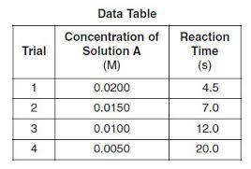
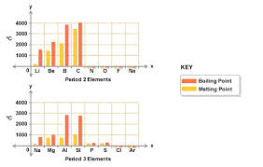
Tables- Calculated and Measured Values

Slide 21
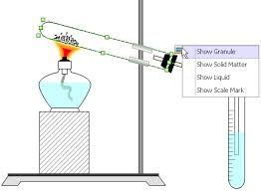
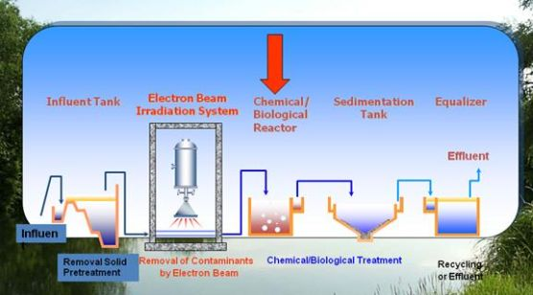
Figures- Set up drawings

Slide 22
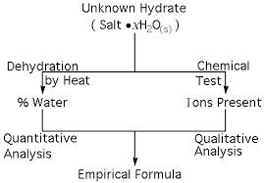
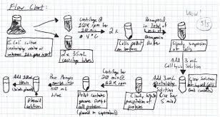
Scheme- Process

