Slide 1

Intellectual and Developmental Disabilities

Slide 2
New Name
Rosa’s Law (Nov 2009 S.2781)
The r – word is derogatory offensive
Not stupid – limitations in thinking
Limitations, delays in developmental milestones
Interchangeable terms

Slide 3
Prevalence
Historically 2.7% of population
Lower due to BIF diagnosis – LD
New medical technology – aborting pregnancy genetic testing

Slide 4
AAIDD Definition
American Association on Intellectual and Developmental Disabilities
Controversial due to thought that the intellectual functioning and adaptive behavior can be improved
Normalization theory

Slide 5
Normalization
The term normalization, or social role valorization, refers to an emphasis on conventional or normal behavior and attitudes in all aspects of education, socialization, and other life experiences (Wolfensberger, 1977, 1983).
The focus of normalization is that all people should lead lives that are as normal as possible.
The two dimensions of normalization:
  direct contact or interaction with typically-developing individuals (this is the basis of inclusion)
  the way an individual with disabilities is described to others
  (which is why we use people first language)

Slide 6
IDEA definition
Manifests before the age of 18.
Refers to substantial limitations in present functioning. It is characterized by significantly sub-average intellectual functioning, existing concurrently with related limitations in two or more of the following applicable adaptive, or life skills area:

Slide 7
Life skills – Adaptive Behaviors
Communication
Self-care
Home living
Social skills
Community use
Self-direction
Health and safety
Functional academics
Leisure and work

Slide 8
Examples of Functional Curriculum Domains or Areas
Domestic: Areas : kitchen, bathroom, laundry room, bedroom
Community: Areas : grocery store, bank, post office, restaurants, school
Recreation/Leisure: Areas : park, YMCA, movie theater, bowling alley, fishing pond
Vocational: Areas : specific job sites (hotel, restaurant, landscape)
Skill areas to be addressed across all domains: communication, transportation, social skills, attire, behavioral expectations, word/ sign/symbol recognition, area-specific skills (for example, using the stove, depositing money, bowling, greeting customers), decision-making skills.

Slide 9
Classifications of ID
Mild IQ 50 -70
Moderate IQ 35-50
Severe IQ 20-35
Profound IQ < 20

Slide 10
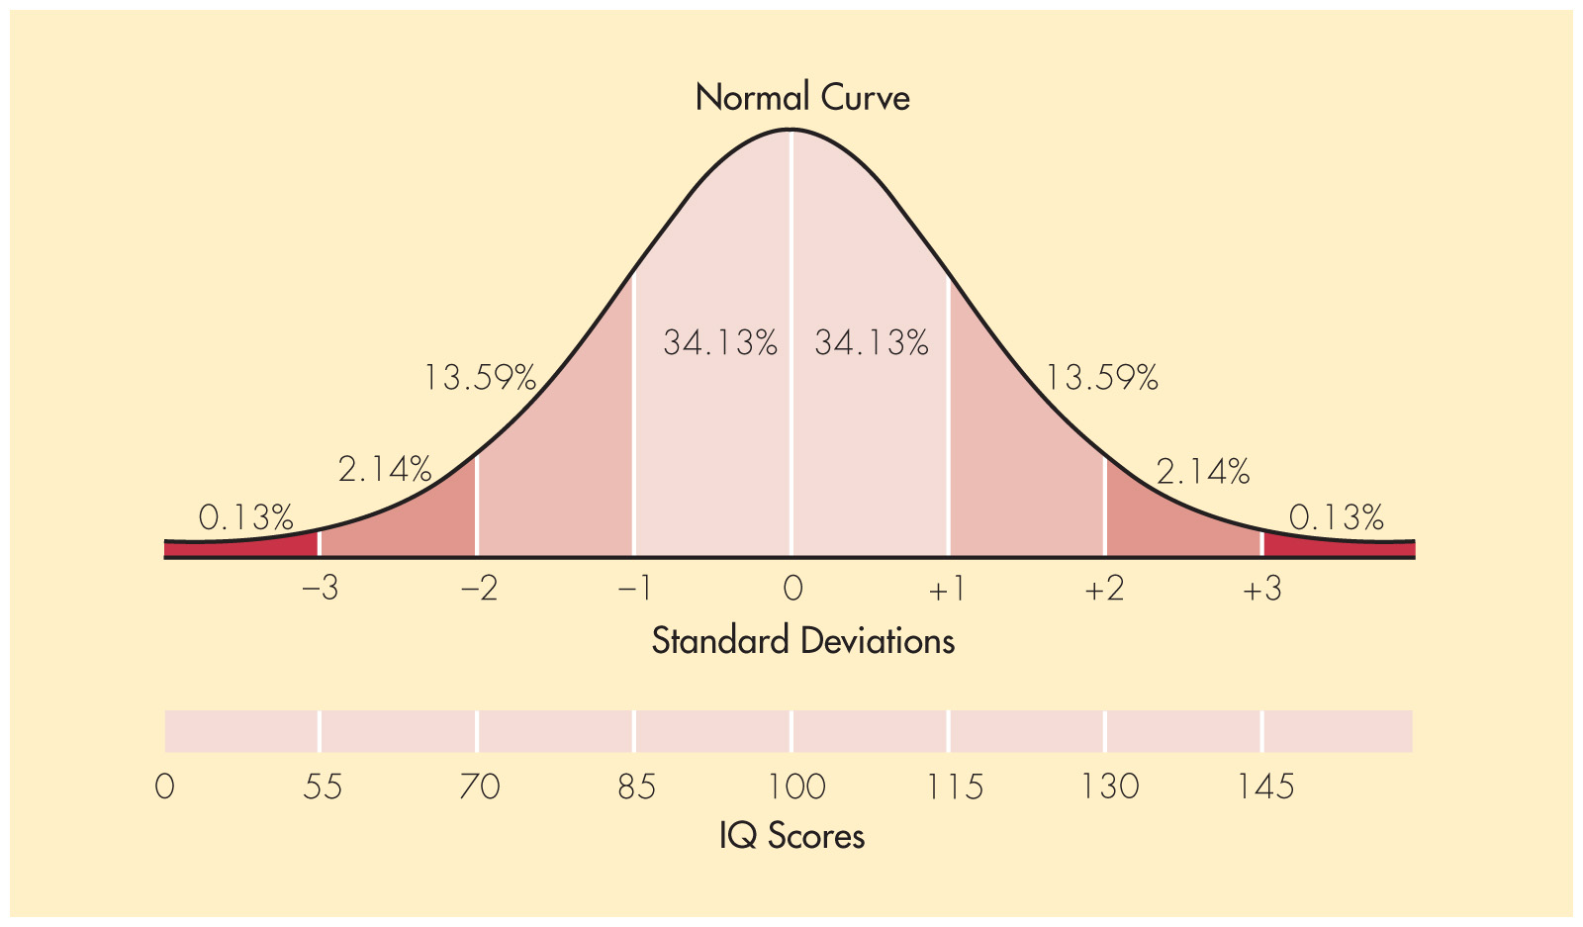
Normal Curve of IQ Scores

Slide 11
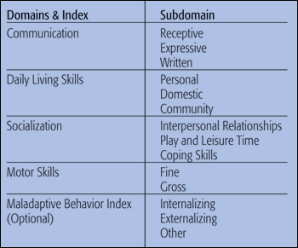
Vineland Adaptive Test

Slide 12
Causation
Prenatal – before birth
Perinatal – time of birth
Postnatal – after birth
10-15% of cause is known

Slide 13
Prenatal Causes - Chromosomal
Down syndrome – 21st pair anomaly
also called trisomy 21st (trio not pair)
Fragile X Syndrome – most common heredity
Prader-Willi Syndrome – obsessed with food inherited from father most common
Williams Syndrome – 7th pair
PKU – abnormal brain development

Slide 14
Fetal Alcohol Syndrome/Effects
Most common
Most preventable
Mother must admit to abuse
If not effects will be diagnosis

Slide 15
Perinatal Causes
Low birth weight
Premature
Infections : syphilis and herpes

Slide 16
Postnatal Causes
Infections: Meningitis and Encephalitis
Malnutrition
Toxins – environmental

Slide 17
Learning Environments
Resource
Self-contained
Inclusion - General classroom
Functional academics
Social Skills/behavior

Slide 18
Task Analysis
Common form of instruction for students with severe disabilities
Step by step detailed directions to perform a certain task
Students learn each step separately
Once a step is mastered independently by the student, teacher adds the next step
Example: Task Analysis
How to make a peanut butter and jelly sandwich

Slide 19
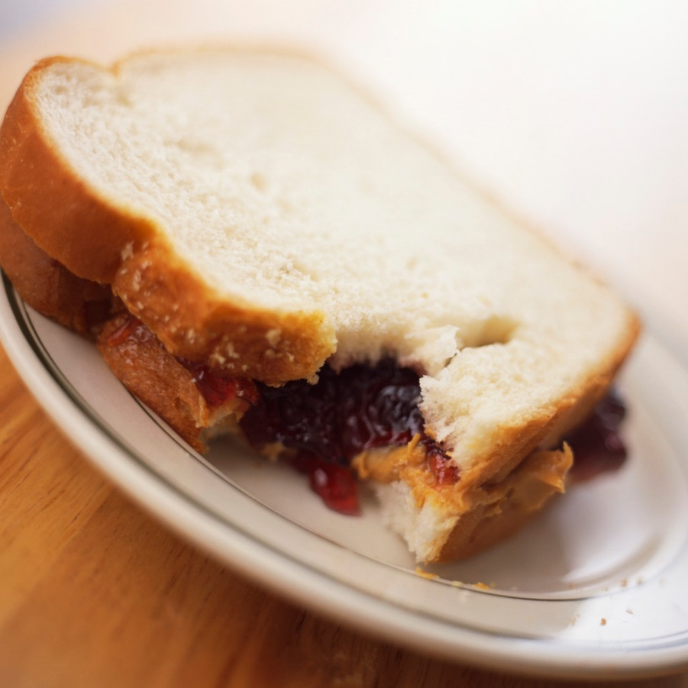
How to make a peanut butter and jelly sandwich
Step 1: get 2 pieces of bread and a plate
Step 2: get jar of peanut butter
Step 3: get jar of jelly
Step 4: get a knife
Step 5: open jar of peanut butter
Step 6: open jar of jelly

Slide 20
How to make a peanut butter and jelly sandwich
Step 7: put each piece of bread on a plate
Step 8: put knife into jar of peanut butter
Step 9: scoop out peanut butter
Step 10: spread peanut butter on to one piece of bread

Slide 21
How to make a peanut butter and jelly sandwich
Step 11: put knife into jar of jelly
Step 12: scoop out jelly
Step 13: spread jelly on to the other piece of bread
Step 14: pick up piece of bread with peanut butter on it
Step 15: put this piece on top of the piece with jelly (make sure peanut butter faces the jelly

Slide 22
How to make a peanut butter and jelly sandwich
Step 16: push pieces of bread together
Step 17: take a bite !!!

Slide 23
Task Analysis
Think about the many steps it requires to complete any task
I am sure there on some steps or items that I might have overlooked in making a peanut butter sandwich.
Are the steps necessary in the order that I put them in. Some tasks can start in various ways.
You will be required to write a task analysis as part of your Lesson 3 activities.

