Slide 1
You are a corporate executive of a global construction company (residential and commercial property.) It is your job to understand the economy. You have read several articles that our economy is heading for a recession.
Based upon our discussion in class, what do you think the economy will be like in 2016. Use multiple indexes to support your answer.
How might your understand of the US 2016 economy impact your company (consider expansion, cost of money, hiring, profit, inventory, and inflation).
Congress passed its spending bill in December. Specifically where did we decrease taxes? What are some of the winners of increased spending. Research
Do corporations pay their fair share of taxes? Discuss one suggested tax reform – research

Slide 2
Discussion on economy - What are your thoughts????
Forecasted GDP for 2016?
Comment: core inflation excludes food and energy may rise to 2.2% next year (medical 3% to 3.5%, prices of service 3%, rents 3-4%)
Be able to discuss factors that impact forecast:
Price of oil decreasing and will it continue
More money to spend – but are people spending?
Oil producing companies
Oil producing nations?
Money invested in sustainable fuels
Consumer
Spending
Savings
Confidence
discretionary income
Debt – increased back to 2007 record of $14.1 trillion
Residential building – Median home price to income is 4.1 was 2.1

Slide 3
Other nation’s economy
China – GDP dipped to 7% for first time
Impact on other nations – commodities market
Impact on Banks / Investors
Impact on American businesses
Unemployment
Residential construction
Stock Market swings
Debt of industry grown from $10.1 to $14.1 trillion
Strong dollar – impacts exports? Impacts imports
Business – production will grow 2.6%, 3.0 in 2017,
Corporate profits – global earnings per share is declining – several quarters

Slide 4
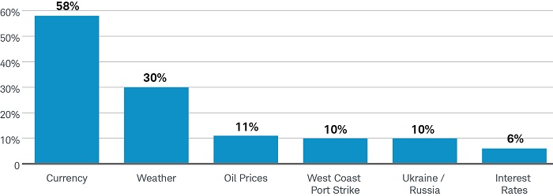
Inflation -

