Slide 1
Value of the following discussion
Additional points can be added to your assignment grade based on the value of your contribution. However, if you do not discuss nor do not understand your topic, points can be deducted.
Material in red on the PowerPoint can be an essay question on your first exam. Please take notes
Optional Extra Credit is based upon this discussion and your additional research

Slide 2
James Murnane, Cam O’Connor, Cam mcClennan
Why do We need immigration reform and is immigration good for our economy? – listen to discussion –
Prosperous nations such as the United States, Canada, Australia and the United Kingdom will always attract immigrants that are in search for a better life. They cross the border illegally or overstay their VISA.
How many – 11- 12 million – highest percentage are Latino The United States has
Reform – United States has one of the most active and complicated immigration system in the world. The wait time for visas varies
There are at least 4.4 million waiting to become citizens legally. The wait is long and complex
Most illegal immigrants want to become legal but again the process is long and complex and expensive

Slide 3
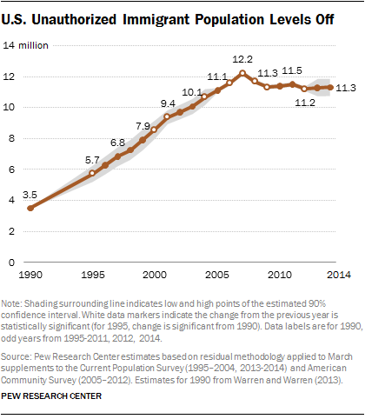
Then there are the millions of undocumented immigrants already living inside the United States.

Slide 4
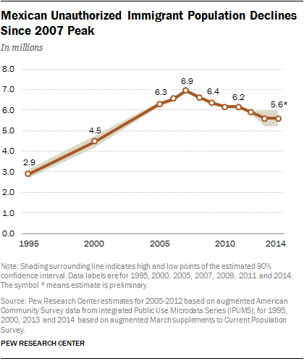
What does this tell you?

Slide 5
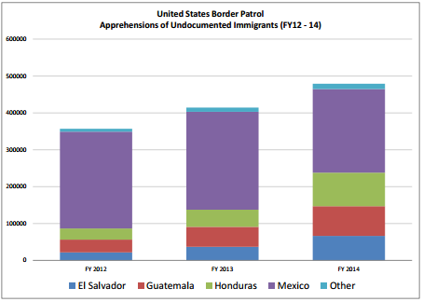
Illegal immigration rate is declining

Slide 6
Additional complexity - Children born in the US are legal citizens – break up families
Reform – Legislation “Path to Citizenship” did not pass the House of Representative. Why – what should be passed and why?
Obama did implement DACA (executive action) – question whether it will be funded or repealed
Illegal immigrants under 30 years of age who came to the America illegally before June 2007 if they were 16 will be protected from deportation and can apply for a two-year work visa (which can be renewed indefinitely) given that they have lived in the United States continuously for at least five years, have not committed any crimes, have a high school diploma (or GED equivalent), or have served (or are currently serving) in the military. This is not a path to citizenship but a stopgap until Congress passes a long-term comprehensive plan.

Slide 7
Economic issues regarding illegal immigration
many arguments have been made on economic grounds. Undocumented workers, some suggest, undercut wages and take jobs that would otherwise go to Americans. Worse, the argument goes, many use social programs, like hospitals and schools, that cost taxpayers and add to our $16 trillion national debt. Nearly all economists, of all political persuasions, agree that immigrants — those here legally or not — benefit the overall economy. “
Labor economists have concluded that undocumented workers have lowered the wages of U.S. adults without a high-school diploma — 25 million of them — by anywhere between 0.4 to 7.4 percent.
skilled workers made more money and worked more hours; the economy’s productivity grew. From 1990 to 2007, undocumented workers increased legal workers’ pay in complementary jobs by up to 10 percent. Reform – should we increase visa for skilled workers because we will need more technology
The benefit multiplies over the long haul. As the baby boomers retire, the post-boom generation’s burden to finance their retirement is greatly alleviated by undocumented immigrants. Stephen Goss, chief actuary for the Social Security Administration said that undocumented workers contribute about $15 billion a year to Social Security through payroll taxes. They only take out $1 billion

Slide 8
While undocumented immigrants don’t hold legal migration status, they generally pay a host of taxes. Many file income tax returns, and more than 3 million have payroll taxes deducted from their paychecks. - example pay $100 billion to social security over last decade
Undocumented immigrants are not eligible for welfare
amnesty to undocumented workers, which would create a sudden increase in tax payments
Problem/Reform? - The problem, though, is that undocumented workers are not evenly distributed. In areas like southern Texas and Arizona and even parts of Brooklyn, undocumented immigrants impose a substantial net cost to local and state governments, Shierholz says. Immigrants use public assistance, medical care and schools. Some immigrant neighborhoods have particularly high crime rates.

Slide 9
Recent issue are refugees (10% of immigrants) who are legally placed in countries – Reform – are they a security risk – are they assimilated - are they a drain on the economy?? Interesting video http://www.pbs.org/video/2262091142/
A refugee is someone who has been forced to flee his or her home country.
As such, refugees can apply for asylum in the United States
Getting refugee status isn't easy. The applicants have to prove that if they return to their home country, they'll be injured because of their race, religion, nationality, membership in a particular social group or their political opinion
United States ceiling is 85000
Before admission to the United States, each refugee must undergo an extensive interviewing, screening, and security clearance process conducted by Regional Refugee Coordinators and overseas Resettlement Support Centers (RSCs).
Once admitted money is available for settlement and paid to private agencies . Federal money disappears after several months
Often settled in poor areas – ramifications?????
All social services are available to refugees – unlike unauthorized immigrants
Welfare use is staggering among refugees. Welfare usage is never counted by officials as part of the cost of the program. Yet, when it is included, the total cost of the refugee program soars to at least 10-20 billion a year

Slide 10
Illegal immigrants residing in the U.S. send $50 billion in remittances to their home countries each year, according to the Bureau of Economic Analysis. The World Bank estimates that number is even higher, closer to $120 billion.
To put that figure into context, $50 billion is the same amount as the U.S. government’s annual foreign aid budge. Helps foreign countries tremendously – Foreign countries want and sometimes depend upon this aid. Often this aid is more effective than private donation because it is generally sent for a reason to improve quality of life
Reform – regulations to make sure it falls into the right hands and used in the right way.
Regulators, concerned that these services are being used by terrorists or drug lords to launder money, are holding banks responsible for monitoring the usage of those services

Slide 11
Discuss Water scarcity = Frank Dipillo, Shane Scipion
Environment - Cameron Repici, Christopher Smith, Bruno Ueda
Conflict – scarce resources Oliver Katic
Scarce resources – China Thin Dang
Economists agree that climate change MUST be immediately addressed – Economists agree several actions must be taken -what
Reduction of prices for alternative energy
Decrease price in order to stimulate demand - how
there should be increase funding /subsidies for research to achieve greater efficiencies and reduce costs.
Increase demand in order to decrease costs per unit – government policies
Increase the costs of fossil fuels by taxing them proportionately to the amount of carbon they release created https://www.youtube.com/watch?v=r6KsTnICxiY be able to explain
Carbon tax
Cap and trade

Slide 12
Tougher regulations for emissions.
The Clean Air Act passed by George Bush was gave the Environmental Protection Agency authority to research, work with states in order to address pollutants and recently it was used by Obama to create pollution standards particularly for carbon emissions-
Economists also agree that we should set international standards. In a recent study of 144 economics , 97% believe America should enter into an international treaty to reduce greenhouse gas emissions. Of that, 57% believe we should reduce emissions no matter what actions other nations take.
In December 2014, The UN Climate Accord in Paris, 195 nations reached a landmark accord that will, for the first time, commit nearly every country to lowering planet-warming greenhouse gas emissions
Each country must ratify their promise. The United States promised In the United States, the goal is to reduce greenhouse gas emissions 26 to 28 percent from 2005 levels by the year 2025

Slide 13
Poverty - Cameron Repici
Technology and outsourcing - Boris Connor, Alex Porter , Peter Larsen
Outsourcing – Bruno Ueda

