Slide 1
CM 220 Unit 9 Seminar
QUOTE FOR THE WEEK:
“Set your sights high, the higher the better. Expect the most wonderful things to happen, not in the future but right now. Realize that nothing is too good. Allow absolutely nothing to hamper you or hold you up in any way.” (Eileen Caddy)

Slide 2
UNIT 9: creating digital media content
Seminar agenda:
Review Unit 8
Assignments for Unit 9 & 10
Digital Media
Peer Review

Slide 3
Unit 8 Review
Last week we talked about:
Introductions
Conclusions
Revision Strategies

Slide 4
Unit 8 Review
Our $1,000 question of the hour:
Name one strategy for either an introduction or a conclusion and then share the benefits and liabilities of that approach.

Slide 5
Unit 9 assignments
Learning Activities
Quiz
Discussion: remember to create substantial paragraphs of 3-5 grammatically correct sentences
Seminar
Digital Project

Slide 6
PROJECT: Digital media
Develop a slide presentation or video that is designed to have a strong impact on the audience.
Your digital media presentation is not necessarily testing your design skills, though you should certainly try to practice the design suggestions provided in the KUWC resources.
More importantly, you are practicing your composition skills by combining text and images to compel your audience to recognize the importance of your argument.

Slide 7
Project: required elements
Title page/slide with the presentation title, your name, and course information
If you are submitting a video, Vimeo® , PowToon, Prezi, etc., please submit a separate Word document with the title page, references page, a link to the presentation, and the text for your presentation
References to sources, including graphics, are cited in APA 6th Edition style both in-text and on a separate References slide

Slide 8
Creating a successful presentation: Purpose, Topic, Audience, Context
Unit 9

Slide 9
Creating a successful presentation
Choose technology wisely
Consider what can you reasonably learn how to do or what do you already know how to do
Use your strengths (and know your weaknesses!)
Plan your message before creating your presentation (use the unit 8 essay as a starting point)
Keep it simple
Design for your audience
Motivate your audience—what do you want them to do/believe after seeing your presentation?

Slide 10
Topic
Narrow topic to manageable size
“Dangers of Technology” too broad
“Sexting and Its Consequences” would be more manageable
What angle will interest your audience and meet its needs?

Slide 11
Audience
Who is my audience?
How much do they know about my subject?
What do they need to know?
Consider educational level, age, gender, interests
Example: What would an audience of 13 year olds vs. parents need to know about sexting?

Slide 12
Purpose and context
What is the context of your argument for change? How does it reflect a particular economic, social, or political problem?
What background information do you need to include to establish context?
Do you intend to inform, entertain, or persuade?
Do you have a clear thesis?
Have you considered potential audience objections?

Slide 13
Media possibilities
Unit 9

Slide 14
Technology possibilities and resources
Technologies | KUWC Resources
PowerPoint | KUWC workshops and Creating Effective PowerPoint Presentations
Animoto, Prezi, GoAnimate | Look for YouTube tutorials, tutorials on site
Graphic design (flyers, brochures) | Using Images Effectively in College Writing Creating Multimodal Compositions
Notes:
Go Animate video:
My technology presentation is an animated video explaining what SLS is and how it works. My video includes an example of what a music video could look like with added captioning. I unfortunately could not include a bouncing ball over each word in the video as it is being heard in the audio. The technology was not advanced enough to allow me to do that, or to do highlighted text. I did not attach references here, as the video itself contain a reference page and in text citations.
Here is the link to my video: http://goanimate.com/videos/0wm_fY4mfe2Y .

Slide 15
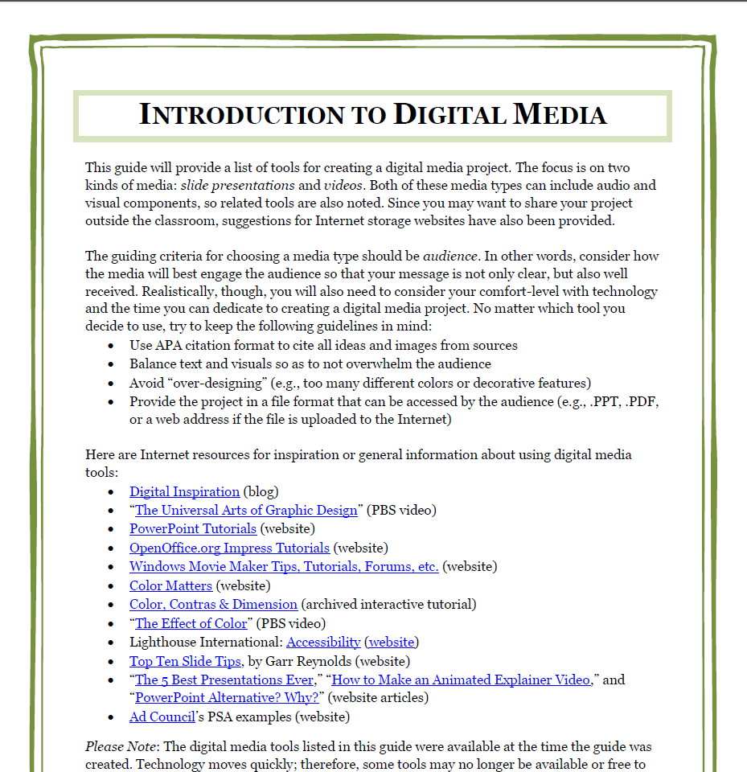
Resources in Doc Sharing
Introduction to Digital Media guide
KUWC resources on power point, Windows Movie Maker, podcasts and other digital media
Sample ppt and video in unit 8 discussion instructions

Slide 16
Animoto and Kizoa: Alternatives to PPT
Animoto “animates” slides and images and is very user-friendly
Kizoa allows more control over transitions and text movement
Both easy to share (Animoto has direct link or embed, Kizoa can be uploaded to YouTube)
Both have pre-approved music options
Limitation: 30 second video with free version of Animoto
Kizoa takes more practice to get the timings right
For more music, template, and image options, upgrades required
Notes:
Example by Drevon Stanford, CM 220 student
I decided to create a video using Animoto, I wanted visually show the opportunities people have for higher education.
The Link: http://animoto.com/play/rCc0Yo8FlKKchrgqHhVdSg
Go Animate video:
My technology presentation is an animated video explaining what SLS is and how it works. My video includes an example of what a music video could look like with added captioning. I unfortunately could not include a bouncing ball over each word in the video as it is being heard in the audio. The technology was not advanced enough to allow me to do that, or to do highlighted text. I did not attach references here, as the video itself contain a reference page and in text citations.
Here is the link to my video: http://goanimate.com/videos/0wm_fY4mfe2Y .
another option: Powtoon
http://www.powtoon.com/blog/best-free-presentation-software-and-powerpoint-alternative/

Slide 17
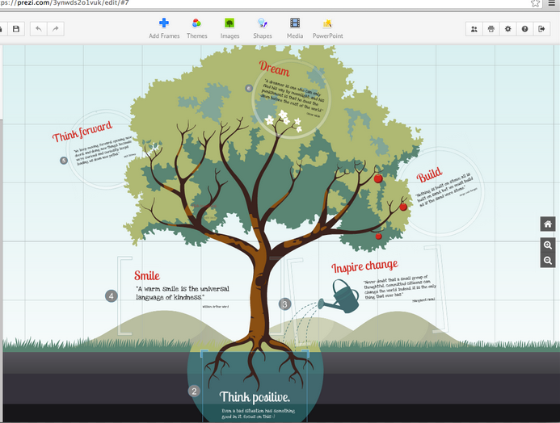
Prezi
Prezi creates a more dynamic “flow” and allows easy uploading of YouTube videos
Drawbacks:
No sound except for embedded videos
Spatial layout can be challenging
Benefits:
No time limitations
Embedded YouTube videos

Slide 18
Creating effective Power point Presentations
Unit 9

Slide 19
Content
Use a title and a references slide
Make sure the presentation has a clear beginning, middle, and end
Include a thesis as you would with an essay
Each slide should have one main idea
Use graphics to reinforce a point
Include citations for sources (in-text and references) and use sources appropriately
(Hood, 2012)

Slide 20
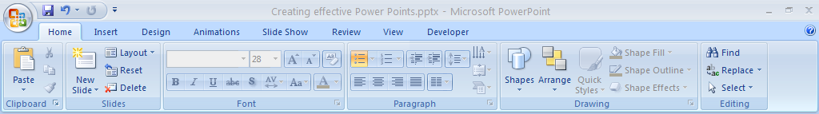
Where to Start
Choose slide layout (title, section header, title + content, contrast, image)
Add or delete slides
Choose font size, color, and style
Add shapes

Slide 21
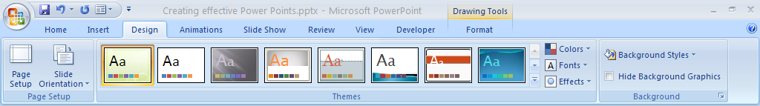
Selecting a Design
You can find additional templates online. Check Microsoft’s site for topic-appropriate templates.

Slide 22
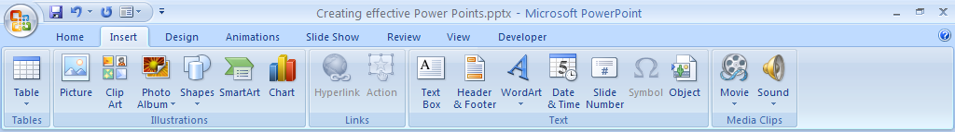
Insert Selections
Select “Insert” tab
Select item you wish to insert (Picture, clip art, charts)
For pictures, your computer’s “explore” screen will appear
Navigate to the selected file or picture and attach as you would a Word file to your drop box.
Notes:
Select “Insert” tab
Select item you wish to insert (Picture)
Your computer’s “explore” screen will appear
Navigate to the selected file or picture and attach as you would a Word file to your drop box.

Slide 23


Images from clip art file, Wordle word cloud
Notes:
www.wordle.net

Slide 24

“good design” strategies
Use high contrast for easy reading
Make font size large enough for audience to see (28 pt is best)
Choose readable font (Arial, Times New Roman)
Use larger font for titles and headings
Avoid all caps except for titles and headings
Use relevant headings
(Hood, 2012)

Slide 25
“Good design” strategies
Aim for 4-6 bullet points per slide
Use simple and parallel language
Stick with simple graphs and charts
Avoid distracting cartoony clip art
Keep animations and sounds to a minimum
(Hood, 2012)

Slide 26
Grammar tip: Parallelism
Make bullet points parallel in grammatical structure.
If your first item in the list is a noun phrase, make all items in the list a noun phrase.
You can read more about parallelism in The Kaplan Guide to Successful Writing (Boone, 2010, p. 260-261).

Slide 27
Example
My classes last semester were difficult for the following reasons:
Lengthy reading assignments
Numerous unannounced quizzes
Difficult final exams
Note: the list follows an adjective/noun structure.

Slide 28
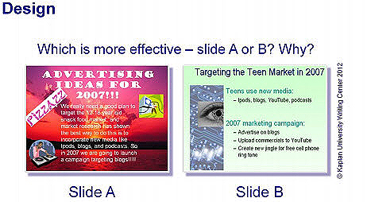
Which is more effective?

Slide 29
Choosing Visuals
Unit 9

Slide 30
Determine rhetorical situation of image
How is the image communicating ideas to others?
What are the subject and purpose of the image?
Who is the main audience for this image?
What is the context of the image (cultural, political, historical, etc.)?
(Sexton & Hammond, 2010)

Slide 31
What to look for. . .
Grounding
Color scheme
Medium
Topography (Sexton & Hammond, 2010)
Notes:
Grounding or the placement of images within a text. What is the most prominent element in
the composition? What is the last prominent element?
Color scheme, the colors the artist chooses
-Hues of blue may feel cool, tones of greens may
seem relaxing, while shades of red may indicate feelings of energy and warmth (Blair, 2004).
Medium, the materials the artist chooses. A painter may use watercolor on canvas, a sculptor
may choose copper, bronze, or iron, and a cartoonist may use lead pencils on paper.
Typography, the appearance of printed characters on a page or screen.

Slide 32
Questions to ask. . .
“Do the words function by themselves? How?
Do the images function by themselves? How?
Are the words dependent or anchored to the image to convey
meaning?
Or is the image dependent or anchored to the words to convey meaning?
Are the words and image interdependent in controlling the function?” (Crump & Versoza, 2008, p. 7)

Slide 33
Peer reviewing
Unit 9

Slide 34
Peer review in the real world
Journals use “peer review” to critique and select articles for publication
Architecture schools use “juries” of peers and instructors to critique projects and offer advice
Many jobs will ask groups of employees to work on a project, and typically, the collaboration will involve critique and revision

Slide 35

How Have I Been Using Peer Review in class?
Comments from classmates and friends about your project
Discussion board responses
Formal peer reviews in previous courses

Slide 36
Common Misconceptions and Concerns
“I’m not a great writer (or technically savvy), so how can I offer advice?”
“I’m scared about getting critiqued by someone else. What if she hates my paper?”
“How can a classmate give me good advice? I don’t care about what anyone but the teacher has to say since she is the one giving me the grade.”

Slide 37
Peer response guidelines for unit 9
What is the main message that you took away from the digital media presentation?
How well do the written text and visuals work together to create an argument?
How might the identified audience respond to the presentation’s text and visuals?
What were the strengths of the presentation?
What are at least two areas that need improvement?

Slide 38
Additional suggestions
Make sure your first response is to a classmate who has not yet gotten one
Review ch. 16 of The Kaplan Guide to Successful Writing for more on peer reviewing
Offer concrete suggestions for revising and improving the draft.
Do not focus on grammar, punctuation, spelling, or formatting concerns

Slide 39
Effective peer reviews should provide. . .
Accountability: Respect your classmate's efforts. Be honest but not harsh!
Assistance: Offer specific, thorough advice. Give suggestions about the thesis, organization of ideas, and strength of the overall argument as well as the visual appeal of the presentation. Avoid general statements and provide specific examples of what you might change or improve.
Audience awareness: Does the presentation take audience into consideration? Are there any ways your classmate could better address potential objections? (Grady & King, 2010)

Slide 40
Things to Avoid
Not helpful. . .why?
I really liked this presentation/paper.
I thought the images on your slides were great!
Some other examples would be helpful.
This is boring.

Slide 41
Helpful Feedback
Much better
While you have a lot of interesting information in your presentation, I’m unsure what the overall purpose of your presentation is. Maybe you could include a slide that covers your proposal for solving the problem you outline in the rest of the presentation.
You might include a statistic to let your audience know how big of a problem this is. I read this great article in the Washington Post this week that would give you some good numbers; here is the link. . .
I have had a really hard time creating parallel structure in my bullet points, too. I found this helpful website that you might review . . .

Slide 42
Responses should . . .
Be specific in your suggestions for improvement. For example, note difficulties in reading text on a slide and recommend how the author could make the slides more visually appealing.
Be constructive and note strengths as well as weaknesses in the presentation.
Be honest and sincere in your response. Remember that the more advice everyone provides in this week’s Invention Lab, the better the final projects can be!

Slide 43
Guidelines for Critique
Be tactful
Be specific
Don’t focus on grammar, usage, mechanics, or spelling
Highlight strengths
Note phrasing that needs clarification
Indicate how the presentation can be strengthened based on the assignment guidelines
Note any questions you still have about the author’s argument that the presentation is not answering

Slide 44

Critique this slide

Slide 45

Critique This slide

Slide 46

UNIT 10
There will be no seminar in Unit 10.
However, there will be discussion and a quiz.

Slide 47

Unit 10
DISCUSSION:
You will share your revised presentation in unit 10 DB and let everyone see what a great job you have done.
CONGRATULATIONS!

Slide 48
QUESTIONS?
***There are some wonderful EXTRAS after this slide, so please download this from DocSharing and review.

Slide 49
Some Sample Presentations
Unit 9

Slide 50
Sample Presentations
Source | Media Type | URL
Class sample | PPT/ Windows Movie Maker | https://www.youtube.com/watch?v=Y2OJH5tbr2k
Kim Hess | GoAnimate! | http://goanimate.com/videos/0wm_fY4mfe2Y
Evelyn Varela | Prezi | http://prezi.com/mw3q8yhtwv8j/?utm_campaign=share&utm_medium=copy
Steven Dennis | Website (Doodlebug) | http://doodlebug-soft.com/kaplan/Electricity/electricity-revised.html
Drevon Stanford | Animoto | http://animoto.com/play/rCc0Yo8FlKKchrgqHhVdSg

Slide 51
Citing visuals, videos, and music
Unit 9

Slide 52

Citing Guidelines
Cite copyrighted material
This includes photographs, graphs, charts, maps, music, and videos
Notes:
For more on citing graphics, including photos, charts, and graphs, see the KUWC resource Using Graphics and Visuals (included in this week’s reading).

Slide 53
Photographs
Artist's last name, artist’s initials. (Year). Title of work [Photograph]. Retrieved from URL or web address.
Tilcock, W. (2011). University of California, Davis [Photograph]. Retrieved from http://lightbox.time.com/2011/12/07/time-picks-the-top-10-photos-of-the-year/#5

Slide 54
Music Recording
Songwriter, W. W. (Date of copyright). Title of song [Recorded by artist if different from song writer]. On Title of album [Medium of recording]. Location: Label. (Recording date if different from copyright date).
Lovett, L. (1996). That’s right (you’re not from Texas). On The road to Ensenada. Nashville, TN: Curb Music Company.

Slide 55
YouTube Video
Poster last name, first initial. (Date). Name of video [Video file]. Retrieved from. . .
Anner, Z. (2010, June 13). Zach’s audition: Oprah’s search for the next tv star [Video file.] Retrieved from http://www.youtube.com/watch?v=OIBS6LeXnT4.

Slide 56
References
Boone, J. (2010). Grammar, mechanics, and spelling. In D. Martinea, S. Carlson, & K. VanDam (Eds.), The Kaplan guide to successful writing, p. 221-296. New York: Kaplan Publishing.
Grady, E. & King, D. (2010). Effective peer reviews. In The Kaplan Guide to Successful Writing, eds. D. Martinez, S. Carlson, & K. VanDam, p. 213-219. New York: Kaplan Publishing.]
Hood, R. (2012, July 10). Power point basics [Power point presentation]. Retrieved from https://kucampus.kaplan.edu/DocumentStore/Docs11/pdf/WC/KUWC_PowerPoint_Basics_RMHrevisedMPNotes3.pdf
Sexton, A. & Hammond, M. (2010). Visual and spatial rhetoric: Analyzing images. Retrieved from https://kucampus.kaplan.edu/DocumentStore/Docs11/pdf/WC/VisualRhetoricPrimer_final.pdf

