Slide 1
CM 220 Unit 4 Seminar
QUOTE FOR THE WEEK:
“Education is not the filling of a pail, but the lighting of a fire.” (William Butler Yeats)

Slide 2
Seminar 4 Agenda
Unit 3 Review
Preview Unit 4
Effective arguments
Toulmin Model
Fallacies

Slide 3
Unit 3 Review
Last week we:
Began working on our thesis statements
Addressed the components of an argumentative stance

Slide 4
Review
What claim will you be making?
Policy
Proposal
Causal
Ethical
Value

Slide 5
Unit 4 “To Do” list
To Do | Where to find | Points
Complete Learning Activities | Click on the “Learning Activities” icon
Complete reading quiz | Click on “quiz” under left navigation bar | 5
Attend live seminar or complete option 2 assignment | Click on the seminar icon | 10
Participate in discussion | Click on the “discussion”. | 40
Complete Assignment | Click on the “assignment” icon | 50

Slide 6
Unit 4 outcomes
After completing this unit, you should be able to:
Identify types of logical fallacies (types of logical fallacies).
Identify the steps in the Toulmin Model of an Argument.
Create a logical argument using the Toulmin Model.
Course outcome(s) practiced in this unit:
CM220-2 : Construct logical arguments.

Slide 7
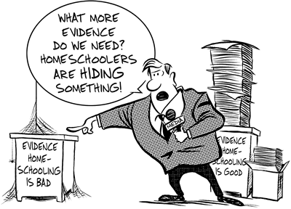
Unit 4 Learning Activities
Readings
Argument and Persuasion Writing
How to Support an Argument and Avoid Logical Fallacies
How to Avoid Hasty Generalizations and Other Logical Fallacies
Activities: Name that Logical Fallacy
Reading Quiz (5 points)

Slide 8
Unit 4 discussion
Select a TED Talks video to analyze. Note: If you can find a speech related to your topic, that is ideal, but if not, think about how you might use the argumentation style as a model for your own writing.
To find a video, go to the browse site: https://www.ted.com/talks/browse
Respond to the following questions in paragraph format:
Identify the claim, type of claim (a claim of policy, claim of value, claim of cause, ethical argument, proposal argument, etc.) , supporting evidence, and assumptions you think the speaker used in his or her argument.
Describe what aspects of the argument you felt were particularly strong or weak.
How will you use the Toulmin Model to strengthen an argument for change in your community or workplace?

Slide 9
Unit 4 assignment: (50 pts)
Assignment criteria
Format and source citations follow APA 6th edition style
First paragraph includes persuasive thesis statement, identifies type of claim, discusses why thesis is effective
Second paragraph describes use of logical appeals (logos, ethos, pathos)
Third paragraph evaluates thesis based on the Toulmin Model and considers how to avoid logical fallacies
Paragraphs are well-developed and cohesive
Paragraphs are written in Standard American English and style is appropriate for an academic audience

Slide 10
KUWC Resources
Live tutoring available 6 days a week, including Monday and Tuesday from 12 pm to 10 pm ET
Paper review service—allow 72 hours to receive feedback
Check out live workshop schedule for sessions on APA, thesis statements, and more

Slide 11
What makes an argument effective?
Unit 4

Slide 12
What is an ARGUMENT?
An argument is an issue that has at least TWO SIDES.
In order to present your side of the argument, you must know the various positions on your issue. If you don’t know the arguments for the other side, you leave yourself open to be blindsided by a counterargument you had not anticipated.
Notes:
Do a thesis review—reiterate need for statement, not ?, specific proposal, and if possible, reason why the solution is needed or how it will help resolve the problem:
More doctors should consider prescribing music therapy as a type of pain relief instead of immediately prescribing pharmaceutical pain medication. (Sonseeharay Tunis-Roberson)
Implementing a nutrition program in elementary schools will help decrease wasted cafeteria food and he lp promote healthy eating. (Julie Olson)
Should the US make domestic adoption free of charge to encourage adoptive parents complete the process, including the program foster to adopt. (Carlos Velasquez) –how to change from question to statement?
A disaster such as a house fire occurs more often than we are aware of; however, it is more common to have many displaced families question the services and efforts of the resources provided to them, especially since it can be a challenge to find affordable housing after experiencing this type of tragedy . (Janelle Dye)—how to make this more specific about how to solve the problem?

Slide 13
Purpose
What are your goals for writing the message?
What would you like to persuade your audience to do or to believe?
What is the most effective means of achieving your purpose?

Slide 14
Audience
Why is paying attention to your audience KEY to successful persuasion?
Who is the audience you would like to communicate to?
What do you know about them and what do you need to know about them?
What do you want to communicate to that audience?
How can you best communicate your information to that audience?

Slide 15
Discuss—Your experiences with argument
Think about a time when you took a stand to defend an idea against an unreceptive or defensive audience. It may have been at work, school, home, or in your community. It does not necessarily need to be a life-changing situation, but a situation that you needed to gather your thoughts and convey them in a compelling way, either through writing or spoken-word. With this situation in mind, respond to the following questions:
What idea or stance did you need to defend?
What were the characteristics of those opposing you?
How did you make your argument? Was the argument effective?
What did you learn from this experience?

Slide 16
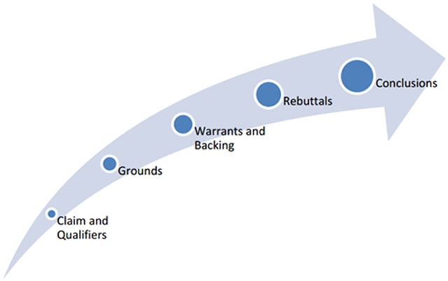
Toulmin Model
The Toulmin Model:
How to Support an Argument and Avoid Logical Fallacies
How to Avoid Hasty Generalizations and Other Logical Fallacies
Name That Logical Fallacy
Notes:
The Toulmin Model is also another common way to structure an argument. This method has seven parts to it (“Argument,” 2011):
Claim: In the simplest terms, a claim is your thesis phrased as an argumentative statement. A claim is often one sentence long and is phrased as an arguable judgment. The claim will need to be proven and supported throughout your essay, but is simply an assertion at this point in the argumentative paper (“Argument,” 2011).
Qualifiers: Qualifiers are conditional terms such as “sometimes” or “often,” and focus your argument and prevent it from becoming too grandiose or absolute. For instance, an effective argument would likely not state: “All men wear blue.” To qualify this statement, the arguer would likely write, “Some men wear blue.” This assertion is far more reasonable when cushioned with a qualifier (“Argument,” 2011).
Grounds: The evidence you use to support your claim. Grounds could include data sets, definitions, examples, and outside information that bolsters your claim (“Argument,” 2011).
Warrant: Warrant is a term that is synonymous with assumption. Warrants in the Toulmin Model are the assumptions you, the writer, implicitly (unspoken or not clearly stated) or explicitly (spoken or written) hold about how you use evidence, or the grounds, to support your claim (“Argument,” 2011).
Backing: Your explanation of why you hold certain assumptions as the writer. If your assumptions are held by the audience you’re addressing, then you may not include your rationale for why your warrants, or assumptions, hold true (“Argument,” 2011).
Rebuttals: Rebuttals investigate and anticipate key weaknesses from your opponent (or opposing viewpoints). Rebuttals are pre-emptive since you, as the writer, consider how your opponents might respond to your claim before they do and then explain how their objections or interpretations are unfounded or incorrect (“Argument,” 2011).
Conclusions: Do not simply restate your claim and rehash or summarize your points in the conclusion. Instead, in addition to a brief summary, explain why your rationale plus your evidence and rebuttals create a compelling case for the audience, your readers, to accept your argument.

Slide 17
The toulmin model
Claim: the position or claim being argued for; the conclusion of the argument.
Grounds: reasons or supporting evidence that bolster the claim.
Warrant: the principle, provision or chain of reasoning that connects the grounds/reason to the claim.

Slide 18
The toulmin model
Backing: support, justification, reasons to back up the warrant.
Rebuttal/Reservation: exceptions to the claim; description and rebuttal of counter-examples and counter-arguments.
Qualification: specification of limits to claim, warrant and backing. The degree of conditionality asserted.

Slide 19
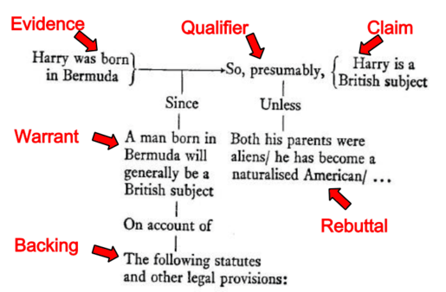
The Toulmin Model: Example

Slide 20
Examining an argument
The United States should abolish capital punishment because it does not reduce the crime rate.
Conclusion/Claim: The United States should abolish capital punishment.
Assumption/Warrant (may not be directly stated): If something does not reduce the crime rate, then it should not be used.
Evidence: Capital punishment does not reduce the crime rate.

Slide 21
Logical fallacies
Unit 4

Slide 22

What is a DECEPTIVE ARGUMENT?
Deceptive arguments may mislead you, causing you to believe the wrong information.
Because deceptive arguments often confuse and distract people, they may take attention from important issues. Deceptive arguments are often more emotionally charged, gaining bigger headlines.

Slide 23
Recognizing and Avoiding Deceptive Arguments
When researching, you need to read the information carefully and to apply your best critical thinking skills to what the author is saying.
Analyze and find the “holes” in the arguments that you are reading. Decide which arguments are valid and which are not.
With practice, you will become better at detecting deceptive arguments.

Slide 24
“Non Sequitur” Fallacy: when the conclusion does not follow from the premises
Description: In more informal reasoning, it can be when what is presented as evidence or reason is irrelevant or adds very little support to the conclusion.
Logical Form: Claim A is made. Evidence is presented for Claim A. Therefore, claim C is true.
Example #1:
People generally like to walk on the beach. Beaches have sand. Therefore, having sand floors in homes would be a great idea!
(This information taken directly from http://www.logicallyfallacious.com/index.php/logical-fallacies/137-non-sequitur )

Slide 25
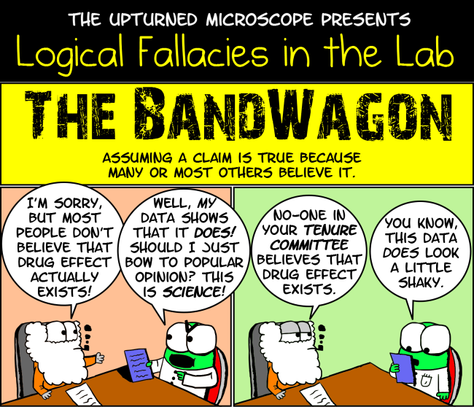
Bandwagon Fallacy: assuming a claim is true because others believe it.

Slide 26
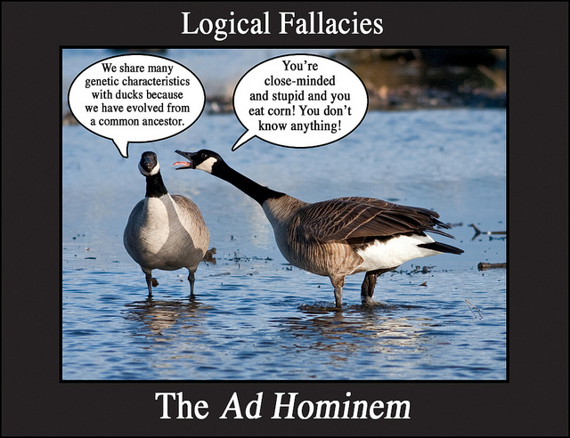
Ad hominem Fallacy: Attacking the character of a person
Notes:
Definition: an attack on the character of a person rather than her/his opinions or arguments

Slide 27
Some other common fallacies
Post hoc ergo propter hoc: assumes that if 'A' occurred after 'B' then 'B' must have caused 'A.'
Appeal to Authority: If X says so, it must be so.
Either/Or Simplification: The arguer suggests here that only two options exist: one can support the petition or one can reject it and suffer the consequences.
Hasty Generalization: Drawing a conclusion on insufficient evidence.

Slide 28
Some other common fallacies
Begging the Question: accept this conclusion without evidence (also may present an argument where the premise and conclusion are the same)
False Analogy: Comparing two things without offering any proof that they share a connection
Slippery Slope: If A happens, then B will occur

Slide 29

Review: Types of Claims
Policy
Value
Cause
Ethical
Proposal

Slide 30
REVIEW TYPES OF APPEALS: Logos, ethos, pathos

Slide 31
LOGOS
Logos is “an approach to argument that appeals to the reader’s sense of logic” (Clements, “Three Appeals,” 2013).
This appeal would use the following:
Statistics
Facts
Examples
Expert testimony (Clements, “Three Appeals,” 2013)

Slide 32
Ethos
An ethos appeal “attempts to show the writer as a fair-minded, concerned, and reliable individual. It’s the reader’s sense of the writer as trustworthy and credible that makes what he/she says convincing” (Clements, “Three Appeals,” 2013).
An ethos appeal would use the following:
Reasonable tone
Fair consideration of opposing arguments
Credible evidence
Word choice that is not offensive

Slide 33
Assessing credibility of Author
Is the author or sponsoring organization credible?
Is the author trying to sell a product?
Where/how is the author disseminating the information (a personal blog, etc.)?
Does the author show bias?
Is the evidence (facts, statistics, etc.) that the author uses credible? You can go to FactCheck.org to read credible information on this topic.
(KUWC, “Conducting Research,” 2014).

Slide 34
Pathos
Pathos is used to appeal “to the audience’s emotions. The idea is to stir up the feelings of readers as a way to gain their support for what the writer claims to be true about a subject” (Clements, “Three Appeals,” 2013).
A pathos appeal might use the following:
Emotional examples
Vivid, sensory details
Imagery and analogies

Slide 35
QUESTIONS?

Slide 36
REferences
Clements, K. (2011, March). How to support an argument and avoid logical fallacies. Retrieved from https://kucampus.kaplan.edu/DocumentStore/Docs11/pdf/WC/HowToSupportAnArgumentEditV2Jan25MP.pdf
Clements, K. (2013, September 6). The three appeals of argumentative writing [Podcast]. Effective Writing Podcast Series. Retrieved from http://www.screencast.com/t/8gyyeFs27
Kaplan University Writing Center. (2014). Conducting research. Retrieved from https://kucampus.kaplan.edu/MyStudies/AcademicSupportCenter/WritingCenter/WritingReferenceLibrary/ResearchCitationAndPlagiarism/ConductingResearch.aspx

