Slide 1
Resilience
Creating growth and finding meaning out of trauma and suffering
Holly Baker
PSY/225
August 1, 2017
Claire Clifford

Slide 2
introduction
This is a mock case study.
The client, who will be referred to as Hanna, is a survivor of a traumatic event. The following presentation is designed to demonstrate how Hanna overcame her harrowing experience and is now triumphantly exhibiting resilience as well as overall wellbeing.

Slide 3
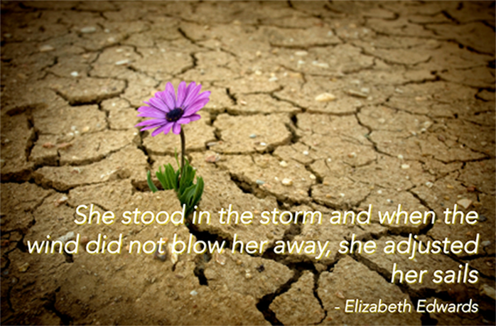
what is resilience?
“Resilience refers to humans’ amazing ability to bounce back and even thrive in the face of serious life challenges” (Baumgardener & Crothers, 2009, p. 57).
Clinically speaking, “The concept of resilience highlights the strength of the individual and his or her coping resources” (Baumgardener & Crothers, 2009, p. 60).
Baumgardener & Crothers (2009) further defines resilience by citing “Ann Masten definition of resilience as “a class of phenomenon characterized by good outcomes in spite of serious threats to adaptation or development” (p. 58).

Slide 4
what happened to Hanna?
Hanna was physically assaulted by her sister on Father’s Day due to a text message she ironically sent to her niece’s new husband’s step daughter on Mother’s Day.

Slide 5
Hanna’s realization
interpretation of the event how the client understood the event

Slide 6
How Hanna triumphed
how the client overcame the event

Slide 7
meaning-making

Slide 8
sense-making

Slide 9
benefit-finding

Slide 10
post-traumatic growth

Slide 11
protecting wellbeing

Slide 12
In conclusion

Slide 13
references
Baumgardener, S. R. & Crothers, M. K. (2009). Positive Psychology. Upper Saddle River, NJ: Prentice Hall

Slide 14
references
The Congruence Framework . (2012). Retrieved from http://www.congruenceframework.com/building-resilient-organisations-aligning-individual-and-organisational-bounce/

