Slide 1
Leadership & Surviving A Financial Crisis
Richard Fuld & Kenneth Chenault
BUS 101 Portfolio Project Option 2
Jane Doe
Notes:
Tips: This slide should contain identifying information about the PowerPoint including title, course and assignment option, and student name. PowerPoint is meant to summarize your key points and allow the presentation to highlight the manner in which the information will be presented to your audience.

Slide 2
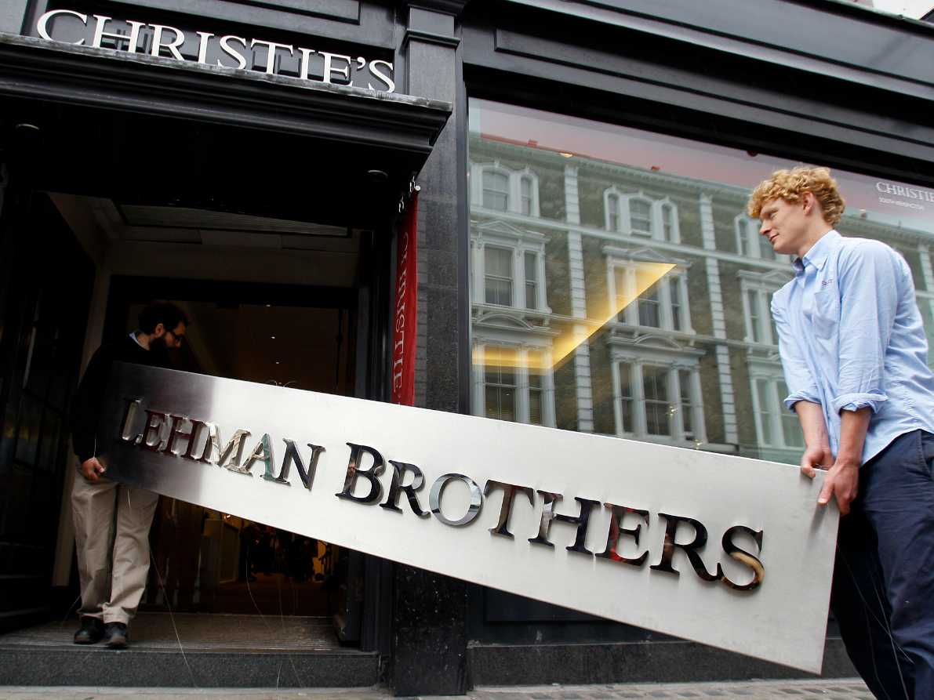
Chronology & Analysis
If you include an image from the Internet, make sure you include the source information. You do not need to include source information if you use free clip art.
Lehman Brothers History
History
Leadership (Fuld)
American Express
History
Leadership (Chenault)
Comparison & Advice
Source: http://blog.gbmhomebroker.com/topic/news
Notes:
Tips: This slide should introduce the audience to the structure of the presentation. Consider it to be a short outline. Speaker notes should expand on the content you deliver on the PowerPoint. The speaker notes in this slide may be a good place to include a focus or thesis statement.
For example:
This presentation will outline the history and leadership methods for coping with a major financial crisis. We will investigate Lehman Brothers and Richard Fuld as well as American Express and Ken Chenault. A comparison of their leadership styles during the 2008 financial crisis will reveal a key set of skills needed to navigate difficult business-related circumstances.

Slide 3
Lehman Brothers History
1850’s: Founded as a grocery business by brothers Henry, Emanuel, and Mayer Lehman
1858: Moved to New York City
1877: Joined the New York Stock Exchange
Early 20th Century: Pioneered the private placement financing method for highly regulated loans between key investors to help companies survive the Great Depression
1984: Purchased by American Express
1994: Arranged a new Lehman Brothers spin off company under the direction of Fuld and Gregory (“Lehman Brothers”, 2012)
If the entire page is summarized from one source, put the in-text citation at the bottom of the slide.
Notes:
Tips: Speaker notes should expand on the content you deliver on the PowerPoint. Be sure to include in-text citations where appropriate.
For example:
Although the Lehman Brothers founded a grocery business in 1850’s Alabama, the scope of their endeavor soon widened to include not only merchandising but also commodities. Cotton was the first trade focus since the cotton industry still led the southern United States economy. Soon, the company opened a an office in New York City; and after the Civil War, this New York branch became the center of company operations. During this time, Lehman Brothers was key in helping to create the New York Cotton Exchange and expanded into trading securities as well.
The firm continued to grow in the 20th century, supporting successful industries such as entertainment and communications; pioneering a private placement financing method for highly regulated loans between key investors, and developed a talent for picking out key markets such as oil and computer technology.
In 1984, Lehman Brothers was purchased by American Express and merged with the retail brokerage firm Shearson. At that time, Lehman Brothers served Shearson with Wall Street negotiation and risk tactics. A new generation of traders at Lehman, including Richard Fuld pushed Lehman to become independent once again. As a result, Lehman Brothers became independent once more in 1994. (“Lehman Brothers”, 2012)

Slide 4
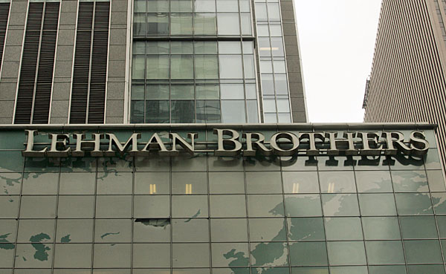
Lehman Brothers Recent History
Lehman Brothers became a global financial services firm which participated in:
investment banking
equity and fixed-income sales
research and trading
investment management
private equity
private banking
Source: http://www.businessweek.com/careers/managementiq/archives/2008/09/kill.html
Lehman Brothers grew to be the fourth-largest investment bank in the United States.
(BBC News, 2008)
Notes:
Tips: Speaker notes should expand on the content you deliver on the PowerPoint. Be sure to include in-text citations where appropriate.
For example:
After its 1994 independence, Lehman Brothers eventually participated in a number of activities including investment banking; equity and fixed-income sales; research and trading; investment management; private equity; and private banking. Lehman Brothers operated at a wholesale level, dealing with governments, companies, and other financial institutions. At the firm’s peak, it employed approximately 25,000 people worldwide and was known for heavily investing in securities linked to the U.S. Mortgage market (BBC News, 2008).

Slide 5
Lehman’s Track Record
Economic Crises Survival
Railroad Bankruptcies of the 1800s
Great Depression in the 1930s
Long-Term Capital Management Collapse of 1990s
As of 2008: No quarterly loss reported
Sept. 15, 2008: Chapter 11 petition with U.S. Bankruptcy Court in Manhattan (Sheern, 2008)
Notes:
Tips: Speaker notes should expand on the content you deliver on the PowerPoint. Be sure to include in-text citations where appropriate.
For example:
Lehman Brothers had a successful track record. The firm had survived many of our nation’s economic crises, like the railroad bankruptcies of the 1800s, the Great Depression in the 1930s, and the collapse of Long-Term Capital Management in the 1990s. Prior to June of 2008, Lehman Brothers had not reported a quarterly loss even once.
The collapse of the giant investment bank came as a major shock for the entire world markets that plunged after Lehman filed a Chapter 11 petition with U.S. Bankruptcy Court in Manhattan. This made it one of the largest bankruptcies resulting from the housing market crash, sending ripples of concern throughout the investment industry. About US$46 billion in market worth had vanished. Creditors were expected to recover about 20 cents on the dollar and among the lawsuits filed against the firm. As the bankruptcy dragged on, examiners and analysts found further problems with Lehman actions. (Sheern, 2008).

Slide 6

What Went Wrong?
Credit crisis and real estate prices
$60 billion loss in bad real estate loans forced the bank to file for bankruptcy (Sheern, 2008)
Leadership pride and greed
You do not need to include source information if you use free clip art.
Notes:
Tips: Speaker notes should expand on the content you deliver on the PowerPoint. Be sure to include in-text citations where appropriate. Notice how this slide helps to transition the audience from the idea of Lehman Brothers history to what went wrong. It also helps transition the audience to begin to think about leadership.
For example:
A number of factors contributed to the collapse of Lehman Brothers. The firm was hit by a large dose of bad luck, pride, arrogance, and greed.
In general, Lehman Brothers was strangled by a massive credit crisis and fast plummeting real estate prices. Additionally, a $60 billion loss in bad real estate loans forced the bank to file for bankruptcy (Sheern, 2008).
Those problems aside, it can be argued that leadership, primarily, the pride and greed of its chief executive officer Richard Fuld, also contributed to the collapse. The next slides will examine this notion in more detail.

Slide 7
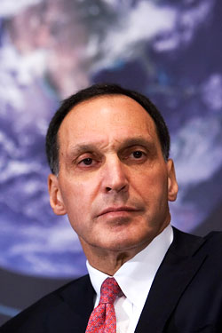
CEO Richard Fuld
If the information on your slide is from various sources you need to cite each bullet with source.
Fuld’s Lehman transformation (Halpern, 2005)
Ignored telltale signs
Rejected bids to save Lehman Brothers
Known for intimidating presence and tough talk (Sheern, 2008)
Source: http://nymag.com/daily/intelligencer/2008/06/lehman_ceo_richard_fulds_posit.html
Notes:
Tips: Speaker notes should expand on the content you deliver on the PowerPoint. Be sure to include in-text citations where appropriate.
For example:
Richard Fuld began his career at the firm in 1969—at the end of an era, when the last members of the Lehman family ceased working at the firm. Over a 30-year career Fuld helped transform Lehman from a bond house into a major investment banker. Fuld was quite successful in his role at Lehman Brothers until the company suddenly filed for bankruptcy.
The 62-year-old CEO did not take the telltale signs of impending doom very seriously. For example, he rejected many bids to save Lehman because he thought his bank was worth more than Wall Street gave it credit for. He was even nick-named “The Gorilla” for his foul temper, intimidating presence and tough talk. (Sheern, 2008)

Slide 8
"Income inequality, I know you don’t want to hear this from me but the wealthy are getting wealthier. And again the belly of America is getting hurt.”(Rediff Business, 2009, p. 2, para. 4).
If you quote, don’t forget to include the paragraph or page number of where you found the quote.
Notes:
Tips: Speaker notes should expand on the content you deliver on the PowerPoint. Be sure to include in-text citations where appropriate. Use full quotes sparingly.
For example:
On October 6, the Committee on Oversight and Government Reform held a hearing to hear the testimony of Lehman Brothers CEO Richard Fuld. The major focus of the discussion was CEO compensation, which many claimed to be lavish and unfair. Fuld faced angry questioning from the committee members. From the years 1993 to 2007, Fuld is reported to have received nearly half a billion dollars in total compensation. In 2007, Fuld was reported to have been paid a total of $5,000,000, which included a base salary of $750,000 and a cash bonus of $4,250,000. When questioned, Fuld was recorded saying, "Income inequality, I know you don’t want to hear this from me but the wealthy are getting wealthier. And again the belly of America is getting hurt.”(Rediff Business, 2009, p. 2, para. 4).
As a result, CNN named Fuld as one of the "Ten Most Wanted: Culprits of the Collapse" of the 2008 financial collapse in the United States Mr. Fuld has been accused of doing too little too late to save the firm (Rediff Business, 2009).

Slide 9
Leadership Analysis
Internal biases that lead to poor decision making:
Inappropriate prejudgments
Inappropriate experience
Self interest
Attachments (Boyle, 2008)
Notes:
Tips: Speaker notes should expand on the content you deliver on the PowerPoint. Be sure to include in-text citations where appropriate.
For example:
Boyle (2008) cites four internal biases that lead to poor decision making. They include: inappropriate prejudgments; inappropriate experience (for example, what worked before will work again); self-interest; and attachments.
In this case, Fuld was arrogant and refused to heed the warning signs that bad business decisions lead to larger problems. Fuld needed to take this opportunity to make hard changes to the business and resisting risks would have been supremely beneficial in this case.

Slide 10

A Different Leadership Model
Humility
Company interest
Risk evaluation
Salary sacrifice
Notes:
Tips: Speaker notes should expand on the content you deliver on the PowerPoint. Be sure to include in-text citations where appropriate.
For example:
Lehman Brothers may not have experienced the severity of problems it did if I different leader had been in place leading up to and at the time of the collapse. A leader who would be able to set aside pride and personal interest may have been able to steer Lehman Brothers in a different direction.
For example, the firm needed a leader who could set aside his own pride for the sake of the company. A leader who evaluated risks and made well-thought-out decisions could have saved the company from collapse. Furthermore, Fuld was criticized time and time again for his lack of willingness to take a pay cut when times got bad. A different leader may have weighed risks and company interest differently than Fuld in order to put Lehman Brothers into a better situation.
Next, we’ll take a look at a leader who demonstrated those types of qualities.

Slide 11
American Express History
1850: Founded as an express shipment company for packages
Late 19th Century: offered money orders and traveler’s checks
1958: Released first charge card
1984: Purchased Lehman Brothers
1994: Separated from the Lehman Brothers merger (“American Express”, 2013; “Lehman Brothers”, 2012)
Notes:
Tips: Speaker notes should expand on the content you deliver on the PowerPoint. Be sure to include in-text citations where appropriate.
For example:
American Express was an express mail company founded in 1850 in Buffalo, New York, as a joint venture between the express mail companies Wells & Company, Livingston, Fargo & Company, and Wells, Butterfield & Company. Even though American Express was not a financial company in the beginning, most of its clients were banks. In 1882 American Express ventured into the financial world by introducing the first money order system. The company furthered its venture in 1891, when it introduced the world's first traveler's check. American Express issued its first charge card in 1958. By 1963 the company had over 1 million cardholders and over 85,000 establishments that accepted them. In 1994, Lehman Brothers separated from American Express.

Slide 12
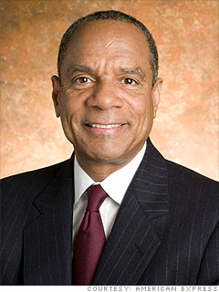
CEO Ken Chenault
Chenault’s AE Transformation
Decisions after 9/11
Development of the Blue card
(“American Express”, 2013)
Source: http://money.cnn.com/galleries/2009/news/0904/gallery.biggest_ceo_paychecks/4.html
Notes:
Tips: Speaker notes should expand on the content you deliver on the PowerPoint. Be sure to include in-text citations where appropriate.
For example:
Ken Chenault began his career at American Express in 1981 and progressed through several different departments before becoming CEO in 2001. Gradually transforming AMEX from an uncompetitive, obsolete company into a booming business. The level of interest in the Membership Rewards program surprised even Chenault. Quests for airline miles generated a surge in AMEX charges, and the program helped AMEX woo new merchants as well: the number accepting the card grew from 3.6 million in 1993 to more than 7.2 million worldwide in 1999. Under Chenault, American Express has maintained the highest market capitalization of all global financial services firms/
Chenault made countless decisions that would ease the impact of the attacks on both cardholders and employees. To help the cardholders, millions of dollars in late fees were forgiven, and credit limits were increased. He also pushed hard for the development of the Blue card, a trendy, fashionable card with a microchip allowing cardholders to make secure transactions online. The card appealed to the much-coveted younger demographic (“American Express”, 2013).
Chenault’s success are evident in his statements as well as his values, personalities, and decision making abilities.

Slide 13
Leadership Analysis
Values (integrity, courage, positive communication, and a sense-of-self)
Personality (team player, adaptability, and personal development)
Decision-making ability (execution, compassion, and reflection) (Chester, 2005)
Notes:
Tips: Speaker notes should expand on the content you deliver on the PowerPoint. Be sure to include in-text citations where appropriate.
For example:
According to Chester (2005), integrity, courage, positive communication and a sense of self are Chenault’s values. Chenault believes that integrity means a lot more than just being honest. Integrity embodies consistency in words and actions. Courage: A leader must speak out and challenge others. Chenault likes to surround himself with people who are willing to question the status quo. Positive Communication: Chenault believes a leader clearly defines reality and gives hope. Chenault urges leaders to realize that we must know who we are and what we stand for. “If you don’t have strong values and a sense of self,” he insisted, “you will fall off a cliff later in your career” (para. 6). (Chester, 2005.)
Personality plays a big part of Chenault’s success as well. Chenault believes leaders must not only be personable people who work well with others, but must learn to give cutting, honest feedback. A leader must know how to respectfully and productively engage in confrontation. Chenault emphasizes the vital importance of remaining flexible and adaptable, particularly in the current economical climate. A leader’s success is judged by the success of his or her followers. A leader is one who has not only mastered his or her own personal attributes, but is able to assist others in their own self-development (Chester, 2005).
Decision-making ability also distinguished Chenault as a leader. Chenault believes intelligence is not the same as the ability to execute. It is easy to conceive strategic concepts, but the ability to execute differentiates a leader from others. Chenault understands that in volatile times, leaders are closely scrutinized. A leader must have clear direction and must not lose his or her composure, yet must also be compassionate. When American Express was going through a difficult financial crisis, Chenault opted not to take any bonus. Reflecting on his own career, Chenault suggests to other leaders to focus on the task at hand and to do it thoroughly and excel. Then, hone in on one small element of a job, organization, or process, and strive to transform it (Chester, 2005).

Slide 14
Why was Chenault Successful?
"Today's business climate reflects unprecedented levels of uncertainty and change. Business models have to change every three to four years and leaders must have a long-term perspective that focuses on structural flexibility and adaptation, rather than the preoccupation with meeting quarterly financial benchmarks,” (Chester, 2005, para. 2)
Notes:
Tips: Speaker notes should expand on the content you deliver on the PowerPoint. Be sure to include in-text citations where appropriate. Use full quotes sparingly.
For example:
When asked why Chenault was successful in leading his company thought a financial collapse, he responded with the quote here.

Slide 15
Fuld vs. Chenault
Fuld
Chenault
More focused on meeting quarterly financial benchmarks than the big picture.
Kept doing the same things, refused to change his business model.
Continued to gamble on unsupported securities and loans.
Turned away potential buyers because of pride.
Took a bonus of $4,250,000 in 2008.
Did too little too late to save the organization.
Had a long-term perspective that focuses on structural flexibility and adaptation.
Was willing to challenge the status quo.
Focused and decisive during good times and bad.
Focused on staying profitable, cutting costs and selectively investing in growth.
Declined to take any bonus in 2008.
Believed in being ahead of the curve and making changes even when things seem good.
Notes:
Tips: Speaker notes should expand on the content you deliver on the PowerPoint. In this example, the student, not external resources, is making the comparison between these two leaders.
For example:
On this slide you will see a comparison of Fuld and Chenault’s handling of the economic crisis in 2008. Overall, Chenault demonstrated the values, personality, and decision-making abilities that proved to be beneficial to a crisis situation.

Slide 16
Conclusion
In the end, Chenault demonstrated better leadership skills than Fuld when leading his company through crisis.
Saved American Express during hard financial times.
Viewed with respect from a number of his colleagues and general population.
Appears to have a strategy to face a current challenge of new mandates on credit cards.
Will make the necessary changes to his organization and come out stronger than before.
Notes:
Lehman Brothers and American Express have fairly similar histories. They are both U.S. companies that started around the same time, experienced some financial successes, and dealt with serious hardships. The factor, at least in recent history, which has set the two companies apart is their leadership. While Fuld refused to heed the warning signs that bad business decisions lead to larger problems at Lehman, Chenault worked to keep American Express flexible and adaptable in a volatile economic climate. While many Americans were appalled at Fuld’s actions and statements justifying his actions, Chenault demonstrated compassion and reflected on how he could maintain the best interest of his company.
The 2008 financial crisis may not be Chenault’s last challenge. But, it appears he has a leadership strategy to cope with ongoing changes and challenges at American Express.

Slide 17
References
“American Express”. (2013). In Encyclopedia of Global Brands (2nd ed., Vol. 1, pp. 37-41). Detroit: St. James Press.
BBC News. (2008). Q & A: Lehman Brothers bank collapse. Retrieved from http://news.bbc.co.uk/2/hi/7615974.stm
Chester, A. (2005). Kenneth Chenault, AMEX CEO, Speaks on leadership. Retrieved from http://media.www.whartonjournal.com/2.10095/kenneth-chenault-amex-ceo-speaks-on-leadership- 1.1455143
Halpern, Tim. "Fuld, Richard S. Jr. 1946–." International Directory of Business Biographies. Ed. Neil Schlager. Vol. 2. Detroit: St. James Press, 2005. 88-91.
“Lehman Brothers: Fall of an investment titan”. (2012). In M. H. Ferrara & M. P. LaMeau (Eds.), Corporate Disasters (pp. 180-183). Detroit: Gale.
Rediff Business. (2009, May 14). World's 20 worst CEOs. Retrieved from http://business.rediff.com/slideshow/2009/may/14/slide-show-1-worlds-20-worst-ceos.htm
Sheern, T. (2008). What went wrong with Lehman Brothers. Retrieved from http://www.millionface.com/1/what-went-wrong-with-lehman-brothers/
References should appear in alphabetical order and formatted correctly. Traditional hanging indents, spacing do not have to be followed.

