Slide 1
Chapter 18
Using Research in Evidence-Based Nursing Practice

Slide 2
Research Utilization Versus
Evidence-Based Practice
Research utilization (RU)
The use of study findings in a practical application unrelated to the original research
Evidence-based practice (EBP)
Basing clinical decisions on best possible evidence—especially high-quality research

Slide 3
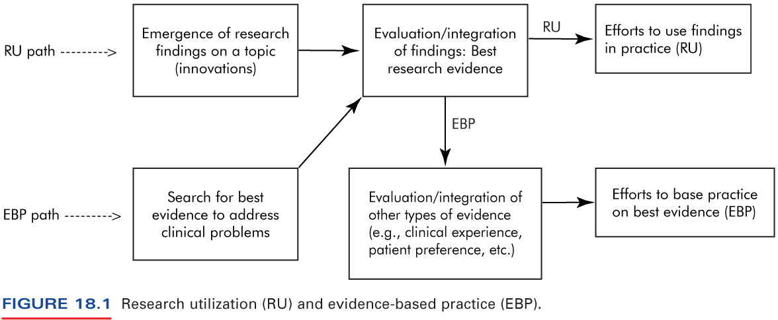
Figure 18-1
Schema of How RU and EBP Are Interrelated

Slide 4
Types of Research Utilization
Instrumental (direct) utilization
Conceptual (indirect) utilization
Persuasive utilization

Slide 5
Stages of Adoption of an Innovation
Awareness
Persuasion
Occasional use
Regular use

Slide 6
Key Proponents of the Evidence-based Practice Movement
Archie Cochrane
  Efforts led to development of Cochrane Center in Oxford and the Cochrane Collaboration
  Proposed an evidence hierarchy for weighing evidence
David Sackett
  EBP pioneer at McMaster Medical School

Slide 7
Six-Level Evidence Hierarchy (Stetler)
Levels of evidence (from strongest to weakest):
Meta-analyses of controlled studies
Individual experimental studies
Quasi-experimental studies
Nonexperimental studies
Program evaluations, RU studies, quality improvement projects, case reports
Opinions of respected authorities and expert committees

Slide 8
Barriers to RU and EBP in Nursing
Research-related barriers
Nurse-related barriers
Organizational barriers
Barriers related to the nursing profession

Slide 9
Strategies for Nurses to Play a Role in RU/EBP
Read widely and critically
Attend professional conferences
Learn to expect evidence indicating that a procedure is effective
Become involved in a journal club
Pursue and participate in RU/EBP projects

Slide 10
Three Models for Evidence-Based Nursing Practice
The Stetler Model of research utilization to promote evidence-based practice
The IOWA Model of evidence-based practice to promote quality care
The Ottawa Model of Research Use (OMRU)

Slide 11
Major Activities/Steps in Using Research in Nursing Practice
Select a topic or problem
  Knowledge-focused triggers
  Problem-focused triggers
Assemble and evaluate evidence
  Use integrative reviews
  Search for other evidence
  Evaluate evidence

Slide 12
Major Activities/Steps in Using Research in Nursing Practice (cont’d)
Assess implementation potential
  Assess transferability of innovation
  Evaluate feasibility of adopting innovation in new setting
  Assess costs and benefits of innovation
Develop, implement, and evaluate the innovation

Slide 13
Research Integration and Synthesis
Forms of integrative reviews:
  Narrative, qualitative integration (traditional review of quantitative or qualitative results)
  Meta-analysis (statistical integration of results)
  Meta-synthesis (theoretical integration of qualitative findings)

Slide 14
Steps in Conducting an Integrative Review
Define research problem or hypotheses to be tested
Select sample of studies to be included in the review
Extract and record data from research reports

Slide 15
Steps in Conducting an Integrative Review (continued)
Determine quality of the evidence (e.g., quality ratings to weight findings)
Analyze the data (i.e., cumulative findings)
  In meta-analysis, calculate an effect size
Write up integrative review

