Slide 1
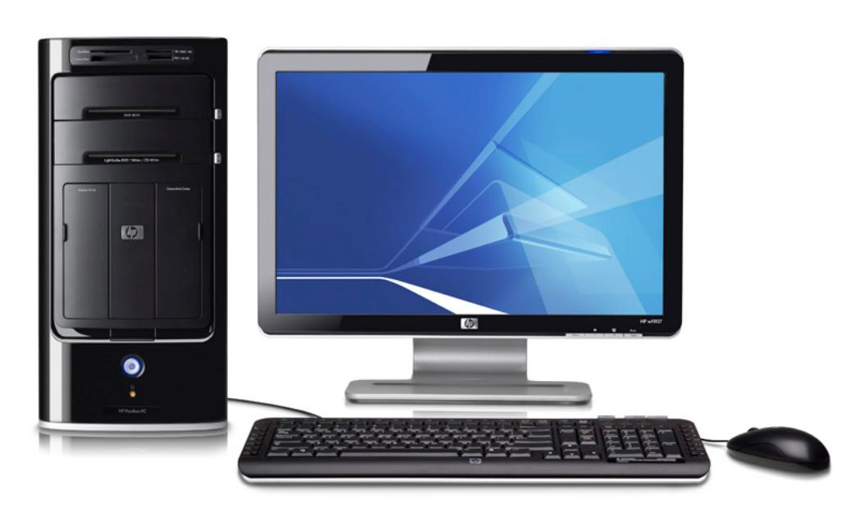
Creative Genius
Usability Review of
www.umuc.edu
David Johnson
CMST 290: Introduction to Interactive Design
Project 3 – Fall 2016

Slide 2
Critical Goal
The critical goal of _____________ is to ____________.

Slide 3
Usability Issue #1
ITEM A: Usability Issue
ITEM B: Severity Rating
ITEM C: Rationale
ITEM D: Recommendation

Slide 4
Usability Issue #2
ITEM A: Usability Issue
ITEM B: Severity Rating
ITEM C: Rationale
ITEM D: Recommendation

Slide 5
Usability Issue #3
ITEM A: Usability Issue
ITEM B: Severity Rating
ITEM C: Rationale
ITEM D: Recommendation

Slide 6
Usability Issue #4
ITEM A: Usability Issue
ITEM B: Severity Rating
ITEM C: Rationale
ITEM D: Recommendation

Slide 7
Summary
_________________________________________________
_________________________________________________
_________________________________________________
_________________________________________________
_________________________________________________
_________________________________________________

Slide 8
Questions

Slide 9
References
____________________________________________________
____________________________________________________
____________________________________________________
____________________________________________________

Slide 10
Project Reflection
Did I face challenges completing this project?

