Slide 1
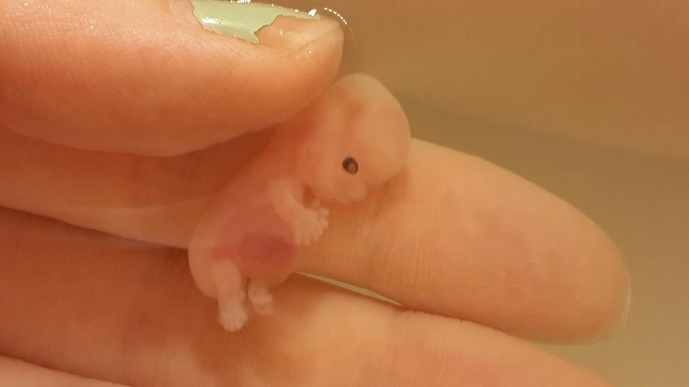
CASES FOUR
ABORTION
By (NAME)
September, 2016

Slide 2
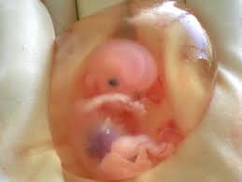
Case summary
A young girl who is 16 years old come from a respectful Christian family. Her father is a well-known reverent in the community together with her mother. Both parents kept on instilling good values and behavior to their daughter. They condemned abortion especially during their preaching in church. The parents tried as much as possible to preserve the image of their family name. One day the girl was sent to the shop in the evening, on her way some men grabbed her and raped her instantly, she was devastated. Some Good Samaritan’s help her to her home. When she was taken to the hospital she was discovered that she was pregnant. Both the parents and the girl did not want to ruin the reputation of the family’s name, so they asked for an abortion to be done on the girl. Since the pregnancy was entirely unintentional the doctor explained to them that they conduct an abortion when there are serious medical problems in the case where the pregnancy was caused by rape, failure of the contraception and the potential parents are not to be blamed, when the vasectomy was badly done, when the parties do not know that sexual intercourse can cause pregnancy and also in the cases where the person is mentally capable of understanding all this.

Slide 3
Ethical issues in the case
The dilemma that exists between preserving the image of the family by doing the abortion and following the religious belief of condemning abortion.
Following the guidelines and regulations of the hospital.
Conflicts between the responsibilities and right of the mother versus those of the fetus
Legal ethical issue of woman rights on her body, right of fetus, and the beginning of human personhood
Following the rules and laws of the society on how they see abortion as a wrong doing
Deciding whether the girl’s decision to abort is morally wrong or right
They should allow capital punishment to those who rape or do illegal abortion
Ethical arguments
If the girl aborts the baby, she will be discriminated in her community
The girl will be depriving the fetus of having a valuable future
She will be hunted with hat she has done in the future
She would retain the reputation of her family name
If the girl aborts keep the baby, it will ruin her and the parent’s reputation
The baby will keep on remaining her of the trauma of rape she went through
The child could become an important person in the society, which in turn will make his/her parents proud in the future.

Slide 4

Possible solutions to the case and its justification to the solution
For the girl to abort the baby and remain silence about the issue
Positive reaction remains from the community (+)
Retain her own image in the years of the society (+)
The effect of abortion may damage her body if she remains silence (-)
The girl and to and the parents to obtain the health risk of abortion from the doctor (+)
The abortion the girl will commit might traumatize her in the future (-)
Remaining silence about the trauma of rape that leads to abortion of the baby may affect the psychology of the girl that may make her hate men in the long run.(-)

Slide 5
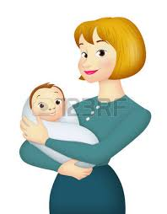
Cont. Possible solutions to the case and its justification to the solution
The girl to keep the baby and talk to someone about the issue
Receiving counselling to help her through the trauma of early pregnancy and rape (+)
Negative reaction from the community (-)
Her reputation together with the parents ruin in the society they come from (-)
Giving the fetus its right to live (+)
Considering her body’s health by not aborting (+)
N/B the signs (-) and (+) represents the negative effect and the positive effect of abortion respectively.

Slide 6
What should be done and why?
The girl should receive counselling
This will help to overcome her trauma and see life in a positive way
The parents should be educated more on the effects of abortion
This will help understand the risks involve and educate their child well and also help the child through her journey
The government should put in place laws of server punish individual who commits rape
This will help people to avoid raping ladies and in turn, will reduce unwanted pregnancy that will lead to abortion.
To retain her own image and the parents
This is by not information other people what really happened but look for alternatives of how to cope with the challenges they ae facing
Creation of awareness about abortion
This will educate more people to understand the reason why abortion should be conducted and not conducted to a woman. This will help people not to condemn others when they perform an abortion due to medical problems.
Educating religious leader like the girl’s father about abortion
This will help them preach the right message to others and not condemn abortion the way they do.

Slide 7
An ethical theory that will assist in this case
An ethical theory that could be used in this case is the utilitarianism theory that is used to implement the fair choices to ensure little harm is done to the parties who are involved. The parents and the girl should decide and look at the course of action they need and also evaluate the outcomes of the action they will obtain from aborting the fetus. Here they will look at the benefits or the harm of their action and decide based on the outcome of the two.

Slide 8
Questions
According to the law, is abortion legal or illegal? Explain your answer
What are the circumstances in which abortion can be legal and illegal?
Is abortion morally wrong or right?
Was the decision of the parents and the girl to abort ethical? Example your answer
What other ethical theories can be used to explain the case above?
Should the girls doing abortion be condemned and discriminated by the society?
Is abortion database issue? Explain your answer.

