Slide 1
Classical Conditioning
Corina Reveles, Mauri Smith, Martha Vazquez, Myia Featherstone-Jones
June 20, 2016
Psy/390

Slide 2

What is Classical Conditioning
Classical Conditioning is a “learning theory” ….

Slide 3
Classical Conditioning
John Watson
Three stages of classical conditioning
Little Albert experiment
Notes:
John Watson proposed that the process of classical conditioning was able to explain all aspects of human psychology. Everything from speech to emotional responses were simply patterns of stimulus and response. Watson denied completely the existence of the mind or consciousness. Watson believed that all individual differences in behavior were due to different experiences of learning (McLeod, S. A., 2014)
.

Slide 4
Three stages of classical conditioning
Stage 1: Before conditioning
the unconditioned stimulus produces an unconditioned response in an organism
this stage also involves another stimulus which has no effect on a person and is called the neutral stimulus
Stage 2: During conditioning
during this stage a stimulus which produces no response (i.e. neutral) is associated with the unconditioned stimulus at which point it now becomes known as the conditioned stimulus
Stage 3: After conditioning
Now the conditioned stimulus has been associated with the unconditioned stimulus to create a new conditioned response.
Notes:
Stage 1: In basic terms, this means that a stimulus in the environment has produced a behavior / response which is unlearned (i.e. unconditioned) and therefore is a natural response which has not been taught. In this respect no new behavior has been learned yet. The NS could be a person, object, place, etc. The neutral stimulus in classical conditioning does not produce a response until it is paired with the unconditioned stimulus (McLeod, S. A., 2014).
Stage 2: Often during this stage the UCS must be associated with the CS on a number of occasions, or trials, for learning to take place. However, one trail learning can happen on certain occasions when it is not necessary for an association to be strengthened over time (such as being sick after food poisoning or drinking too much alcohol) (McLeod, S. A., 2014).
Stage 3:For example a person (CS) who has been associated with nice perfume (UCS) is now found attractive (CR). Also chocolate (CS) which was eaten before a person was sick with a virus (UCS) is now produces a response of nausea (CR) (McLeod, S. A., 2014).

Slide 5
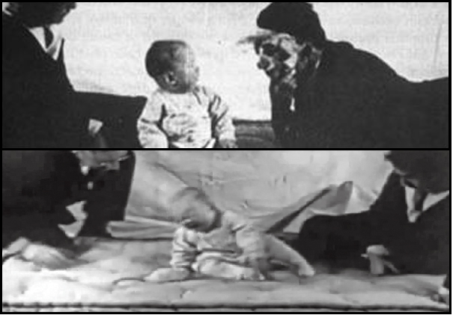
Little Albert
Notes:
The participant in the experiment was a child that Watson and Rayner called "Albert B.", but is known popularly today as Little Albert. Around the age of nine months, Watson and Rayner exposed the child to a series of stimuli including a white rat, a rabbit, a monkey, masks and burning newspapers and observed the boy's reactions. The boy initially showed no fear of any of the objects he was shown. The next time Albert was exposed the rat, Watson made a loud noise by hitting a metal pipe with a hammer. Naturally, the child began to cry after hearing the loud noise. After repeatedly pairing the white rat with the loud noise, Albert began to cry simply after seeing the rat (McLeod, S. A., 2014).
Watson and Rayner had shown that classical conditioning could be used to create a phobia. A phobia is an irrational fear, i.e. a fear that is out of proportion to the danger. Over the next few weeks and months Little Albert was observed and 10 days after conditioning his fear of the rat was much less marked. This dying out of a learned response is called extinction. However, even after a full month it was still evident, and the association could be renewed by repeating the original procedure a few times (McLeod, S. A., 2014).

Slide 6
Scenario
Application of classical conditioning on training a child
Components of classical conditioning.
How the components apply in the training of a child on how to use a potty.
Notes:
The process of potty training a child is challenging hence consumes a lot of time, however, classical conditioning makes the process manageable. Classical conditioning involves a technique applied in learning which relates to stimuli hence in the paper it will indicate the process of using the potty instead of diapers and later using the toilet. The process involves the application of five components which are namely neutral stimuli (NS) which produce no response therefore considered to be irrelevant. The NS appears to be the training toilet for the child hence should be child-friendly for instance a training potty. The unconditional stimulus (UCS) appears to produce response naturally and automatically, for instance, the child longing to use the bathroom (Maia & Jozefowiez, 2015). The unconditioned response (UCR) appears to be natural response towards the stimulus that is unconditioned hence requires no learning, for instance, visiting the bathroom in diapers. Conditioned stimulus coordinates with unconditioned stimulus to come up with a conditioned response. Therefore, the conditioned response appears to be the ability of the child to take the training potty for use when they long for bathroom use instead of using the diapers.

Slide 7
Child Training
Training begins with putting the potty on the ground next to the toilet.
Take child to the toilet where the potty is located.
Process is repeated continuously.
Praise the child for learning.
Notes:
The training potty should be on the ground near the toilet, then after feeding the child and wait for him to feel like relieving himself. Take the child to the toilet where the potty is hence he should be encouraged on relating the bathroom use with that of the potty. Thereafter, the child should be put on the potty to relieve himself hence the process should be repeated several times until he identifies how to relate the bathroom with the potty. If the child successfully repeats the process after several attempts, congratulate them by showering them with praise (Maia & Jozefowiez, 2015).

Slide 8
Speaking Note
Child training enhances the ability of the child to relieve himself in the potty and not diapers.
Creates easy management
Classes are fun.
Notes:
The ability to train a child on how to relieve himself in a potty increases the child’s ability of going to the bathroom to relieve himself rather than on the diapers. The child makes the work of the parent easy as it will be easy to manage the child as he appears not to use the diapers, therefore, no changing of diapers will often take place. The process of training the child is fun as the parent enjoys seeing the child learn new concepts in life.

Slide 9
Apply classical conditioning to potty training
Neutral stimulus- potty training toilet
Unconditioned stimulus- child's urge to use the bathroom
Unconditioned response- going to bathroom in diaper
Conditioned stimulus- training on potty
Conditioned response- child learns to use potty
Notes:
Training a child to using the potty can be easy but difficult at the same time. It can be easier to train them when using classical conditioning because of the steps it takes to train them. Step one would be a neutral stimulus. This would be the potty training toilet ("How To: Potty Train Your Child ", n.d.). It would be best to get one that is kid friendly so the child knows that it is for them. The best place to put it would be next to the regular toilet so they know what it is for. Step 2 would be the unconditioned stimulus. This would be considered the child's urge to use the bathroom ("How To: Potty Train Your Child ", n.d.) . It is important to learn signs that your child needs to use the bathroom because it makes it easier to train them. Step 3 would be the unconditioned response. This is a natural reaction to the unconditioned stimulus and it would be the child using the bathroom in their diaper ("How To: Potty Train Your Child ", n.d.). At this point the child don’t know any better but to use the bathroom in their diaper. Step 4 would be conditioned stimulus and this step would start training on the potty ("How To: Potty Train Your Child ", n.d.). In order to do this part, it is best to set the child on the potty several times of the day so they will know what to use the potty for. Some of the best times would be an hour or so after they eat or when you notice your child has to use the bathroom. Once this part is don’t the last step would be conditioned response. At this point the child knows to use the potty when they feel the urge to use the bathroom ("How To: Potty Train Your Child ", n.d.). This response is to the conditioned stimulus.

Slide 10
Summary

Slide 11
Refernces
Maia, J., & Jozefowiez, J. (2015). Classical Conditioning.
McLeod, S. A. (2014). Classical Conditioning. Retrieved from www.simplypsychology.org/classical-conditioning.html
HOW TO: POTTY TRAIN YOUR CHILD . (n.d.). Retrieved from http://505808166265617584.weebly.com/classical-conditioning.html

