Slide 1
Kilauea Volcano Tour
Contact Lehua Hawaiian Adventures for additional information

Slide 2
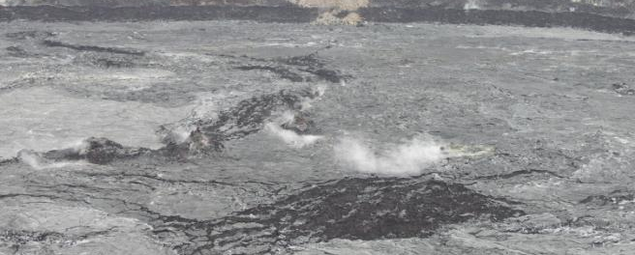
Visit the Smoldering Remains of Kilauea
Drive through miles of black molten lava and into Volcanoes National Park where you will experience the sight and smell of the volcano crater.

