Slide 1
Exercise 4 – Formula/Reference/Range
Task1: Open 04 Budget solution.
Task2: Refer to Data in Another Worksheet
Cell D8 in summary worksheet must reference the Expense Details worksheet
Task3: Compute average payment for other categories in Expense Detail worksheet
In cell A24~A29, Use Concatenate function to type the name of each category
In cell B24~B29, copy the formula in B23
Task4: show average payment for utilities in summary worksheet
Cell D9~D14 in summary worksheet must reference the Expense Details worksheet
Task2: Reference Data in Another Workbook
Open a second workbook file named 04Budget2012.
In 04 Budget solution, on the Summary sheet, click cell C3.
Type =([04Budget2012.xlsx]Summary!B3)
Close 04Budget2012.

Slide 2
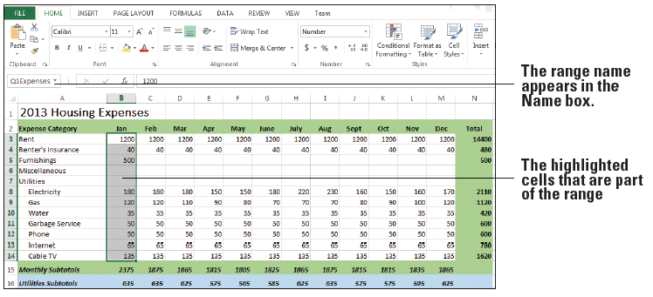
Exercise 4 – Formula/Reference/Range
Task5: Name the first quarter data (B3:B14)
Select the range, and click on the Name box, to the left of the formula bar.
Name the range, Q1Expenses

Slide 3
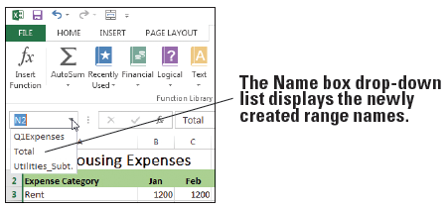
Exercise 4 – Formula/Reference/Range
Task6: Name the utility subtotal data (B16:B16)
Select B16:M16
On the FORMULAS tab, in the Defined Names group, click Define Name. The New Name dialog box appears
Name the range, Utilities_Subtotal
Task7: Name the total data (N3:N14)
Select N3:N14
Right-click and select Define Name.
Name the range, Total

Slide 4
Exercise 4 – Formula/Reference/Range
Task8: Change the size of the range
On the FORMULAS tab, in the Defined Names group, click Name Manager.
Task9: Create a Formula that Operates on a Named Range
In Cell A31, Type “First Quarter Expense”
In Cell B31, type sum function.
On the FORMULAS tab, in the Defined Names group, click Use in Formula.
Task10: display range names and their cell ranges as data in the worksheet
On the FORMULAS tab
n the Defined Names group
click Use in Formula
select Paste Names.

