Slide 1
Notes:
This file created specifically for Colton Mentzer

Slide 2
Why manage your passwords?
Protection
Secure from the start
Uncomplicated
Never type a password again
Maintain access
Easy to back up
Online safety
Minimize risk

Slide 3
Next release highlights
Portable runs from USB device
Enhanced anti-phishing module
Secure virtual keyboard
Dahsboard alerts

Slide 4
More highlights
Proven security
Biometric scanning
Fingerprint
Iris
No Ads Ever
10 Passwords

Slide 5
Sales analysis

Slide 6
Why we’re ranked #1

Slide 7
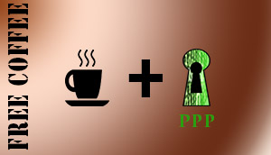
Partnerships

